Slide 1
PDSA Game: Grand Designs
Notes:
https://miro.com/welcomeonboard/O2RdyRtdOxrhJGgYDjWjydNbDS3yKrpGuyexkWTO52EBAf2SioZPUt0HLbkmjsBr
Has to be chrome and follow this

Slide 2
Build a house
Objective: To build a house as quickly as possibly while still passing quality and safety assessments
Notes:
Point of activity
To learn the notion of rapid testing, the importance of gathering data and PDSAs
You can see the house you are building, the architect was very specific
This is the house we want you to replicate.

Slide 3
Roles on your team
Note taker
Fills out PDSA form
Timekeeper
Needs to be able to time in seconds and make a run chart
Quality assurance officer
To assess the quality and safety of the build
Builder/s
To build the house
Notes:
Please assign the roles now.

Slide 4
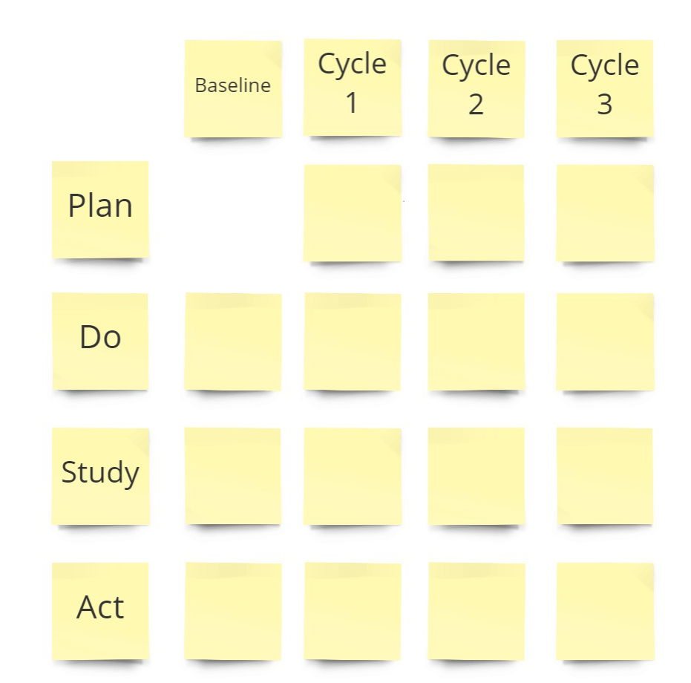
Note Taker: Please fill out this form during planning and debrief
Notes:
What’s your theory?
What do you think will happen?
What’s s your prediction about it?
Think ahead to future tests
….and how they might be shaped by the current small test

Slide 5
 |  |  |  | Time
 | 80
 | 70
 | 60
Seconds | 50
 | 40
 | 30
 | 20
 | 10
 |  | 1 | 2 | 3 | 4 | 5 | 6 | 7
 |  |  | PDSA
Timekeeper – please draw this simple chart on a piece of paper.
You will use this to record your data.
3 – All pieces on Sam & positioned correctly
2 – All pieces on Sam, but one or more is out of place
1 – One or more pieces are not on Sam.

Slide 6
Time keeper
Operational definition for time to build a house
Equipment: Stop watch using a phone
Measurement unit: Seconds
Timing starts: When the first mark on the page takes place
Timing stops: When the builder declares the job complete by saying “build complete”

Slide 7
Quality assurance officer
To assure the quality and safety of the build. A house is complete once it has the following:
Black square wall foundations
Red triangular roof
Two blue windows
A door
Green curved path
To audit the final build. If any items are missing or an incorrect colour add on 10 seconds for each item.
If the house passes inspection get a 5 second bonus.

Slide 8
The Rules
Fill out the PDSA prior to every build, document the plan/theory and prediction prior to beginning the test
Document your Results
Formally debrief after every build

Slide 9
Grand designs
Ready, steady, go….

Slide 10
How did we do?

