Slide 1
Peer assist session March 2023
Troika Consulting

Slide 2
Other events coming up
Social Network Mapping 20th April 12-1pm https://q.health.org.uk/event/q-liberating-structures-user-group-11/
1-2-4-all to explore answers to the wicked questions and relax using all the senses 20th April 4.30-5.30pm https://q.health.org.uk/event/the-compassion-paradox-making-sense-of-a-difficult-work-environment-together/ This is repeated 18th May https://q.health.org.uk/event/the-compassion-paradox-making-sense-of-a-difficult-work-environment-together-2/
Power of peer-to-peer approaches on 26 April to Huddlecraft: https://q.health.org.uk/event/q-online-visit-huddlecraft/
The Network Maturity Matrix 27th April 4-5.30pm https://q.health.org.uk/event/active-learning-and-collaboration-around-network-weaving/
Peer support around ideas to support staff wellbeing 2nd May 4-5pm https://q.health.org.uk/event/peer-discussion-sharing-and-learning-around-the-wellbeing-of-staff/ repeated 3rd August 12-1pm https://q.health.org.uk/event/peer-discussion-sharing-and-learning-around-the-wellbeing-of-staff-2/
How charge is your personal battery 25th May 12-1pm https://q.health.org.uk/event/active-learning-session-delivered-in-partnership-with-the-staff-wellbeing-special-interest-group/

Slide 3
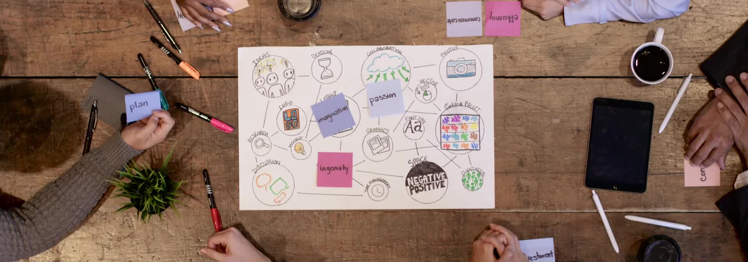
Overview of today’s session
What other sessions are coming up
Being in the moment
Introduction to Troika
Time to share

Slide 4
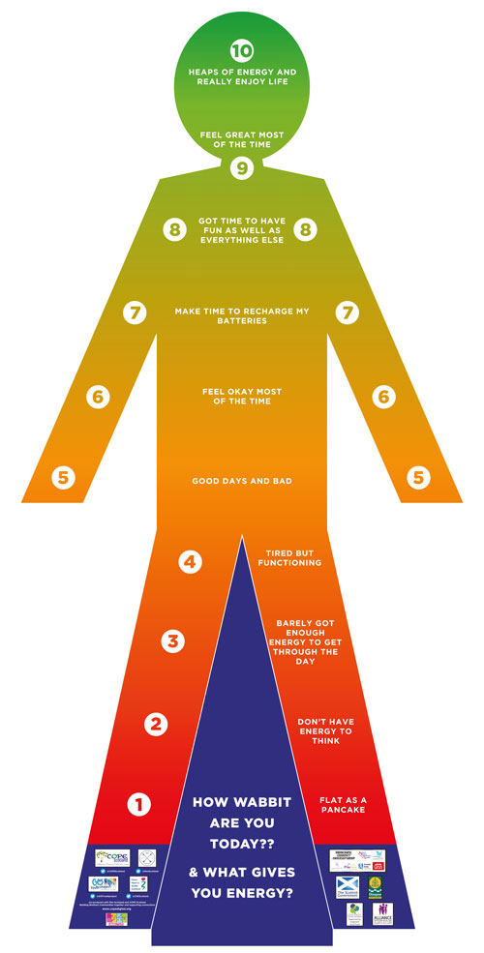
Moment to pause

Slide 5
Overview of Troika consulting
What is made possible? You can help people gain insight on issues they face and unleash local wisdom for addressing them. In quick round-robin “consultations,” individuals ask for help and get advice immediately from two others. Peer-to-peer coaching helps with discovering everyday solutions, revealing patterns, and refining prototypes. This is a simple and effective way to extend coaching support for individuals beyond formal reporting relationships. Troika Consulting is always there for the asking for any individual who wishes to get help from colleagues or friends.
Attribution: Liberating Structure developed by Henri Lipmanowicz and Keith McCandless. For more information visit https://www.liberatingstructures.com/8-troika-consulting/

Slide 6
Time to connect using Troika Consulting
In each round, one participant is the “client,” the others “consultants” Everyone has an equal opportunity to receive and give coaching
In groups of 3 introduce yourself to each other (2min)
Reflect alone on the following to share when you are the ‘client’ ‘’What is your challenge?” and “What kind of help do you need?” (2min)
Groups have first client share their question. 1-2 min.
Consultants ask the client clarifying questions. 1-2 min.
Client turns around with their back facing the consultants
Together, the consultants generate ideas, suggestions, coaching advice. 4-5 min.
Client turns around and shares what was most valuable about the experience. 1-2 min.
Groups switch to next person and repeat steps.

Slide 7
Time to reflect
Thank you for your time and contribution
For more information please contact
Hilda Campbell
Hilda@cope-scotland.org
www.cope-scotland.org
@COPEScotland

