Slide 1
Liberating Structures User Group
Thursday 7 March 2024
Hannah Harding - Proactive Hospital Improvement Coach, UHBW
Peter Smith – Improvement Advisor
Notes:
Development: Peter Smith / Tami Kramer August 2023

Slide 2
Wild Tea
Timings
Introductions 10 minutes
Introduction of Wild Tea 10 minutes
Our Wild Tea Party 30 minutes
Reflections 10 minutes

Slide 3
Wild Tea
What Is Made Possible?
Mad Tea quickly provokes a deeper set of reflections and strategic insights among group members.
The questions focus attention and produce fresh understanding of strategic options and next steps.

Slide 4
Wild Tea in person
How does it work?
Participants form two circles, one inside the other. Each person faces one other person and completes an open-ended sentence in less than thirty seconds. When time is up, participants are invited to move to their right so that they are in front of someone else to complete the next sentence, and so on. In a seriously fun way, the unfinished sentences focus attention on every individual and the group answering tough questions together.

Slide 5
Structural Elements – Min Specs
Structuring Invitation
You are invited to finish a set of open sentences that relate to shaping your next steps together
How Space Is Arranged & Materials Needed
Unlimited # people, face-to-face in pairs in two concentric circles
The inner circle faces out and the outer circle faces in
Each person is directly across from one other person
Facilitator projects each question on a screen and dings once to shift the exchange between the pair and twice to shift to a new partner (rotating two people to the right)

Slide 6
Sequence of Steps and Time Allocation
1. Ask everyone in the group to for two concentric circles and find one other person, standing directly across from them, face to face
2. Describe the rules succinctly: in very short order, one person completes the sentence on the screen while the other expresses keen interest and curiosity
3. Invite one person in each pair to finish the sentence # 1 first, ding the bells once at 30 seconds, then invite the other to do the same
4. Ding the bells twice at 1 minute, remind participants to move two to the right (you will not have to remind them after the first round)
5. Repeat step 2-4 for each additional open sentence (up to 15 total)
6. Ask, what did you notice about the Mad Tea experience?
7. Invite participants to silently complete the strategy worksheet

Slide 7
Mad Tea Open Sentences
What first inspired me in this work is…
Something we must learn to live with is…
An uncertainty we must creatively adapt to is…
What I find challenging in our current situation is…
Before we make our next move, we cannot neglect to...
Something we should stop doing (or divest) is…
What I hope can happen for us in this work is…
A big opportunity I see for us is…
If we do nothing, the worst thing that can happen for us is…

Slide 8
Mad Tea Open Sentences
A courageous conversation we are not having is…
An action or practice helping us move forward is…
A project that gives me confidence we are transforming is…
Something we need to research is…
A bold idea I recommend is…
A question that is emerging for me is…
When all is said and done, I want to...
Something I plan to do is...

Slide 9
Where can it work best?
Part of the opening of any meeting with 20 or more people present
Use before a more formal conversation about strategy
Use at the end of any meeting
In person is great (but noisy – you need a loud bell/ping), but also works virtually by using breakout rooms (practice how to move people around breakout rooms of 2 each on your chosen meeting platform)

Slide 10
Strategy Questions Worksheet
1. What is the deepest need for my / our work?
2. What is happening around me / us that demands creative adaptation?
3. What paradoxical challenges must I / we face down to make progress?
4. Where am I / are we starting, honestly?
5. Given my / our purpose, what seems possible now?
6. How am I / are we acting our way forward toward the future?

Slide 11
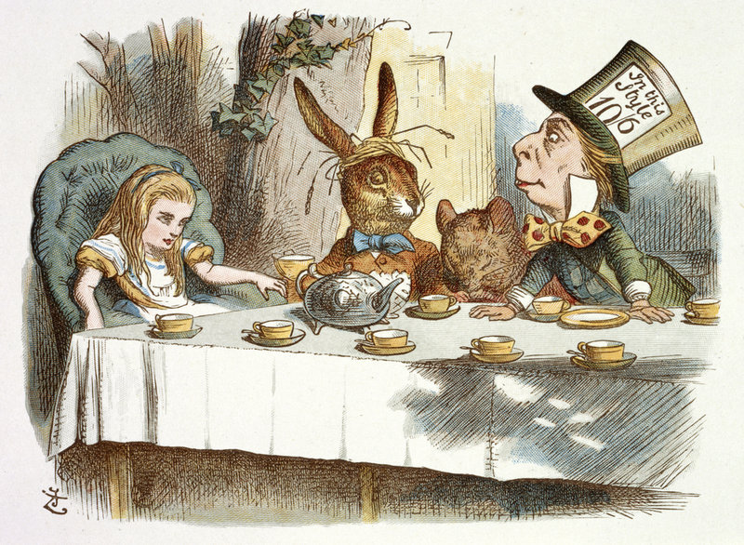
Wild* Tea Party (breakout rooms version)
Hats ON!
* https://www.liberatingstructures.com/mad-tea/
Notes:
This structure was originally named after a scene in Alice in Wonderland – the Mad Hatter's Tea Party, and called 'Mad Tea' but we're renaming it Wild Tea because we realized "mad" is offensive in the mental health area. In this dizzying networking(like speed networking/dating) activity, you will find yourself in breakout rooms in pairs with a prompt/question, and be asked to make time for each of you in the pair to respond to the question in ONE minute (so 30 seconds each). You'll come back, get another prompt, and go back into pairs again... let's see how it goes! Full description on LS in Development site: http://www.liberatingstructures.com/mad-tea & additional prompts available here: https://docs.google.com/document/d/1EaCW1R29QuCGpKHInYq0k8I26S8PX19MgpFUt3gETHM/edit?usp=sharing
PROMPTS FOR TODAY:
1. I'm here today because...
2. For me, emergence means...
3. A value that emerged for me last year is...
4. An emergent practice in my work environment has been...
5. A question/concern that is emerging for me is...
6. An emergent superpower of mine is...

Slide 12
Invitation to the Party
You will be randomly put into breakout rooms with 2 people in each room
In very short order one person completes the sentence in the room while the other expresses keen interest and curiosity. Change roles so the other person completes the sentence, again with keen interest and curiosity (TOTAL One Minute)
You will be randomly moved to a new room.
Repeat with the next person. Move again and repeat with the next person.
There will be 4 questions, so you will finish each sentence with 3 different people = 12 people to talk to in total!
* https://www.liberatingstructures.com/mad-tea/
Notes:
This structure was originally named after a scene in Alice in Wonderland – the Mad Hatter's Tea Party, and called 'Mad Tea' but we're renaming it Wild Tea because we realized "mad" is offensive in the mental health area. In this dizzying networking(like speed networking/dating) activity, you will find yourself in breakout rooms in pairs with a prompt/question, and be asked to make time for each of you in the pair to respond to the question in ONE minute (so 30 seconds each). You'll come back, get another prompt, and go back into pairs again... let's see how it goes! Full description on LS in Development site: http://www.liberatingstructures.com/mad-tea & additional prompts available here: https://docs.google.com/document/d/1EaCW1R29QuCGpKHInYq0k8I26S8PX19MgpFUt3gETHM/edit?usp=sharing
PROMPTS FOR TODAY:
1. I'm here today because...
2. For me, emergence means...
3. A value that emerged for me last year is...
4. An emergent practice in my work environment has been...
5. A question/concern that is emerging for me is...
6. An emergent superpower of mine is...

Slide 13
Tea Party Conversations
What first inspired me in this work is…
A bold idea I recommend is…
A question that is emerging for me is…
* https://www.liberatingstructures.com/mad-tea/
Notes:
This structure was originally named after a scene in Alice in Wonderland – the Mad Hatter's Tea Party, and called 'Mad Tea' but we're renaming it Wild Tea because we realized "mad" is offensive in the mental health area. In this dizzying networking(like speed networking/dating) activity, you will find yourself in breakout rooms in pairs with a prompt/question, and be asked to make time for each of you in the pair to respond to the question in ONE minute (so 30 seconds each). You'll come back, get another prompt, and go back into pairs again... let's see how it goes! Full description on LS in Development site: http://www.liberatingstructures.com/mad-tea & additional prompts available here: https://docs.google.com/document/d/1EaCW1R29QuCGpKHInYq0k8I26S8PX19MgpFUt3gETHM/edit?usp=sharing
PROMPTS FOR TODAY:
1. I'm here today because...
2. For me, emergence means...
3. A value that emerged for me last year is...
4. An emergent practice in my work environment has been...
5. A question/concern that is emerging for me is...
6. An emergent superpower of mine is...

Slide 14
Reflections
How did it feel to experience a Wild Tea Party?
Are there any scenarios where you would like to use this liberating structure?
Chat in your reflections

Slide 15
Resources
Visit the Liberating Structures page at:
https://www.liberatingstructures.com/mad-tea/

Slide 16
Thank you & happy tea parties!

