Slide 1
The Compassion Paradox in Health and Social care
COPE Scotland
www.cope-scotland.org

Slide 2
Flash report available
The Flash report with slides from the active learning session on 15sec30min is now available https://q.health.org.uk/document/flash-report-from-15sec30min-active-learning-session-with-link-to-slides/

Slide 3
Safe space
We are human too, this active learning session is not a replacement for professional advice, sometimes we suffer compassion fatigue and burnout and need more than this session can offer. Speak to someone as you matter too.
The aim of the session is to begin to explore the idea of the compassion paradox and the need to ask the right questions if we are to find answers which may help, even a wee bit, using the idea proposed by the liberating structure, wicked questions, to support a paradigm shift to help us think about the compassion paradox in a new way, which may lead us to do something in a new and different way, which just may help……………. Even a wee bit!

Slide 4
Session overview
If we do not ask the right questions, then the answer will not make any sense?
1
How can the liberating structure, wicked questions, help offer a possible paradigm shift to explore the compassion paradox?
3
Chance to share and learn with peers
4
WHAT IS THE COMPASSION PARADOX?
2
WHAT NEXT? EXPLORING ANSWERS TO OUR WICKED QUESTIONS USING THE LIBERATING STRUCTURES 1-2-4-ALL
5

Slide 5
Time to pause

Slide 6
What do you think?
Please complete the following sentence
What I am looking for from this workshop on the compassion paradox within health and social care is………..

Slide 7
What do we mean by compassion
‘’ Compassion literally means “to suffer together.” Among emotion researchers, it is defined as the feeling that arises when you are confronted with another’s suffering and feel motivated to relieve that suffering.’’
The Greater Good Science Centre at the University of California, Berkeley

Slide 8
What do we mean by Paradox
‘’ statement that seems to go against common sense but may still be true’’ Plato
The platypus paradox
‘’The platypus is a biological paradox. According to our once hard-and-fast rules regarding animal classification, an animal could only belong to one category, such as a reptile OR a mammal. The platypus appears to be both at the same time.’’

Slide 9
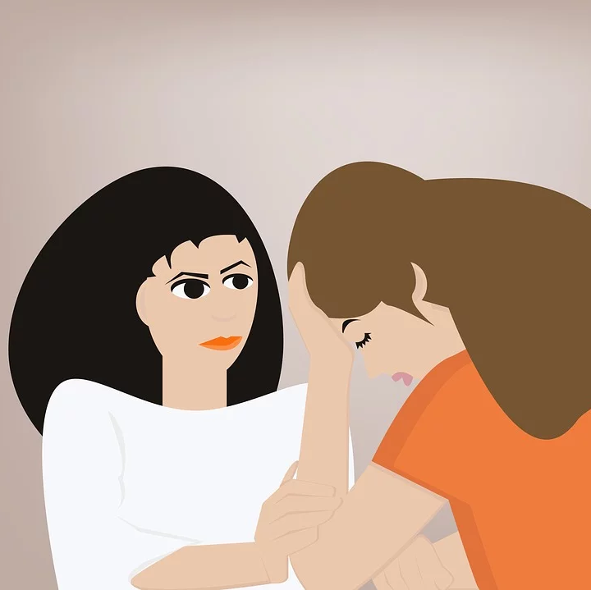
The compassion paradox in health care
‘’Health care is inherently compassionate, and yet the very sense of connection with patients that can make us effective caregivers can lead to feelings of stress and burnout—which then undermines our ability to be compassionate.’’
Leif Hass, M.D., is a family medicine doctor and hospitalist at Alta Bates Summit Medical Centre in Oakland. He serves as a Joy of Work Champion for Sutter Health and as a clinical instructor with UCSF.

Slide 10
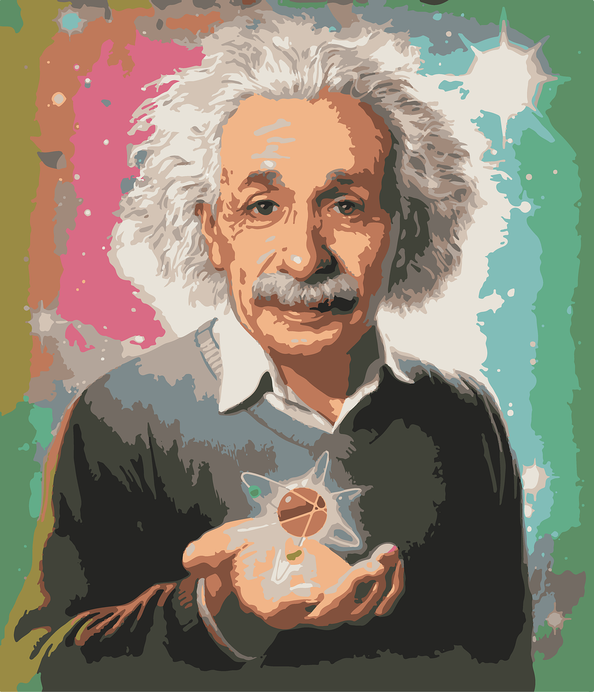
‘’If I had an hour to solve a problem and my life depended on the solution, I would spend the first fifty-five minutes determining the proper question to ask, for once I know the proper question, I could solve the problem in less than five minutes.’’ Albert Einstein

Slide 11
To understand the answer we must first ask the right questions!...............42
https://www.youtube.com/watch?v=aboZctrHfK8

Slide 12
Using wicked questions to explore the compassion paradox
Wicked Questions make it possible to expose safely the tension between espoused strategies and on-the-ground circumstances and to discover the valuable strategies that lie deeply hidden in paradoxical waters.
For more information on liberating structures you may find the liberating structures user group in the Q community of interest https://q.health.org.uk/event/q-liberating-structures-user-group/
Attribution: Liberating Structure developed by Henri Lipmanowicz and Keith McCandless. Inspired by professors Brenda Zimmerman (see Edgeware) and Scott Kelso (see The Complementary Nature).

Slide 13
Overview of wicked questions
https://www.youtube.com/watch?v=uzRc-VT4MOc

Slide 14
Seek a wicked question which offers equal value to both sides
When we think of either or, we can create tension and conflict e.g.
‘’If we didn’t spend so much time on paperwork, we would have more time to offer services to people’’
A wicked question would be
’How is it that we are in the position to have capacity to offer people the service they need, and we are compliant with the relevant administration associated with care simultaneously’’

Slide 15
The compassion paradox in health and social care
How do we offer compassion and care to enable us ease the suffering of others and simultaneously nurture the wellbeing of staff to remain compassionate in the face of continued exposure to others suffering

Slide 16
It takes time
‘’The purpose of wicked questions is not to find a single answer , but to create transparency about seemingly paradoxical realities that exist side-by-side. By accepting both realities, we can engage in deeper strategic thinking and explore new possibilities.’’

Slide 17
Next time
The next active learning session of the staff wellbeing SIG will be taking the wicked questions we have created and using the liberating structure 1-2-4-all begin to search for answers

Slide 18
Compassion counts for all of us

Slide 19
Chance to practice
Jam board Demonstration https://jamboard.google.com/d/1LtBmI0bUJbY-WGEdROi5udIxWsUQV00NBSctD-EdSBI/viewer?f=0

Slide 20
Three invitations
Here are 3 invitations to consider
Reflect whether it has value for you to explore further how to find balance when living in a paradox
Register for the next staff wellbeing active learning session to explore this idea further together
Become mindful of how compassionate you are to yourself as well as to others
There will be a flash report following this session available in the document section of the staff wellbeing special interest group section which will include links references and further reading.

Slide 21
Thank you for helping build a kinder world
Hilda Campbell
hilda@cope-scotland.org
@COPEScotland
www.cope-scotland.org
Never forget you matter, we all do and together we can help each other find ways where life does not need to hurt as much, pain sadly does happen, but we can work together to reduce suffering, even a wee bit

