Slide 1
Network weaving
Together we achieve more
Reflection March 2023

Slide 2
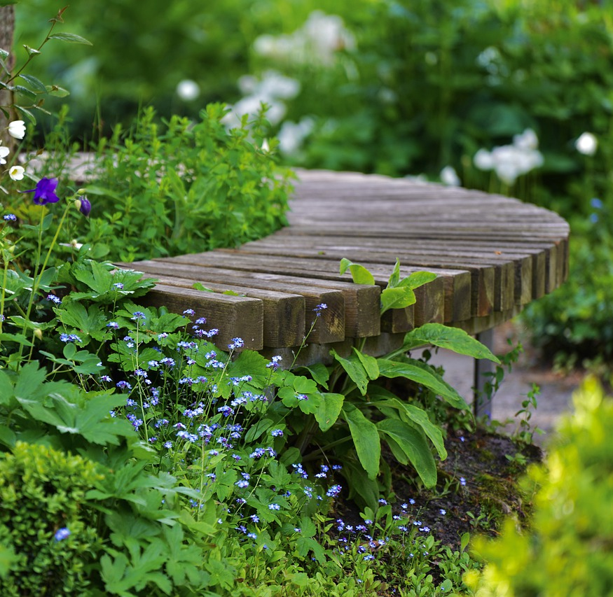
Welcome time to pause

Slide 3
How will we use the time
To connect/reconnect
To reflect on what we agreed last time
To consider where we are now
To discuss where we go next

Slide 4
An invitation to connect and reconnect
Please complete the following sentence in the chat box
Hello, my name is………. From……….My interest in Network weaving is…….

Slide 5
Update from our last session
What we agreed at the last session | Progress against agreed actions | Comments
Further develop a tools and resources to support networks and network weaving focusing on key action learning areas | Final comments and feedback with designer before final proof read | To raise awareness of the resource a formal launch is being planned
Develop a reflective workbook to support individuals learning around networking and their role as a network weaver | Final comments and feedback with designer before final proof read | To raise awareness of the resource a formal launch is being planned
Build further learning spaces within the Q community | These continue 6/4/23 Peer assist 4.30-5.30pm 20/4/23 Liberating Structure User Group 12-1pm Social Network webbing 27/4/23 5-5.30pm The Network Maturity Matrix | https://q.health.org.uk/event/network-peer-assist-building-our-networks-effectiveness-3-3/ https://q.health.org.uk/event/q-liberating-structures-user-group-3/ https://q.health.org.uk/event/active-learning-and-collaboration-around-network-weaving/

Slide 6
What we agreed at the last session | Progress against agreed actions | Comments
Invite people to share their good news stories around using network weaving tools, ideas and resources | This session did not go ahead as planned in January however, we still want to gather and share stories | Anyone interested in sharing their good news stories to contact Mandy Andrew mandy.andrew@alliance-scotland.org.uk
Continue to build connections with other SIGs and Hexitime | Self assessment questions to support goals on Hexitime agreed and work underway to bring them onstream Work underway with Joy in Work SIG Staff wellbeing SIG to share learning | https://hexitime.com/NurturingandWeavingNetworksSIG 25/5/23 12-1pm ‘How charged is your battery’ With the Joy in work SIG https://q.health.org.uk/community/groups/improving-joy-in-work/ Flash report from recent session https://q.health.org.uk/document/flash-report-from-15sec30min-active-learning-session-with-link-to-slides/
Share the reports from these conversations as Flash Reports in the NW Sig documents | Report shared and also invitation to attend this session sent out to the wider Q Community | Flash reports in the document section of the Nurturing and Weaving Networks SIG

Slide 7
Goals being put on Hexitime
I find it easy to make time to invest in my Networks.
Strongly disagree Strongly agree.
1 2 3 4 5
I have a wide range of ideas, tools, and resources which support my Networks.
Strongly disagree Strongly agree.
1 2 3 4 5
I have the knowledge and skills to support the effectiveness of my Networks.
Strongly disagree Strongly agree.
1 2 3 4 5
I feel comfortable asking others for support for my Networks.
Strongly disagree Strongly agree.
1 2 3 4 5
I am confident in evaluating the effectiveness of my Networks.
Strongly disagree Strongly agree.
1 2 3 4 5
I empower my Networks to move ideas to action.
Strongly disagree Strongly agree.
1 2 3 4 5
I am mindful of my own self-care requirements.
Strongly disagree Strongly agree.
1 2 3 4 5
Anything else you would like to add.

Slide 8
Where are we just now?
Getting ready to launch new materials to support learning around networking
We have an established 6 weekly peer assist session where people get together and support each other around networks and networking issues
We have monthly active learning sessions where we can practice and learn about new ideas which can help make our networks more effective
We have opportunities within Hexitime to acquire and share skills around helping make our networks more effective and develop ourselves as network leaders
We have a skilled and experienced community who want to share and learn from each other. the collective wisdom is priceless

Slide 9
Where do we go next discussion…. Introduce yourselves to each other 2min What do you think about what you have heard so far, does it have relevance for you? 8min What do you think should be our plans for moving forward with the Nurturing and Weaving Networks SIG? 8 min What roles do you think SIG members could play as we move forwards together? 4min what support do you think SIG members may need to be more engaged in the SIG? 4min

