Slide 1

The Quality Coach Development Programme
Launch of resources
28th September 2023
Notes:
Jem to open / welcome

Slide 2
Agenda
3.00 – 3.30 Welcome to the Quality Coach Development Programme
3.30 – 3.50 Exploring the programme content in detail
3.50 - 4.00 Train the Trainer offer
4.00 – 4.20 Q&A with members of the co-design group
4.20 – 4.30 Next steps
Notes:
Please add questions for the panel in the chat as we go along.

Slide 3
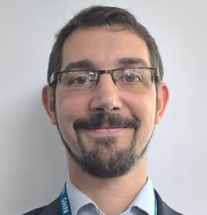
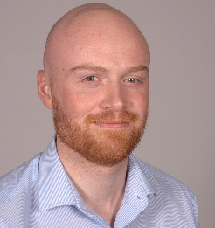




About us
Jem Ramazanoglu | Sid Beech | Hannah Pearson
QI Lead @ CLCH | QI Training Lead @ CLCH | QI Facilitator @ CLCH
Bridget Browne | Robin Davis | Jen Cotter
Improvement Advisor @ CNWL | Director @ NHS Elect | Advanced Practice Lead @ CLCH

Slide 4

Different models for QI support in a provider
QI team are responsible for QI work and are often very “hands on” in the application of QI methods
QI team are responsible for building QI capability and are enablers of others to apply QI methods. Often using coaching style
Dependence
Independence
Notes:
Every healthcare provider strives to improve the care they provide. Using quality improvement methods as an approach to improve care is a well recognised approach and is established to varying degrees in most healthcare providers.
The ambition in the NHS is simple – we want everyone in the NHS to do improvement every day.
To support this, most providers have established a central QI team who have the broad responsibility for embedding QI within their organisation or system. This is by no means a simple task!
These teams use their improvement expertise to support the delivery of key organisational priorities and build improvement knowledge and skills by providing training and support to teams who want to use QI.
There are however challenges to this approach. The most apparent is that as interest in QI grows in the NHS, the QI team needs to respond to this by providing additional support to teams with their QI work. We know that training alone is not enough to bring about sustainable improvements – support from an experienced improver is key to navigating the often complex task of improvement.
-----
Broadly speaking there are 2 common strategies to tackling this growing demand for improvement support.
The first uses a dependency-based approach – whereby a lot of the improvement skills are held centrally and support is often provided through the central team. Think of this like QI team members on the ward or out with clinicians helping them to implement their ideas. It’s a “hands on” approach
The second uses a more independent approach to building QI capability. The QI team focus less on the practical application of QI and more on the development of QI capability and capacity. QI team members train and coach others to become independent (or relatively indepdenet) improvement practitioners. They spread the QI bug and capitalise on this enthusiasm by training others to coach QI.
There are positives and negatives to both approaches….

Slide 5

Different models for QI support in a provider
Dependence
Independence
Expert support may lead to more effective solutions, faster
QI experts have dedicated time for QI work
Easier to allocate QI resource to priorities
Improvements may not be owned by services
Improvement seen as a specialist area
Limits opportunity to develop sustainable QI capability within the organisation
Improvement capacity limited by availability of expert QI resource
Supports development of a culture of continuous improvement
Improvement is everybody’s job
Improvements are owned by the services
Reduced requirement for central QI team
Can take years to develop QI capability across an organisation – needs long term commitment
Requires strategic approach to improvement, teams need time to improve
Requires development of additional QI capacity, outside of QI team
Notes:
There are positives and negatives to both approaches.
This list is by no means exhaustive

Slide 6


The role of a Quality Coach within an organisation or system
People doing improvement work
Anyone who is trying to improve their service
Often only basic QI knowledge
Typically need guidance to apply QI approaches effectively
Often 're-inventing the wheel'
Coach
Coach
Quality Coach
Frontline staff who have been trained in how to coach and support teams through QI work
First line of improvement support
Championing improvement at a local level
QI team
Coach
Central Improvement team
Experts in improvement science
Usually limited resource
Focus depends on strategic approach – typically includes:
  Teaching QI
  Leading/Facilitating projects
  Improvement coaching
  Data analysis
Coach
Coach
Notes:
Let’s view this through the lens of an organisation or system perspective.
Staff are shown here in blue – this is a much simplified perspective as of course there are often thousands of staff within an org. There is abroad ambition in healthcare that we want everyone to do improvements every day.
We know that currently in many orgs most staff have either only a fundamental knowledge and understanding of QI or have no knowledge at all. Of course this is appreciating that many people do improvements all the time, just not necessarily using QI methods.
-------
In response to this drive for staff to use quality improvement, many organisations have established a QI team. These teams employ QI experts who have the remit of supporting bottom-up and top-down improvements. As many of you can appreciate, this is easier said than done. Particularly when you factor in the size and complexity of their organisation. In the dependency model this approach often requires recruiting a sizeable team or several teams across different locations to provide local QI support. In the indepedency model this approach needs something else…
----
So how can we bridge the gap between frontline staff keen to improve and this team of experts? Conventionally this has involved training at a considerable scale – but we know training isn’t always the answer to our challenges, nor is it feasible to upskill all NHS staff in the advanced concepts of QI.
We’re suggesting that QI coaches are a key part of this network on the screen. QI coaches are frontline staff who have been trained in how to coach and support teams through QI work. They are champions of QI at a local level and together they help us better reach staff across the patch. By developing coaches – we expand our network of QI support far beyond the central team. Local people – a friendly, familiar face – who can coach you through the complexity of QI. All without recruiting more people

Slide 7
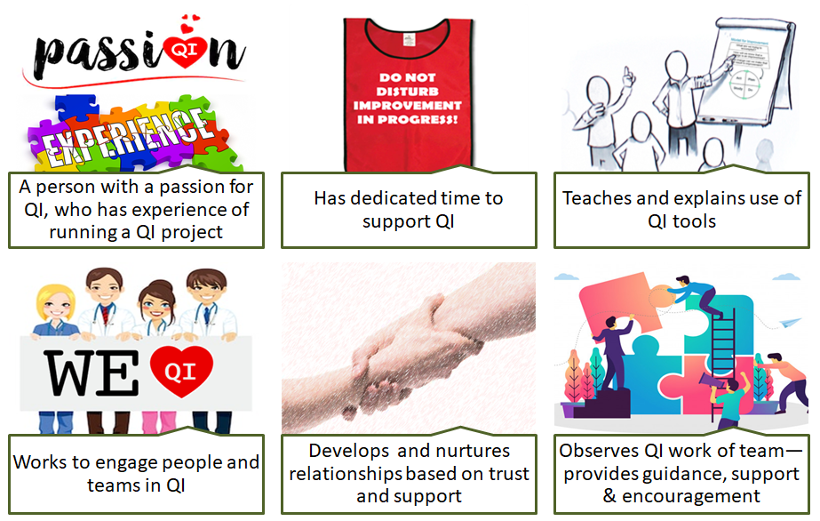
What is a ‘Quality Coach’?
Notes:
The definition of a quality coach is shown on the screen. This definition was created by the 20+ group of QI professionals from across the UK, as part of the co-design process. It includes…
Someone with a clear passion for improvement. We often speak about getting the ‘QI bug’ - coaches understand the value of QI in healthcare and are committed to endorsing QI and supporting QI. Passion comes from experience – experience of doing QI in their work context. This experience is valuable in being able to empathise with project teams
Support is key. Training alone is not enough. Coaches need time to meet with teams and apply the concepts of QI coaching outside the classroom. This means you will have some ‘ring-fenced’ time to be a Quality Coach.
Coaches wear many hats – coaching, facilitating, advising and sometimes teaching. Sharing knowledge about QI tools at the right time can help teams move forward at pace with QI work.
Coaches are champions of QI and work across their org (not just in their team) to engage people in QI
Coaching is in the name - you develop people, nurture and grow relationships based on trust and support.
You will be the ‘go-to’ person for QI as a coach. You will provide a blend of coaching (helping them find the solutions they need) and improvement advice (using your expertise to co-design the solution). You will be a positive force for good - encouraging the teams, consoling the teams and keeping the momentum going

Slide 8
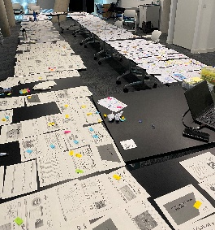
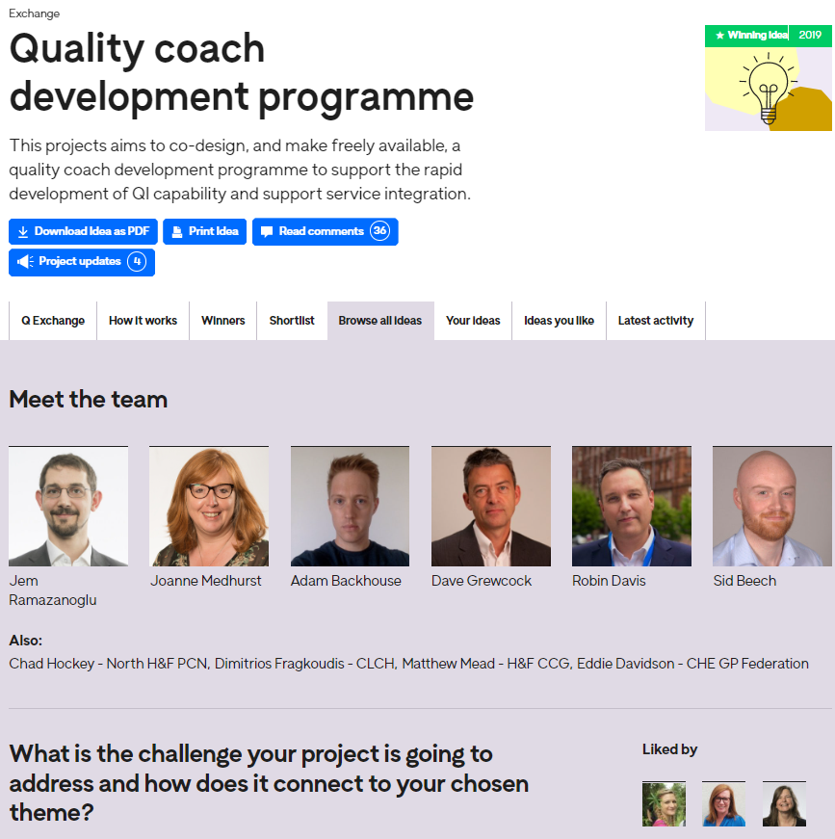
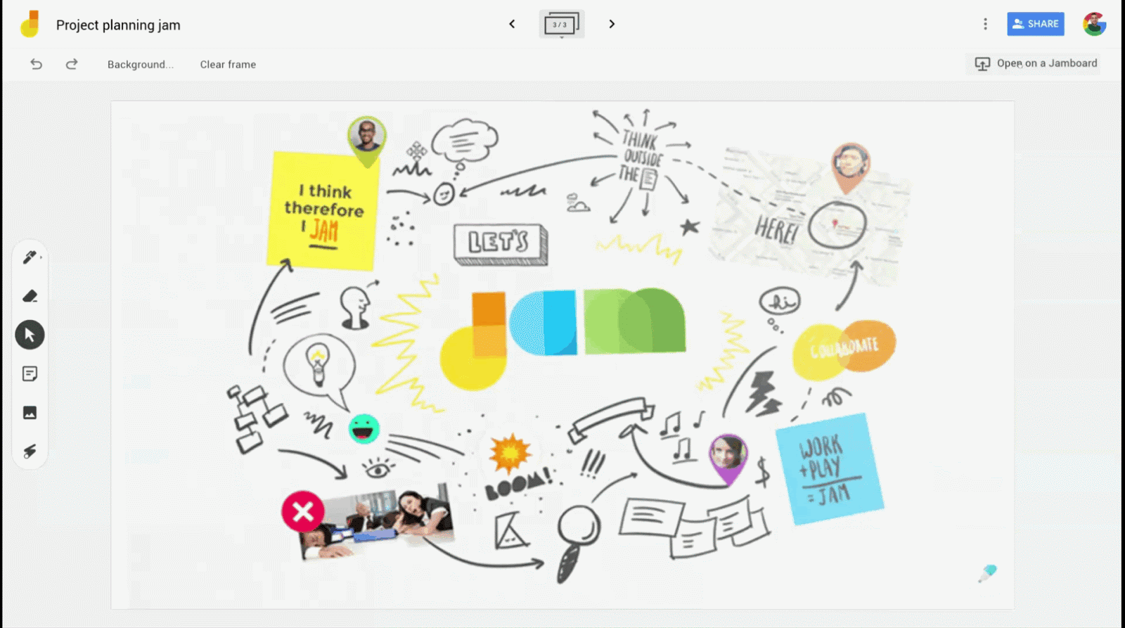



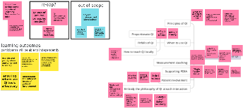
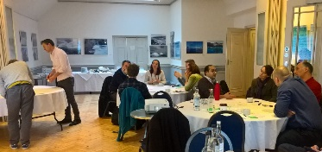



The co-design
First pilot
(July – Dec)
Fourth pilot major iteration
(Feb-Jul)
Q Exchange
bid submitted
Design group
2
Programme redesign
Autumn 2019
Feb 2020
Oct 2020
Winter 20/21
July 2021
Sept 2021
Feb 2022
Apr 2022
Autumn 22
Feb 23
Sept 23
6 workstreams develop module structure and start to design content
Second and third pilots (Sep – Nov and Nov – Jan 22)
Fifth pilot
(Apr - Nov)
Design group 1
Notes:
So looking into the co-design in a bit more detail.
The health foundation run the Q community (a community network of healthcare staff interested in improvement) and each year have a funding round where teams can propose projects and the community vote for who should receive funding.
2019 CLCH was successfully granted £30 000 funding to co-design a QI coach programme. We will explain the purpose of a QI coach later.
Feb 2020 CLCH brought together healthcare staff who had voted for the programme to win the bid for the first design meeting where the broad structure for the programme was designed
Covid caused a pivot to a virtual design group which really opened doors for wider development and involvement and national collaboration. No longer having geographic boundaries enhanced the work. It was also the point that I joined this programme and thought we may have set ourselves an impossible task with large levels of involvement it felt we may not be able to get to a consensus of what the content should be.
We solved this by breaking in 6 workstreams to develop a module structure. Individuals expressed an interest in workstreams based on personal interest, experience and availability. These workstreams over a 6 month period designed initial content. Which was then refined by core project group at CLCH
The initial content was then run as a first pilot with Central London Community Health NHS Trust co-facilitated by Sid and myself
Close behind were pilots 2 and 3 at United Lincolnshire Hospital facilitated by Sharon Hurrell which also provided the opportunity to test the programme leaders guide.
Then pilot 4 at Central and North West London NHS Trust who had previously used an external provider. By this point we had enough information from previous tests to start adapting the content for example co-produced additional content on public and patient involvement and co-delivered this with a carer.
Within a 10 month period we piloted the programme with five cohorts with CLCH running the final pilot in April 2022.
HAN
Taking all the learning across the 5 pilots we undertook a full Systematic review of the programme taking into account all feedback. We did this by going through all the materials used, slides/
In doing this we reviewed the content slide by slide in a co-design with pilot organisations and participants. Refer to photo
Systematic review of all the resources used so far. Involving lots of people – who have done the programme, coaches on the programme,
Giving feedback and steering the direction. Took a long time – lots of sessions both face to face and vitural making sure that the programme would be manageable as a product for someone who wanted ot deliver it. Sclaing it down without losing the core content. Came up with ‘core’ content and supplentary content.
Used reflections of the codesign so far to try and make it less complex.
Agreed to work with designers in March and held a Design workshop in April with a focus group of people who had been part of the programme including past participants, pilot leaders, etc. which helped us to develop a ‘vision’ for the programme, and developing a design concept which is now being incorporated. Expecting this to be completed in August.

Slide 9


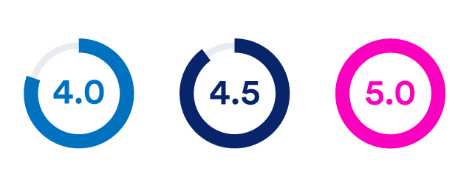
Outcomes of the programme (so far)
Improvement coaching capacity has increased by 50% in our organisation after 3 small cohorts (10-15 people ea.)
More than 3x increase in sustained outcomes for priority improvement work across CLCH from 2021 to 2023
Notes:
Quantitative and qualitative methods have been used for all these methods. Key highlights:
100% of attendees would recommend the programme to a colleague
100% agree that the learning from the programme will be useful to them in the future
100% agree that the programme has enabled them to coach improvement work
The graph on the screen shows self-reported ability to perform key coaching tasks – a significant improvement in all domains from the baseline through this programme
In CLCH we have now trained 3 cohorts of QI coaches. Our capacity to provide QI coaching support has increased by 50%, through the training of new coaches. Engagement from qualified coaches is high.
We have also looked at the outcomes in terms of improvement – do coaches bring value? We have seen an increase in sustained positive outcomes in QI work. This has been measured by looking at the number of projects with a 4.0 score or higher using the IHI assessment framework. 26 projects at our end of year celebration event all scoring 4 above – the year before we had 6 in 2021 and 26 in 2023.
There is a very significant interest to adopt this programme from all over the UK and Ireland. So far 50 providers and/or systems have indicated they plan to deliver this programme in 2024.

Slide 10

Why should you consider developing Quality Coaches now?
Building a shared purpose & vision
Investing in people and culture
Developing leadership behaviours
Building improvement capability and capacity
Embedding into management systems and processes

Slide 11
The Product
Notes:
Sid picks up here

Slide 12
Structure of the programme
Mentoring and support
Coaching and the Foundations of QI |  | Working with People |  |  | Coaching Measurement | Human Side of Change
Session 1 | Session 2 | Session 3 | Session 4 | Session 5 | Session 6 | Session 7 | Session 8
QI vs. other types of change GROW coaching Using coaching questions Active listening | Coaching practice Contracting with teams as a Quality Coach The pitfalls of coaching Coaching circle | Just-in-time teaching practice (teachback) Facilitation and working with groups Methods to build psychological safety | Coaching circle The role of context in QI Reflecting as a coach Measuring sustainable change | Involving patient in QI Qualitative data Coaching best practice PDSA All teach, all learn | Coaching measurement Using creative methods in QI Working with resistance to change Human factors in QI | Using SPC charts in QI Creative thinking (cont.) Designing sustainable change | Behaviour change in QI Creative thinking (cont.) What’s next for you as a coach
QI coaching assessment
Poster presentation:
[date]
Reflective log submission:
[date]
QI coaching
Coach
graduation
[date]
Notes:
Explain the structure of the programme.
We’ve designed the programme to be adaptable – we want adopters of the programme to bring their own insights, expertise and personalities to what we have created. In other words, they should absolutely amend the content to suit their local context.
So although we say 8 days – how or whether you deliver that is up to you. We have put some indications in the documentation about what we feel is “core” content i.e. more important to help you determine how best to deliver this for you. Of course ideally you would deliver all 8 sessions, with amendments to reflect your organisation/system and your own style and experience.
The content has been created to suit both a face-to-face and virtual environment, meaning you can use this to suit whatever works best for you.

Slide 13

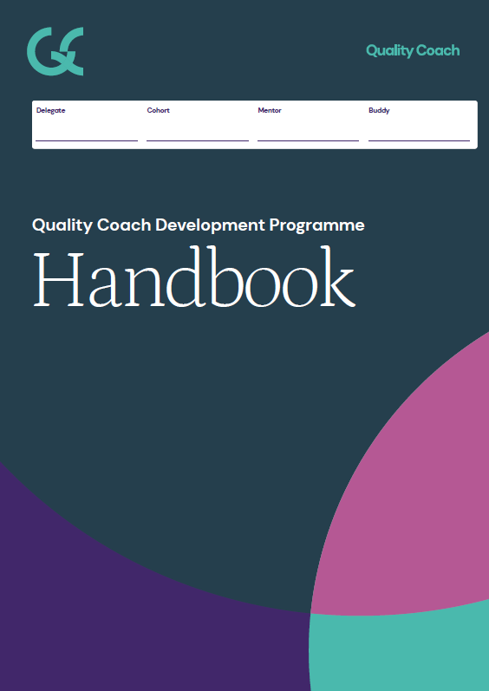
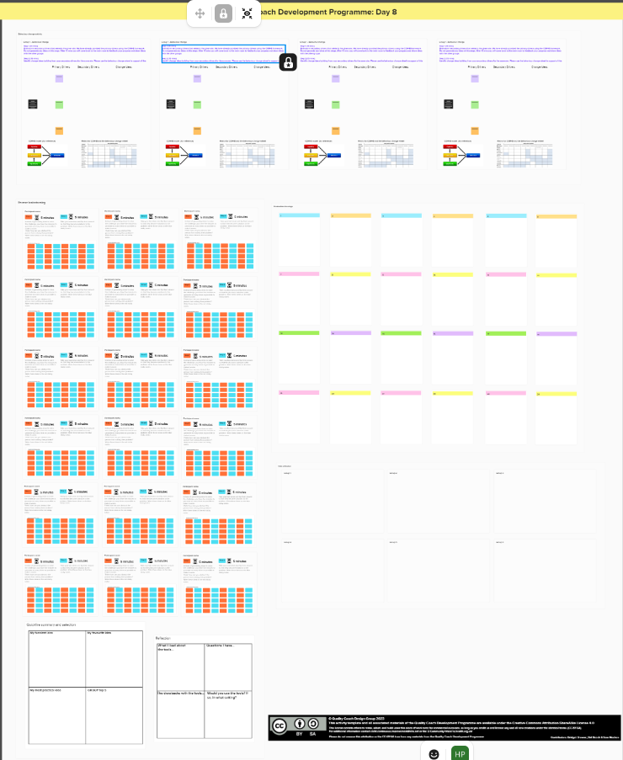


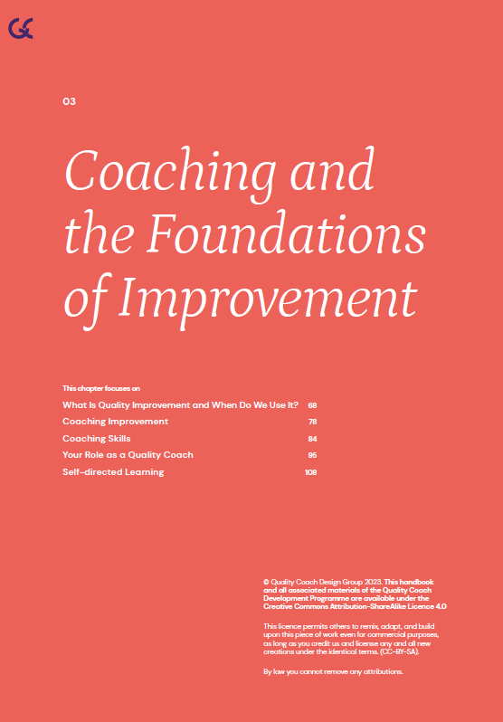

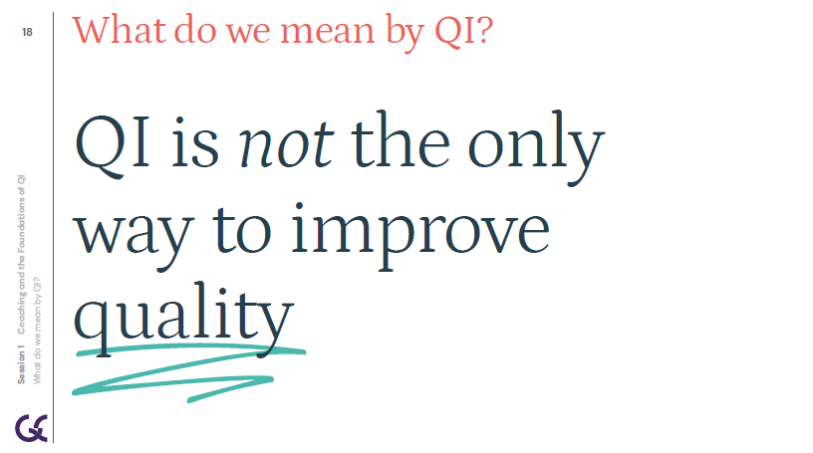
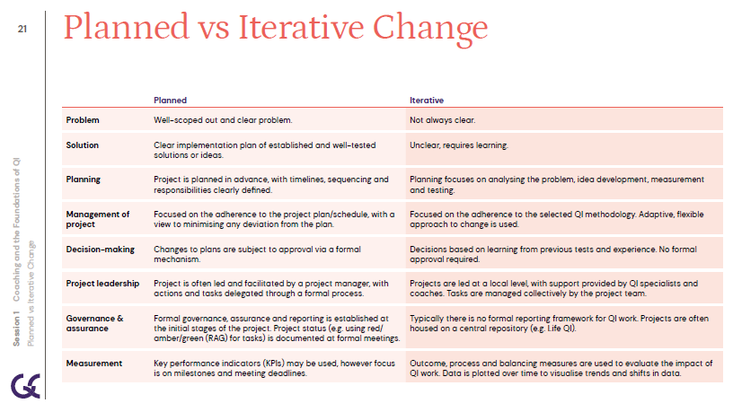


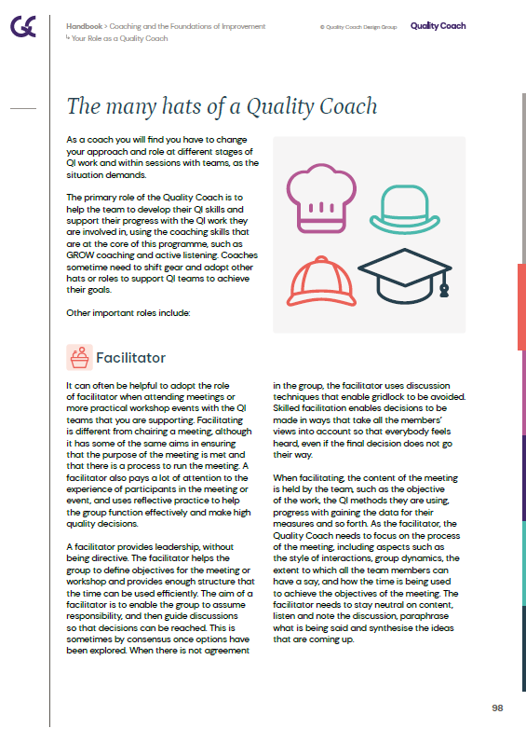
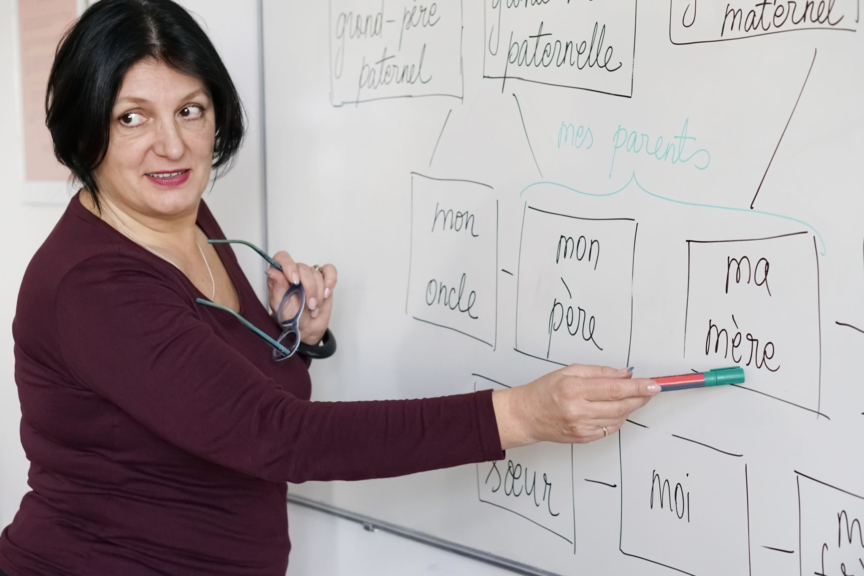
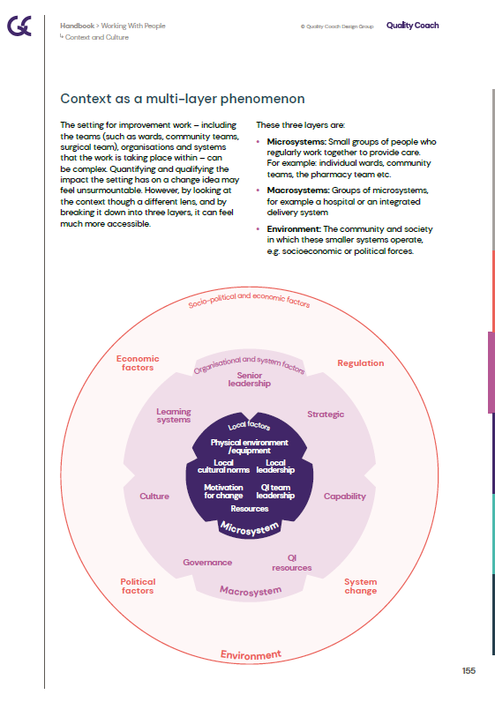
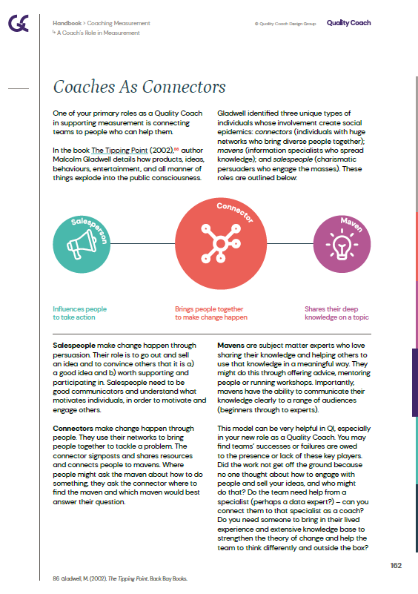
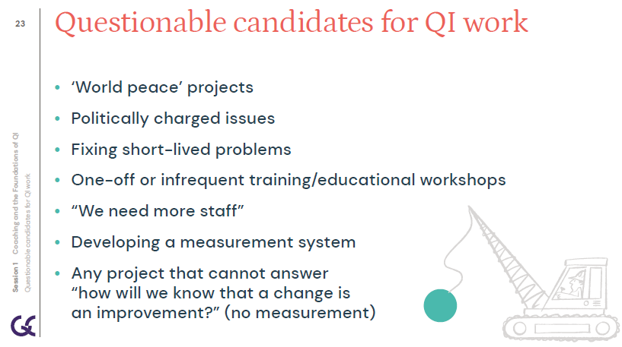

The Product
Slides
with detailed notes
Engaging
activities
Guidance
Handbook
Notes:
Talk through resources
Demo of slides – Sid and Hannah
Demo of activities – Sid
Demo of PL Guide – Jen
Demo of Trainer Guide – Sid
Demo of Eval Guide – Sid and Jen
Demo of App Guide – Han
Demo of Handbook - Han

Slide 14
The Product
Slides
with detailed notes
Engaging
activities
Guidance
Handbook
Notes:
Talk through resources
Demo of slides – Sid and Hannah
Demo of PL Guide – Jen
Demo of Trainer Guide – Sid
Demo of activities – Sid
Demo of Eval Guide – Sid and Jen
Demo of App Guide – Han
Demo of Handbook - Han

Slide 16
Coaching and the Foundations of QI
Session 1
Quality Coach Development Programme

Slide 17
Funding Acknowledgement
The Quality Coach Development Programme was partially funded through Q Exchange by the Health Foundation and NHS England and NHS Improvement
  For additional information contact
  clcht.continuous.improvement@nhs.net or the Q Community
This slide deck and all associated materials of the Quality Coach Development Programme are available under the Creative Commons Attribution-ShareAlike Licence 4.0
  This licence permits others to remix, adapt, and build upon this piece of work even for commercial purposes, as long as you credit us and license any and all new creations under the identical terms. (CC-BY-SA)
Notes:
All materials associated with this programme are copyrighted. CC-BY-SA allows anyone to use this slide deck for free, as long as the authors and contributors are credited.
You should not add your own logos to these materials without the express permission of all authors, as this would be a direct infringement on the copyright. We want to ensure all materials associated with this programme remain free-to-access for everyone.
The legal code for CC-BY-SA can be found here: https://creativecommons.org/licenses/by-sa/4.0/legalcode

Slide 18
Coaching and the Foundations of QI
Cohort A
Notes:
Hello faculty of the Quality Coach Development Programme.
Welcome to Session 1 of the Quality Coach Development Programme. Please refer to the Trainer Guide for more detailed information on the day, including activity templates for the breakout rooms.
In advance of delivering this day you should work through the slides with any co-presenters and tailor the content to suit your local context. This may include swapping slides out for your own slides, adding different visuals, changing icebreakers or adapting activities to suit the target audience.
Notes in bold are instructions for the faculty. Notes in regular text are notes for delegates, and can be read out during the session or adapted as required.
Please do not delete large sections of content – if significant changes are made to the content then it may no longer meet the learning outcomes. See further explanation in the Programme Leader Guide.
All content is copyrighted by the authors. Please do not remove the © mark from any materials and ensure content is correctly attributed. We have made all materials available for free to the public and just ask that you attribute the content fairly.
Notes in bold are instructions for the faculty. Notes in regular text are notes for delegates, and can be read out during the session or adapted as required.

Slide 19
Making the most of our virtual environment
We are happy to take questions – raise your hand at any point or ask in your breakout room sessions
When you see this symbol, we recommend you take a photo or screenshot of the task for the breakout room
Indicates page in handbook
Feel free to use the chat box during the session
Making the most of our virtual environment
Indicates activity
We will be using breakout rooms a lot.
Top tip: don’t touch anything when you are
being moved to rooms
Indicates an independent task for you to complete later
Notes:
You should edit this slide if delivering the content in person. You will only need the icons shown in the right hand box. However you may still wish to explain that you encourage people to ask questions or chat in the breaks, and that the session includes many activities.
If you are using an online whiteboard, ask delegates to open your preferred internet browser. If you are using Mural, we find it works best with Google Chrome.

Slide 20
Programme aim
The aim of this eight week programme is to…
Support individuals to develop the skills
and knowledge required to independently
and confidently coach a team through improvement work.
Programme aim

Slide 21
Ten learning outcomes of the programme
      By the end of the programme delegates will be able to independently:
Coach an improvement team ensuring robust application of QI methods and principles
Help teams to explore barriers and enablers relating to their QI work, in support of the sustainability of interventions
1
6
Understand the concepts of coaching improvement and the difference between coaching and advising
Advocate for meaningful involvement in
QI work and advise teams on methods for involvement
2
7
Ten learning outcomes of the programme
Explain their role as a Quality Coach to different stakeholders
Coach a team to identify, collect and interpret data in support of their improvement work
3
8
Promote an environment that encourages team members to contribute equally to the development of improvement work
Apply creative problem-solving methods and behaviour change concepts to support teams to revive a stalled effort
4
9
Assimilate QI knowledge and facilitation skills that support teams to progress through the different stages of QI work
Critically analyse their own limitations and the limitations of coaching
5
10
Notes:
These outcomes reflect the learning for delegates throughout the entire programme – inside and outside the classroom. We will break them down (highlighted) for each session to identify the key focus of learning for that session.
There are also outcomes for each session – shown in the later slides.

Slide 22
Coaching vs Coaching Improvement
p82
 | Who | What | How | When | Where
Coaching development
Coaching improvement
Coaching vs Coaching Improvement
Notes:
Ask the group for their thoughts on each aspect.
The slide is about comparing coaching for development (aka exec coaching) and coaching improvement (aka Quality Coach).
Who is a Development Coach vs a Quality Coach?
Development coaching – typically an experienced healthcare professional, often in a leadership role. Most will have a qualification in coaching.
Coaching improvement – a Quality Coach. Experienced in QI and trained through this programme or similar.
What is their role?
Development coaching – identify personal goals and development to enable coachees identify action plans for personal growth over a specified period of time as leaders/emerging leaders.
Coaching improvement – identify challenges and barriers to change, and work with the team to overcome these. To guide the team on how to progress, providing their expert support to ensure robust application of QI methods.
How do they operate?
Development coaching – uses a variety of coaching models to facilitate coaching conversations. Facilitates sessions to enable coachees as much time as possible to talk, reflect and contemplate personal action plans.
Coaching improvement – uses a blend of improvement and coaching methods during coaching conversations. Provides advice and guidance on the use of QI methodologies. Leads sessions to enable participants time to talk about how to resolve challenges and identify strategies to overcome them with an agreed plan to work on next.
When/How long?
Development coaching – typically over a short, specified time period e.g. 3–12 months.
Coaching improvement – coach works with a project team through the duration of the project. Their involvement is high at the beginning and gradually reduces over time.
Where?
Development coaching – in person or virtual 1:1 conversations on a frequent basis.
Coaching improvement – dependent on the progress of the project but often at key stages and in person or virtually. Typically a coach will meet with the entire team vs on a 1:1 basis.

Slide 23
You will wear many hats…
You will wear many hats…
        Teach
        Facilitating
        Coaching
        Advice
        Coaching
Notes:
As a Quality Coach, you will soon learn that you will often need to wear many different hats at once. You will employ the skills and knowledge you learn from this programme, along with your own strengths and experiences, to enable teams to succeed in their QI work.
Most of the time you will wear a COACH hat – you will use the techniques such as GROW coaching and active listening from today’s session – to coach teams through the QI process.
At times you will need to draw on your QI expertise to support teams with technical concepts. You will sometimes give advice – remember not to give too much – after all your role is to build independence and growth in QI.
This isn’t easy – it takes experience to know which hat to wear and when. Don’t beat yourself up if upon reflection you think you should have taken a different approach with teams. We’ve all been there!

Slide 24
Coaching over time
Coaching over time
Notes:
The role of the coach changes over time. Typically, with an inexperienced QI team, you will be more involved in a project. This relates both to time, and how 'active' you are in the QI conversations.
As time progresses, your role will shift to a more supportive (and less directive) approach, where you coach teams as opposed to giving them all of the answers.
This can be a hard transition, as you may feel you want to help – it can be hard to let go.
Ask the group: Does anyone have any experience of this?

Slide 25
Coffee break

Slide 26
A structure for a coaching conversation
p90
G
Goal
      What do you want?
R
Reality
      Where are you now?
O
Options
      What could you do?
W
Will
      What will you do?
Developed by Sir John Whitmore
Notes:
Developed in the 1980s by Sir John Whitmore. The GROW Model is a coaching framework used in conversations, meetings and everyday leadership to facilitate problem solving, goal setting and improvement. GROW is an acronym for Goals, Reality, Options and Will. (Sometimes represented as way forward)
Other models are available but this is a nice simple one to get started with.
Explore each segment of GROW (refer to the handbook) to sample questions and more details.
You will see it relates back to the ‘experiment in telling’ exercise earlier. Also the video coaching session shows GROW in action.
You will have a go at using this model in an activity shortly.

Slide 27
A structure for a coaching conversation
G
Goal
      What do you want?
R
Reality
      Where are you now?
O
Options
      What could you do?
W
Will
      What will you do?
      Coaching starts with establishing a goal.
      What questions could you ask to establish a goal?
      What questions could you ask to help establish the current reality?
      Once you both have a clear understanding of the situation. You can start to explore options.
      What questions could you ask?
      Next we establish the will or way forward with a clear action.
      What questions could you ask?
Activity 1.6
Developed by Sir John Whitmore
Notes:
See Trainer Guide activity 1.6.
20 mins
Using the provided template… in groups think of questions you could ask for different steps of the GROW model.

Slide 28
Live coaching
Activity 1.7
Notes:
See Trainer Guide activity 1.7
20 mins max.

Slide 29
Effective coaching skills
p85
Listening | Questioning | Building rapport | Empathising | Summarising and reflecting
Staying focused | Non-judgemental | Not giving lots of advice | Giving feedback | Reflecting on your experience
Effective coaching skills
Notes:
Active Listening is a fundamental coaching skill. Active listening helps you make the shift from telling, problem solving and giving advice to asking and enabling the improvement team or lead to have ownership of their challenges.
Questioning is at the heart of coaching. Questioning enables a coach to put aside their thoughts about the ‘best/correct way’ of doing something and instead, elicit the coachee’s ideas about how to approach a problem. In particular, asking questions can help a coach focus attention, elicit new ideas and build commitment.
Building rapport with your coachee helps to develop trust and openness, which in turn leads to a psychologically safe environment in which parties can work together. Be mindful that rapport cannot be artificially created, but often comes naturally through the application of the other skills mentioned here.
Empathising: The coach should understand and respect the coachee’s feelings, motivations and perspectives. An empathetic coach provides a strong support system and through this, can help the coachee think creatively about solutions to their problems. As with rapport, empathy tends to develop naturally through active listening and observing.
Summarising and reflecting enables a number of benefits for both coach and coachee. It shows a coachee that they have been listened to and allows them to reflect on what has been said. It helps a coach ensure they have understoods the coachee and it helps a coach stay on track. Further, when done well, summarising and reflecting can help build rapport. Summarising entails repeating what the coachee has said, whereas reflecting is closely repeating or paraphrasing the coachee to show comprehension. Make sure that when you summarise/reflect it is just that and not an interpretation.
Staying focused: Sessions can’t cover all topics and scope creep can derail an improvement effort. As such, good coaches need to maintain a session's focus. Maintaining a session’s focus can involve structuring a session (for example by using the “GROW” model below), summarising and by using active listening and questioning skills.
Non-judgemental: Coaches should strive to maintain an open and welcoming curiosity with regards to whatever problem a coachee has. In order to do this, a coach must be non-judgemental. This allows a coach to ‘be with’ their coachee’s thinking and experience, rather than focussing on their own reactions.
Strike the balance between improvement coach and advisor: As a Quality Coach, you will need to change your approach based on the context of each meeting, team you are supporting and the task at hand. Use the Hersey-Blanchard model, your situational judgement and expertise to gauge the right approach.
Giving feedback: Frequent and specific feedback can help a coachee(s) improve their performance over time. When provided appropriately, it can help:
Improve underperformance by helping to highlight obstacles, skill gaps and under motivation
Maintain performance by highlighting success and giving praise
Exceed performance through developing and reinforcing new skills and providing learning opportunities
There is an art to giving good feedback – it needs to be specific, constructive and non-judgemental.
Reflecting on your own experience: As a coach, you should ensure you find time for your own growth and development. Use existing networks to support you with this reflection – through the coaching circles, buddy, mentor or members of the faculty.

Slide 30
The Product
Slides
with detailed notes
Engaging
activities
Guidance
Handbook
Notes:
Talk through resources
Demo of slides – Sid and Hannah
Demo of PL Guide – Jen
Demo of Trainer Guide – Sid
Demo of activities – Sid
Demo of Eval Guide – Sid and Jen
Demo of App Guide – Han
Demo of Handbook - Han

Slide 31
Train-the-Trainer programme
Delivered by NHS Elect

Slide 32

Train-the-Trainer programme
Upskill your QI Faculty / QI Team to deliver the QCDP locally or across the system
Experience the programme as a delegate, with further educational support including
      Mentorship from co-designers
      Action learning sets
      Strategic / delivery planning workshops
  Delivered by the co-designers – learn from the experts!

Slide 33
Train-the-Trainer programme
Cohort 1
23rd Nov 23 – 21st Mar 24
20 spaces available – apply ASAP to avoid disappointment
Delivered virtually
Cohort 2
29th Feb 24 – 4th Jul 24
30 spaces available
Delivered virtually
Organisations should consider if 2+ people are needed to support long term delivery of the programme
Can be delivered as part of existing NHS Elect membership or “at-cost” to non-members

Slide 34
Train-the-Trainer programme
For a further discussion or to apply to the programme please contact:
      Robin Davis, Director at NHS Elect
      robin@nhselect.org.uk
                or
      Sid Beech, Associate Director at NHS Elect
      sidney.beech@nhs.net

Slide 35
Q&A

Slide 36
Q&A
Robin Davis | Jem Ramazanoglu | Bridget Browne | Jen Cotter | Sid Beech
Director at NHS Elect | QI Lead at CLCH | Improvement Advisor at CNWL | Advanced Practice Lead at CLCH | QI Training Lead at CLCH
Co-designed Coaching and the Foundations of QI module Delivering the “train-the-trainer” prog. Panel Chair | Initiated this co-design Co-designed the Coaching Measurement module, amongst others. QI Lead in CLCH for many years – with good outcomes around engagement and adoption of QI | Co-designed Working with Groups, amongst many others. Led on the adoption and delivery of this programme in an organisation with an existing improvement coaching offer | Education role in NHS separate to QI Delegate on cohort 1 of the prog. Faculty for cohorts 2 and 3 of the prog. at CLCH, teaching various modules. | Co-designed various modules of the prog. Oversaw co-design of the prog. Delivered cohorts 1-3 at CLCH

Slide 37
Get started now
Visit https://q.health.org.uk/resource/quality-coach-development-programme/ to access all the resources for free
Read the Programme Leader Guide to better understand how the programme works and how you can get started in adopting and adapting
Register for the Train-the-Trainer programme by emailing robin@nhselect.org.uk or sidney.beech@nhs.net
Join 250+ peers on the Coaching Improvement SIG via the Q Community to collaborate more on this subject https://q.health.org.uk/community/groups/coaching-improvement/

Slide 38


With thanks to…
With thanks to
Our design group
42 people from 24 organisations
Our funders
Karlis Albergs CLCH
Clare Atkins NGH
Ruth Auton HSE
Adam Backhouse NCL ICB
John Bateson RNOH
Sid Beech CLCH
Luisa Brown CLCH
Bridget Browne CNWL
Anna Burhouse RUBRIS.Qi
Jennifer Cotter CLCH
Helen Crisp BMJ / Crisp QI
Robin Davis NHS Elect
Samuel Diaz Hernandez CNWL
Dimitrios Fragkoudis GSTT
Bruce Gray NHSE
Dave Grewcock UCLH
Jonathan Grellier KHFT
Veronica Hanlon HSE
Lucinda Hollinshead CLCH
Karleen Huggins CLCH
Sharon Hurrell ULH
Christine Jordan HRCH
Vernanda Julien CNWL
Agnes Kiraly NGH
Samantha Machen UHS
Gillian McTaggart SCFT
Yvonne Mcwean HHFT
Benjamin Oxford CLCH
Lucy Palmer CNWL
Youraj Pattni Haringey GP Fed.
Hannah Pearson CLCH
Jem Ramazanoglu CLCH
Clare Rogers NGH
Emma Scott Candi
Janet Seale CNWL
Geetika Singh CNWL
Elizabeth Smillie HHT
Emma Stinton KHFT
George Surtees UHP
Gemma Westcott CLCH
Charlotte Wood NHFT
Steve Yarnold EPHFT
The design agency supporting this work
https://www.studioquercus.co.uk/
rosie@quercus.work
Notes:
The programme has been partially funded and supported by the Q Exchange programme, hosted by the Q Community and funded by NHS England and the Health Foundation.
Further funding and oversight in the development of this programme has been provided by Central London Community Healthcare NHS Trust

