Slide 1
How can we do environmentally sustainable healthcare?
Caitríona Callan, Tom Hardie, Charly Coxon and Ayoma Ratnappuli
February 2024

Slide 2
Sustainability at the Health Foundation
What is net zero care?
SusQI and net zero
Future areas of focus
Discussion

Slide 3
The Health Foundation is an independent charity committed to bringing about better health and health care for people in the UK.

Slide 4
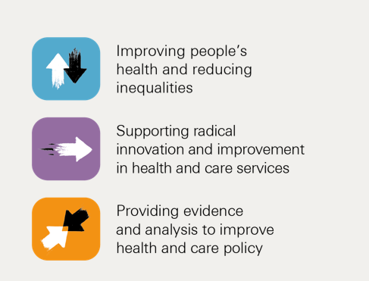
Health Foundation work on sustainability
Our strategy for 2023-2025
Notes:
New strategy this year
Three strategic priorities
Improving health and reducing inequalities
Supporting the radical innovation and improvement that’s needed to meet the needs of our citizens
Providing evidence and analysis to inform policy
We also have three cross cutting themes, which are relevant to all of our priorities. One of these priorities is environmental sustainability, because we recognise the growing impact of climate change on health, the imperative of nhs net zero, and the role we can play within that, as a funder, as a provider of research and analysis, but also our impact on the environment as an organisation with an endowment, a physical space, and over 200 staff which we need to reduce.

Slide 5
Net zero in health and care
NHS in England the first national health system to commit to net zero:
2040 target for directly controlled emissions, 80% reduction by 2028 to 2032
2045 for emissions it influences, 80% reduction by 2036 to 2039
First health system to embed net zero into legislation with Health and Care Act 2022
Notes:
Contributing around 4% of UK emissions, or 40% of public sector emissions, the NHS is both a part of the challenge and the solution; it must tackle climate change at source if it is to protect the health of its patients and the communities it serves.
That’s why the NHS in England became the world’s first health service to commit to reaching net zero carbon; by 2040 for the emissions it controls, and 2045 for those it can influence.
In response to this the NHS launched the Greener NHS initiative ,which has set the ambition for the NHS to become the world’s first carbon neutral health service. Since the Health and Care Act 2022 The Delivering a Net Zero National Health Service report is now issued as statutory guidance
All 212 NHS trusts in England – including more than 1,000 hospitals and healthcare facilities – now have a green plan in place
There are other similar national strategies in the devolved nations, e.g. Wales (net zero target for whole public sector by 2030) and NHS Scotland, (also net zero 2040) Currently there is no specific social care sector target in Scotland or England.

Slide 6
What is net zero care?

Slide 7
Framework of low-carbon care
We adapted the Centre for Sustainable Healthcare's principles of sustainable clinical practice to outline a framework of low-carbon care:
Preventing disease
Improving the management of disease and health
Moving care out of hospitals
Eliminating avoidable waste and unnecessary interventions
Using lower-carbon alternatives
https://www.rcpjournals.org/content/clinmedicine/10/2/110
Notes:
To achieve net zero care, demand for care needs to be reduced, emissions from care delivery minimised, and, eventually, remaining emissions offset.
In order to set out principles of low carbon care delivery, we adapted the CSH's principles of sustainable clinical practice to outline key drivers of low carbon care,
Say them all then triple bottom line approach

Slide 8
Framework of low-carbon care
We adapted the Centre for Sustainable Healthcare's principles of sustainable clinical practice to outline a framework of low-carbon care:
Preventing disease
Improving the management of disease and health
Moving care out of hospitals
Eliminating avoidable waste and unnecessary interventions
Using lower-carbon alternatives
https://www.rcpjournals.org/content/clinmedicine/10/2/110
Notes:
Wanted to highlight examples that show how this approach can be taken

Slide 9
SusQI in practice

Slide 10
SusQI at the Centre for Sustainable Healthcare
Secondary drivers
SusQI Framework is a vehicle for actioning principles of sustainable healthcare
Prevention
Primary driver
Reduce activity
Patient empowerment
Outcome needed
Lean pathways
Improve health, reduce carbon
Primary driver
Low carbon alternatives
Reduce carbon intensity
Operational resource use
Mortimer-F. The Sustainable Physician Clinical Medicine 2010, Vol 10, No 2: 110–11
Mortimer F, Isherwood J, Wilkinson A, Vaux E. Sustainability in quality improvement: redefining value. Future Healthcare Journal, 2018 Vol.5(2):88-93

Slide 11
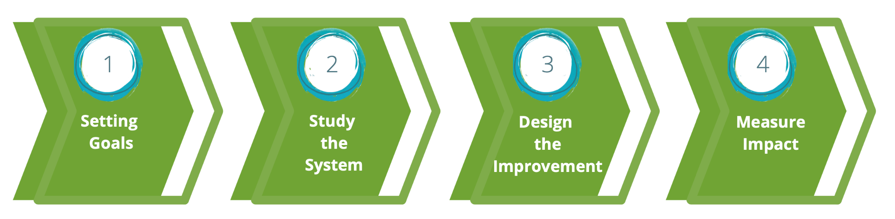
SusQI Framework
Aims to improve sustainable value, by:
Understanding environmental, social and financial impacts of the current system
Using the principles of sustainable clinical practice to design improvements
Measuring the impact on sustainable value.

Slide 12
SusQI in Practice

Slide 13
Framework of low-carbon care
We adapted the Centre for Sustainable Healthcare's principles of sustainable clinical practice to outline a framework of low-carbon care:
Preventing disease
Improving the management of disease and health
Moving care out of hospitals
Eliminating avoidable waste and unnecessary interventions
Using lower-carbon alternatives
https://www.rcpjournals.org/content/clinmedicine/10/2/110
Notes:
Wanted to highlight examples that show how this approach can be taken

Slide 14
Improving the management of disease and health
Oxford AHSN worked to increase use of Placental Growth Factor blood testing in maternity care across Thames Valley in 2021
https://www.healthinnovationoxford.org/wp-content/uploads/2021/07/PlGF_CaseStudy_210720-FINAL.pdf

Slide 15
Improving the management of disease and health
Whole-care-pathway approach critical to realise the gains across the 'triple bottom line' -social, carbon and financial.
1 centre in 1 year saved (est):
386 avoidable admissions
£250-600 per woman receiving test
35t CO2eq and 1.9 t of waste
https://www.healthinnovationoxford.org/wp-content/uploads/2021/07/PlGF_CaseStudy_210720-FINAL.pdf

Slide 16
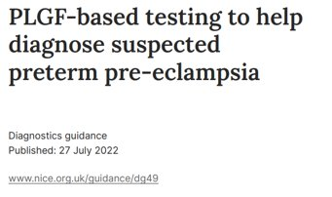
Improving the management of disease and health
Whole-care-pathway approach critical to realise the gains across the 'triple bottom line' -social, carbon and financial
1 centre in 1 year saved (est):
386 avoidable admissions
£250-600 saved per woman receiving test
35t CO2eq and 1.9 t of waste
https://www.healthinnovationoxford.org/wp-content/uploads/2021/07/PlGF_CaseStudy_210720-FINAL.pdf

Slide 17
Using lower-carbon alternatives
Partnership of Revolution-ZERO, West of England AHSN won SBRI funding as part of NHS Accelerated Access Collaborative
Worked with Royal Cornwall Hospitals NHS Trust to switch from single-use surgical gowns and surgical drapes to reusable equivalents
Youtube image via Maria Koijck
UKHACC Green Surgery Report, ukhealthalliance.org/sustainable-healthcare/green-surgery-report/
Notes:
Small Business Research Initiative Healthcare programme
UK-based reusable medical textile business

Slide 18
Using lower-carbon alternatives
Also developed and validated low temperature decontamination process
Estimated savings of 67 tonnes CO2e per year, and £10,000 at this trust
Youtube image via Maria Koijck
UKHACC Green Surgery Report, ukhealthalliance.org/sustainable-healthcare/green-surgery-report/
Notes:
UK-based reusable medical textile business

Slide 19
What is needed to transition to net zero care?
Notes:
So we’ve heard about what net zero care is, and what it can look like in practice, but what is needed to enable that at scale?

Slide 20
Four areas for action to enable net zero care
Invest resources to shift to low-carbon care models
Put sustainability at the core of good leadership
Ensure major policy levers are used to drive progress
Support research and innovation to enable faster decarbonisation of care
Notes:
Through our research, we have identified four main areas for action that senior leaders and policymakers should focus on now to enable the shift to net zero care.
Investing resources to shift to low carbon care models. A lot of this is about human resources: and the capacity and capability to plan and make changes to health and care practice.
Putting sustainability at the core of good leadership, ensuring it is at the forefront of decision making and aligning with other strategic priorities
Ensure that all policy levers are helping not hindering the shift to low carbon care
Supporting research and innovation to enable faster decarbonisation of care. Building the evidence base about what changes are needed, what works and what doesn’t and developing testing adopting and scaling innovations that could enable the changes we need to make

Slide 21
Invest resources to shift to low-carbon care models​
Capacity
Reliance on volunteerism insufficient and unsustainable.
Staff need time, space and resources to focus on sustainability.
Capability
Awareness, skills and knowledge around low carbon care relatively low.
Need to integrate sustainability into education and training.
Integrating into efforts to improve quality of care.

Slide 22
Put sustainability at the core of good leadership
Competing urgent priorities crowding out sustainability – but net zero can be integrated into strategic decision making.
Prioritising sustainability, unlocking resources and investing staff time and training in decarbonising care all rest with leaders.
Support and training should be available to leaders across all levels of health care organisations and ICSs.

Slide 23
Health Foundation work on sustainability
Notes:
To finish, I just wanted to tell you a bit about our work at the Health Foundation on environmental sustainability

Slide 24
Health Foundation work on sustainability
Research and analysis to inform policy
Public polling; Net zero long read
Capacity building
Green surgery report; SusQI; Q community
Frontline change projects
Asthma toolkit; Scaling up virtual consultations
Improving our own sustainability
Net zero endowment; Strategy for wider ops
Convening and engaging policymakers
Net zero NHS immersive installation
Notes:
To date, we’ve undertaken a range of projects that have an environmental dimension
These have largely focused on supporting the ambition of a net zero NHS
- We’ve commissioned research and analysis on some aspects of environmental sustainability in the NHS to inform policy, e.g. polling to understand public awareness of climate change and the role of the NHS
- We’re supporting professional capacity development on sustainability in health care, for instance through a fellowship with the UKHACC focused on net zero surgery, which recently reported (can share link)
- We’ve funded frontline change projects with direct and indirect effects on environmental sustainability e.g Supporting the org Greener Practice to develop an Asthma Toolkit, to help reduce emissions from asthma care and a project to scale up virtual consultations, which has helped to reduce patient journeys
At the same time we’ve also taken some steps towards improving our own sustainability as a foundation, for instance setting a net zero target for our endowment and starting to shift the way we run our investments. We’re also in process of developing a long term carbon reduction plan for our wider operations.
Through the new strategy, we want to go further on environmental sustainability, and we’ll talk a bit more about that towards the end.
But now, the main focus will be on our recent long read: net zero care – what will it take, and I’ll had over to Caitriona to introduce that

Slide 25
Net zero NHS installation
Brought together health care leaders, clinicians and policymakers to:
Explore interactions between net zero and other long-term priorities for the health system.
Stimulate changes in the way people think about and act on the net zero goal within their current role.
Position the Health Foundation as a convener and emerging thought leader on environmental sustainability in health care.

Slide 26
Our planned portfolio on sustainable health care
“The changes that need to occur within health and social care delivery to achieve net zero.”
Objectives
Understanding national health policy levers and how they can better support net zero care delivery.
Identifying, evaluating and scaling innovation and Improvement.
Building capability to implement change.
Notes:
The way services organized and care is delivered.
Tackling these objectives sequentially, starting with policy, asking Where are the current policy barriers/enablers or potential enablers to net zero care?
For example:
Financial incentives, Regulation, Performance targets and metrics Governance and oversight, Health technology evaluations and national guidelines, if you would like to share your thoughts on this, please get in touch

Slide 27
Internal sustainability work
Decarbonisation of our endowment
Constant monitoring with the flexibility to adapt reporting and investment approach.
50% reduction in emissions by 2028
Reach net zero carbon emissions by 2035.
Completed a thorough analysis of our carbon footprint and developed a tool for future measurement.
Published sustainability guidance for grant applications.
Creating a carbon reduction plan.

Slide 28
Questions/ discussion
What are you working on relating to sustainability?
Do any of the topics we've presented here resonate with you?
What would you like to see in the SIG in 2024?

Slide 29
Caitriona.Callan@health.org.uk
Tom.Hardie@health.org.uk

