Slide 1
INCIVILITY IN THE WORKPLACE
Suzanne Turner
Regional Nurse Advisor
Defence Primary Health Care Scotland & Northern Ireland

Slide 2
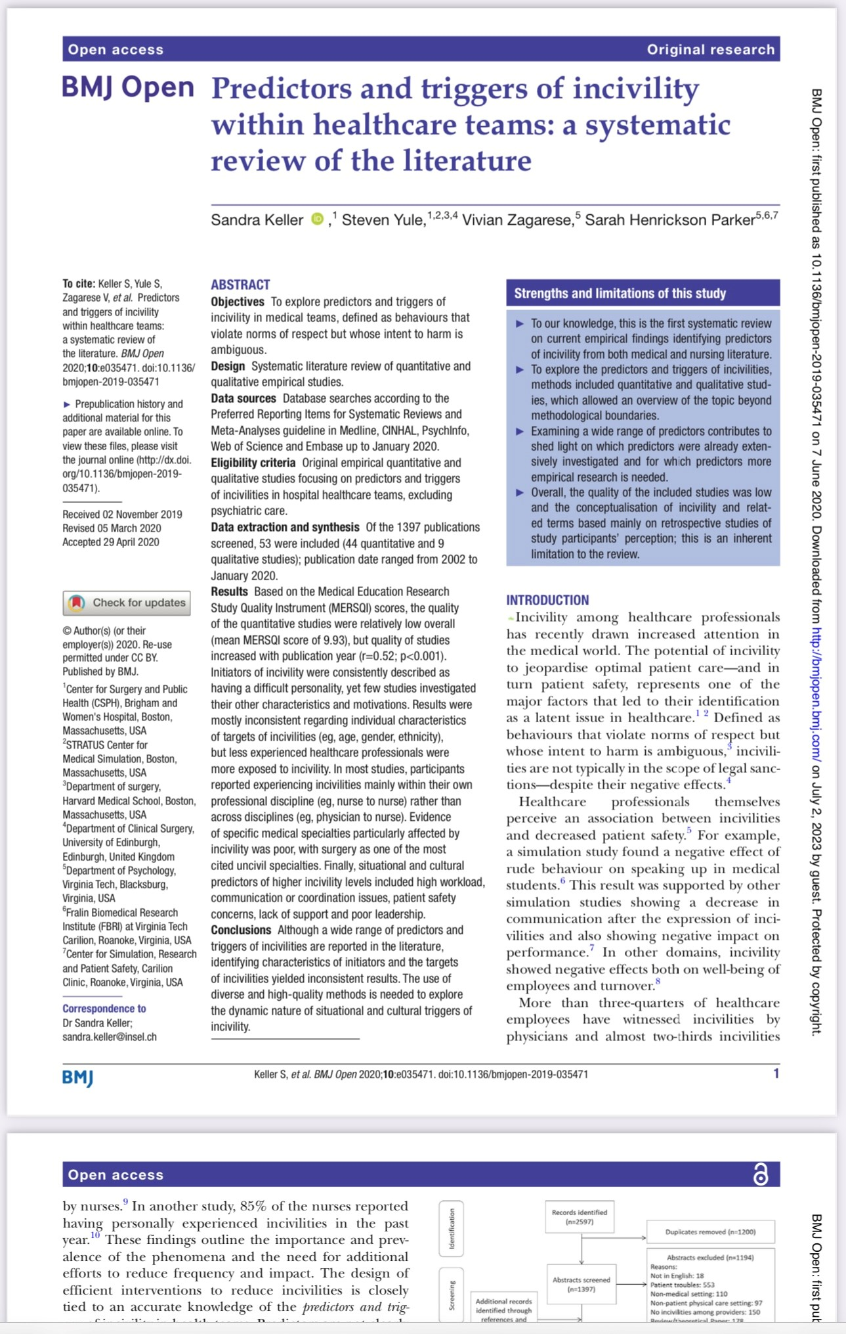
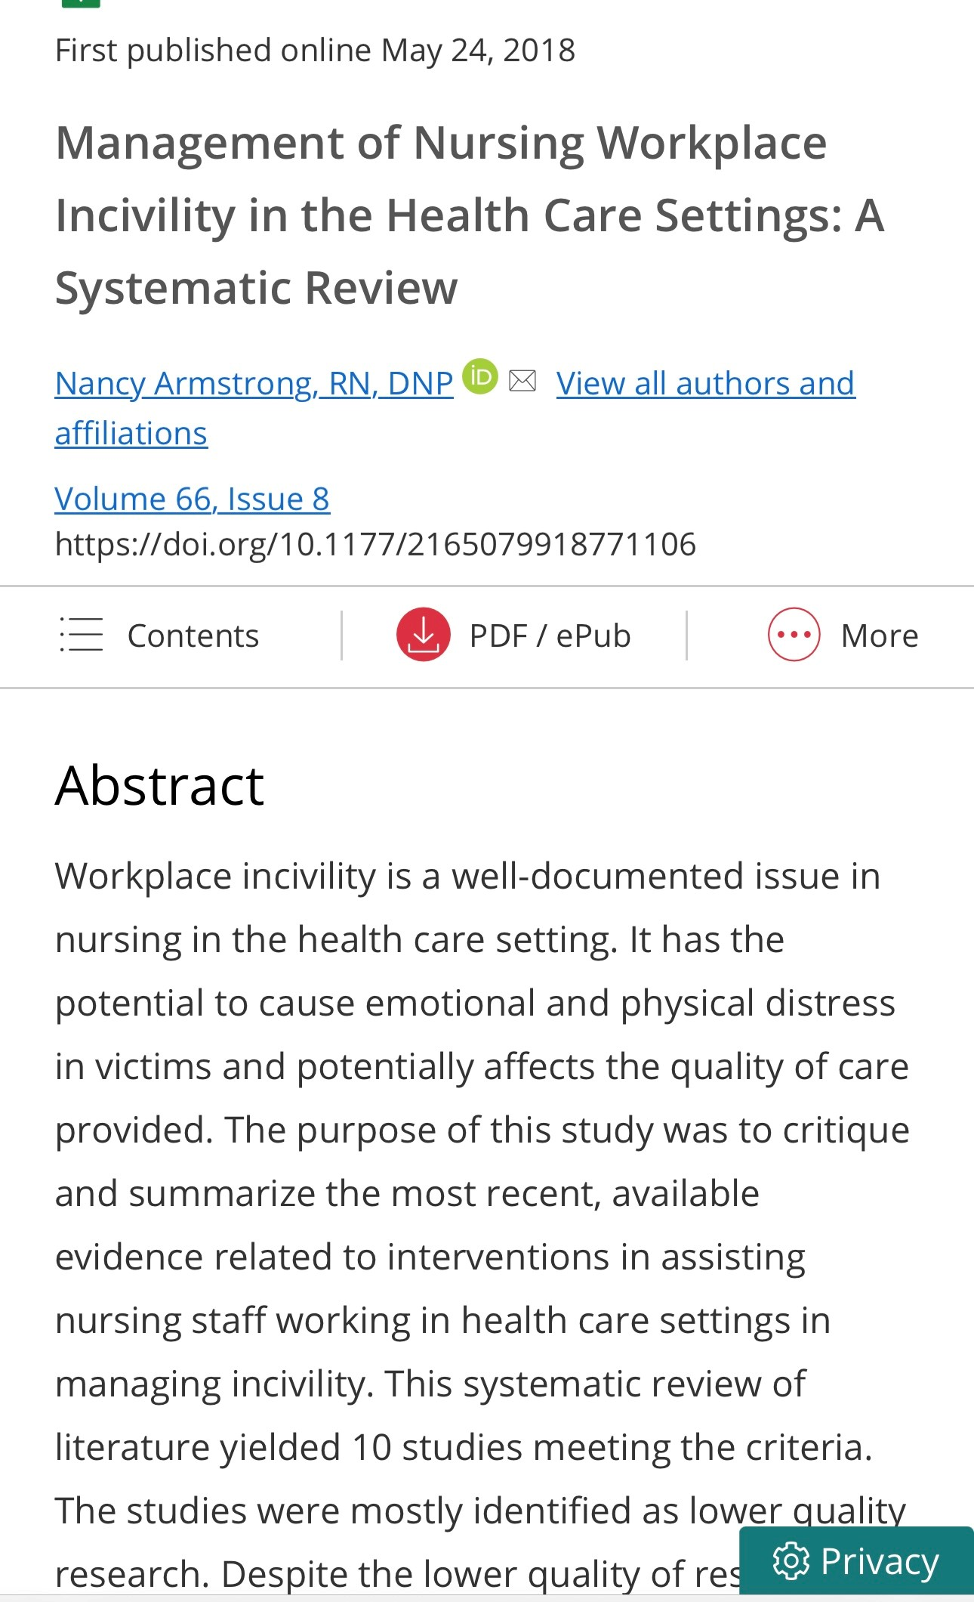
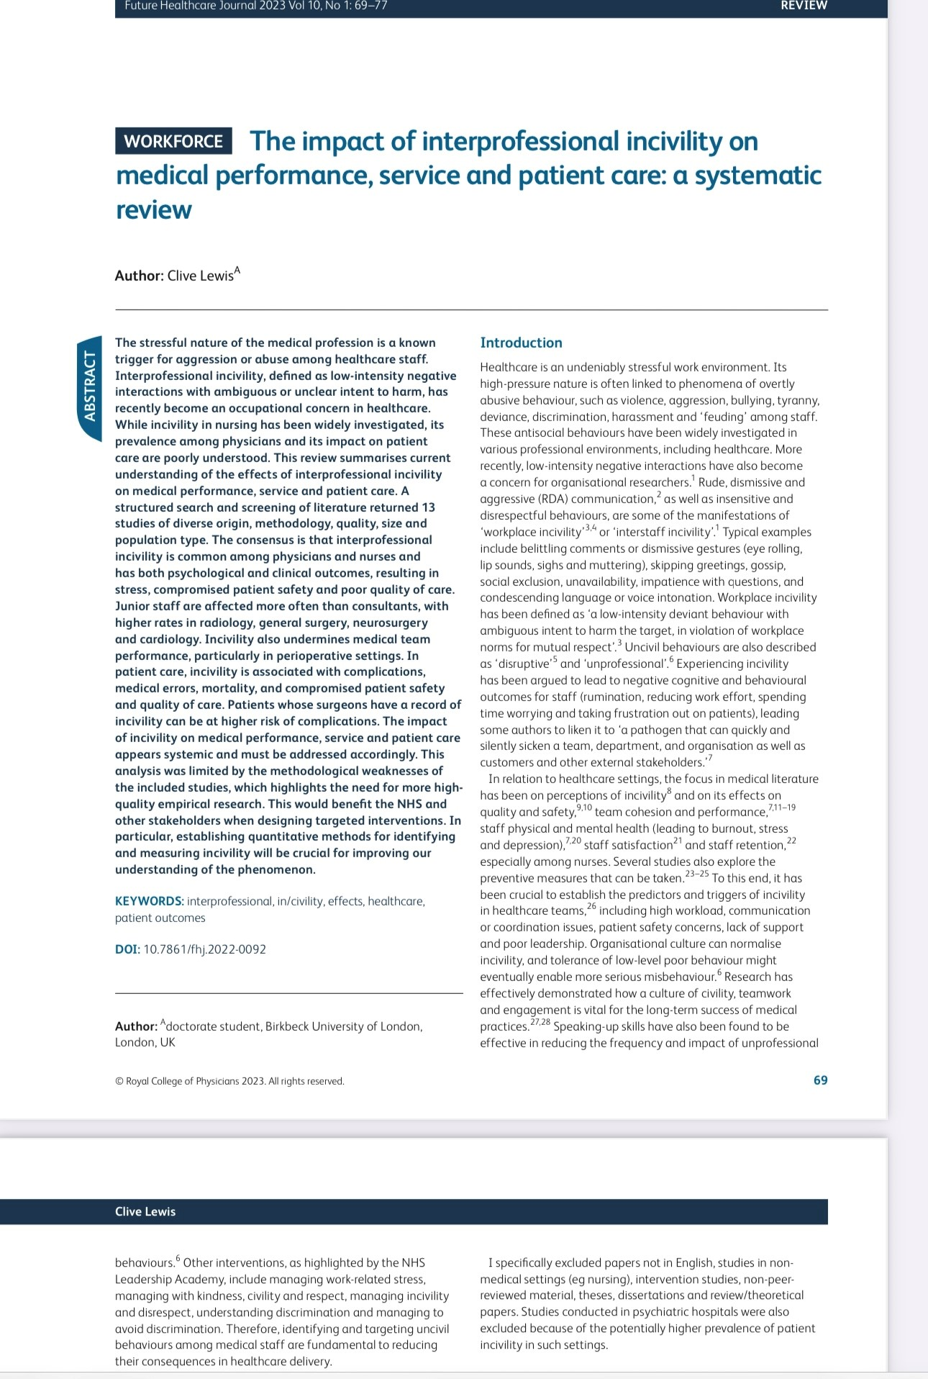
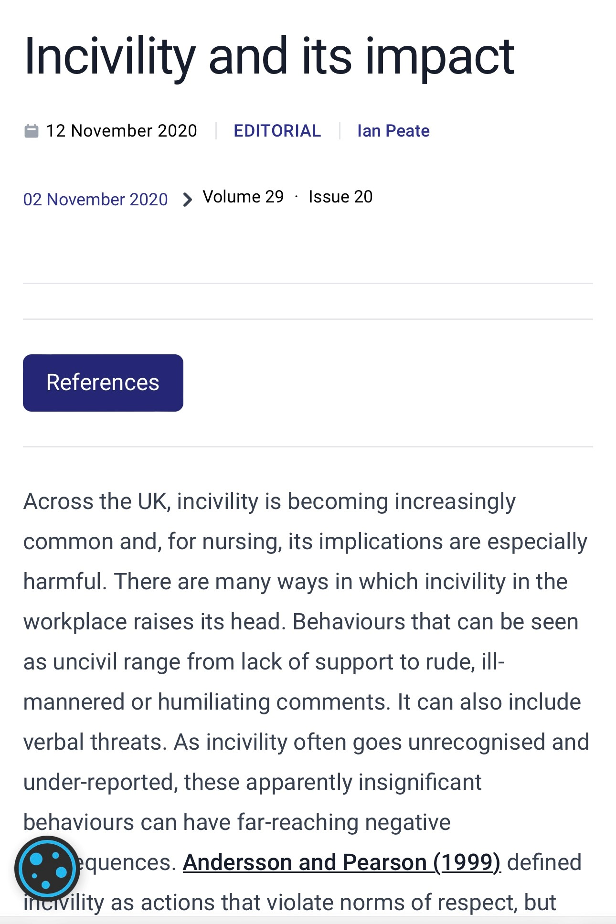
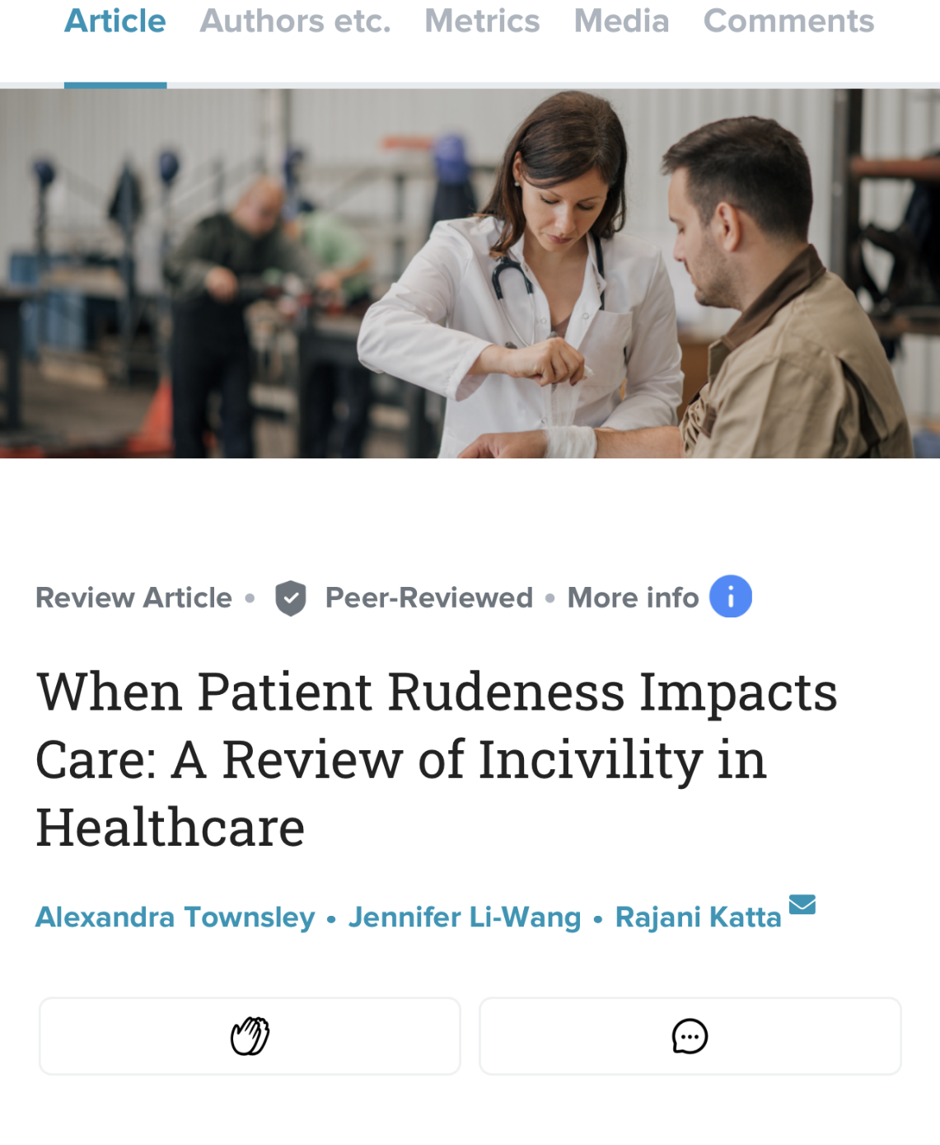

Slide 3
‘When we are in a team which values and respects us, the benefits impact us and our patients’

Slide 4
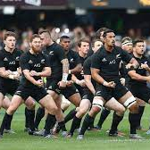
Teamwork
Everything we do for our patients requires teamwork
Evidence shows that good teams perform better, and this leads to better outcomes
Feeling valued and respected as part of the team

Slide 5
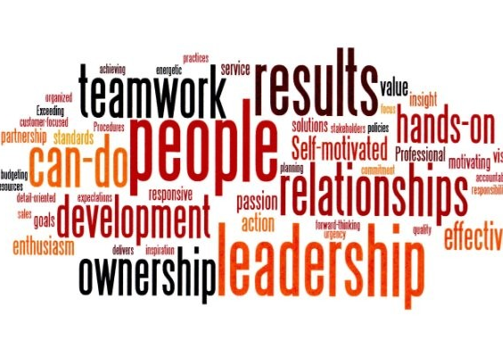
Why good teams matter in healthcare
King’s Fund Survey showed that when staff perceive themselves to be in a good team:-
Reduced hospital standardised mortality rates
Reduced patient complaints
Improved staff satisfaction
Improved staff performances
Better reported health of staff

Slide 6
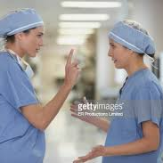
What does incivility look like?
Shouting
Swearing
Aggression (not necessarily towards a person)
Belittling
Sending emails in meetings (lack of respect)
Talking over people
Being ‘difficult’ over the phone
Eye – rolling
‘Tutting’

Slide 7
When rudeness in teams turns deadly
https://youtu.be/4RUIhjwCDO0?t=9

Slide 8
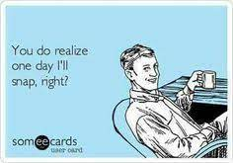
Causes of incivility
Lack of self awareness
Staff shortages
Workplace ‘cliques’
Perceived favouritism
Poor leadership
Personal anxiety and stress

Slide 9
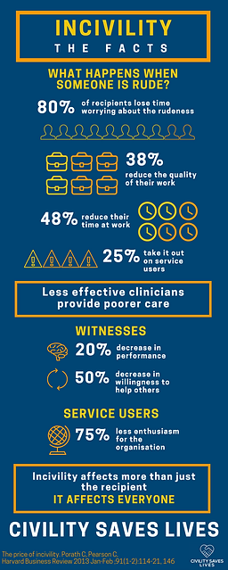
The effects of incivility
If you experience or hear incivility – it can reduce your cognitive ability by 60%
80% recipients lose time worrying
38% experience a reduction in quality of work
25% are reported to take it out on service users directly
For people who witness incivility – there is a 20% decrease in performance and a 50% reduction in willingness to help others
Errors / bad clinical judgements
Negative workplace culture – one of the most common reason that nurses leave the profession

Slide 11
How to tackle incivility
Be aware
Listen – notice what is said, how it’s said, and who it is said in front of
Call it out – but appropriately and with compassion
Don’t respond in the same tone
Deal with the issue quickly
Ask a peer / manager to speak to the offender on the receiver’s behalf
Build trust in your team

Slide 12
“The standard we walk past is the standard you accept”
*Chief of the Army Lieutenant-General David Morrison

Slide 13
Useful contacts:
suzanne.turner157@mod.gov.uk
http://www.civilitysaveslives.com
https://learningfromexcellence.com/
NMC Code
GMC Professional Standards
HCPC Standards Conduct Performance Ethics
https://www.mind.org.uk/

