Slide 1
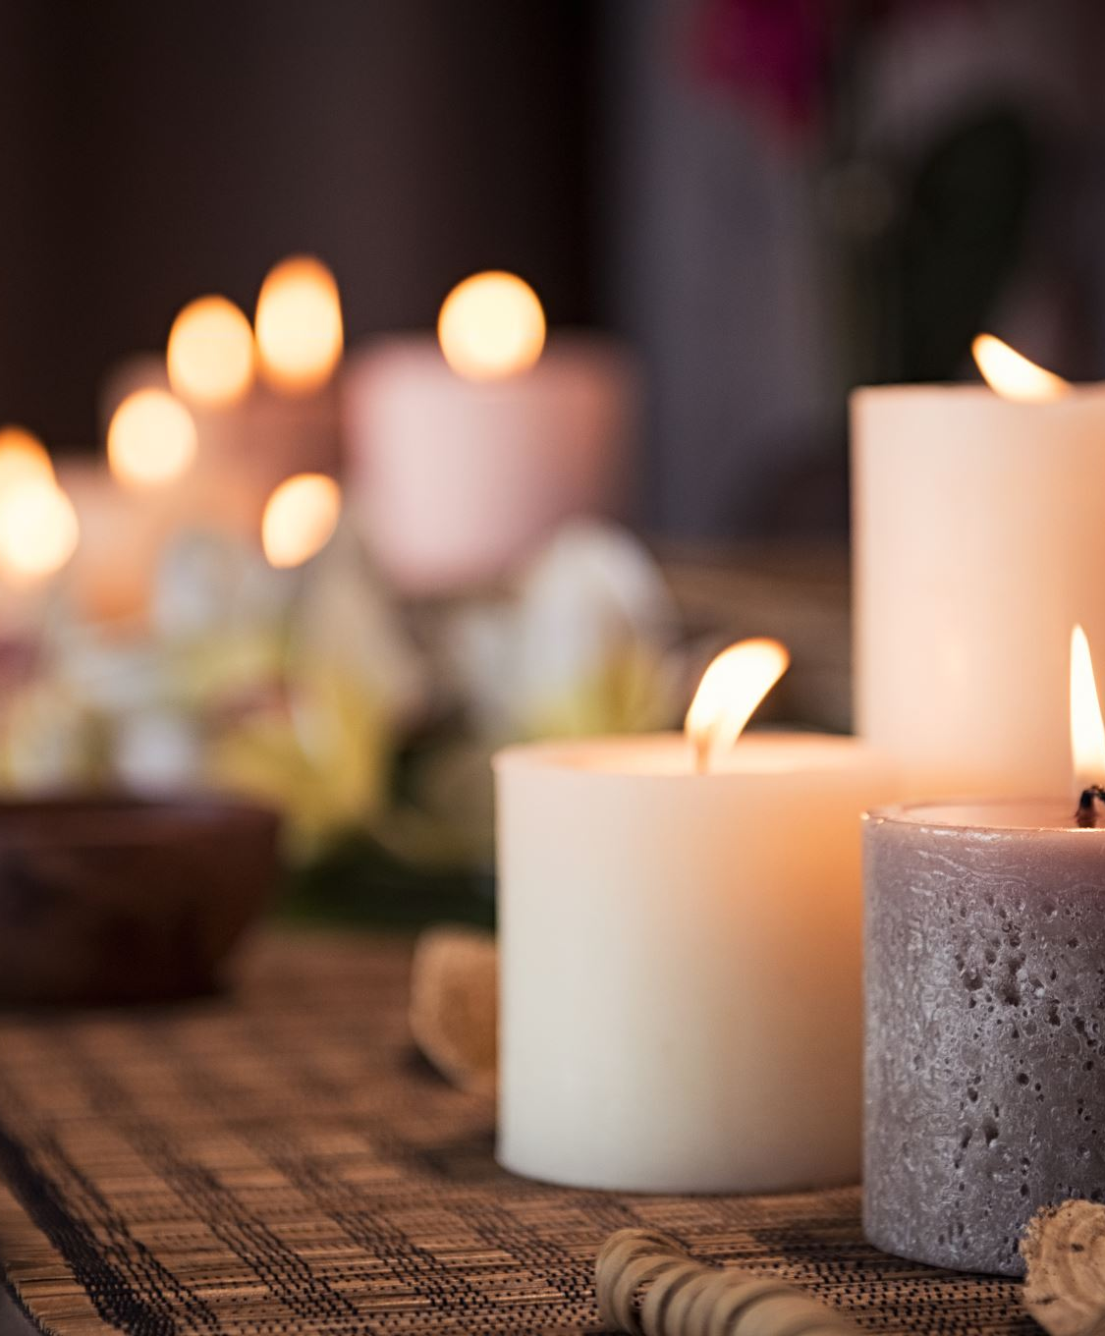
Affirmations and journaling for self-care
Slides which can be used for staff peer support, learning and discussions

Slide 2
Safe space
Sometimes we don’t know how we may react to conversations around self-care & wellbeing. If anyone needs to talk about anything that comes up from the session, please ensure to build in someone they can talk to and provide their contact details.

Slide 3
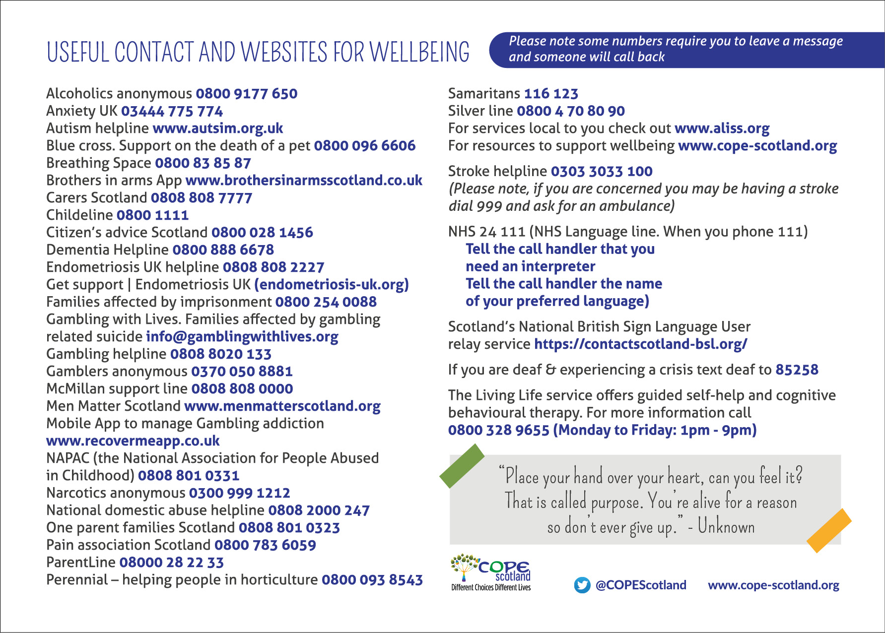
When self help is not enough

Slide 4
What the slides will cover
Acquire new tools and insights which support developing affirmations for self-care
Acquire new tools and insights which can help develop your own style of journaling
Become aware of the internal voice and how to speak with a kinder voice which supports your self-care
Leave with a renewed commitment to yourself around making time for your self-care using the personal promise cards

Slide 5
Kindness to yourself time to pause
https://www.cope-scotland.org/wellbeing-tips/entry/easing-the-heavy-load-do-not-wait-until-the-final-straw

Slide 6
What do you think?
Please complete the following sentences:
One thing about me I want to change is……………
One thing I admire about myself is………..
Now which one was the easiest to complete?

Slide 7
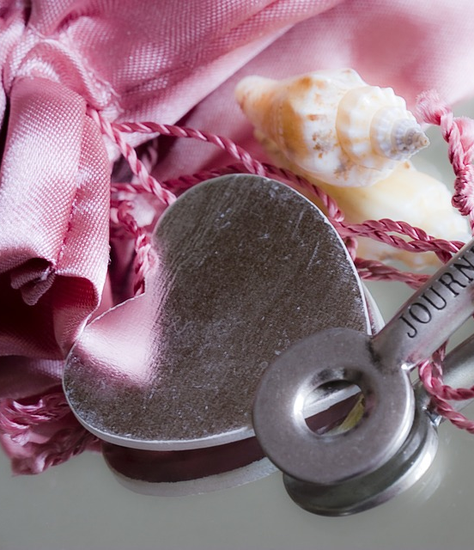
Become aware of our inner voice
https://www.cope-scotland.org/mental-health-videos/entry/what-are-you-saying-to-yourself-because-you-are-listening-1

Slide 8
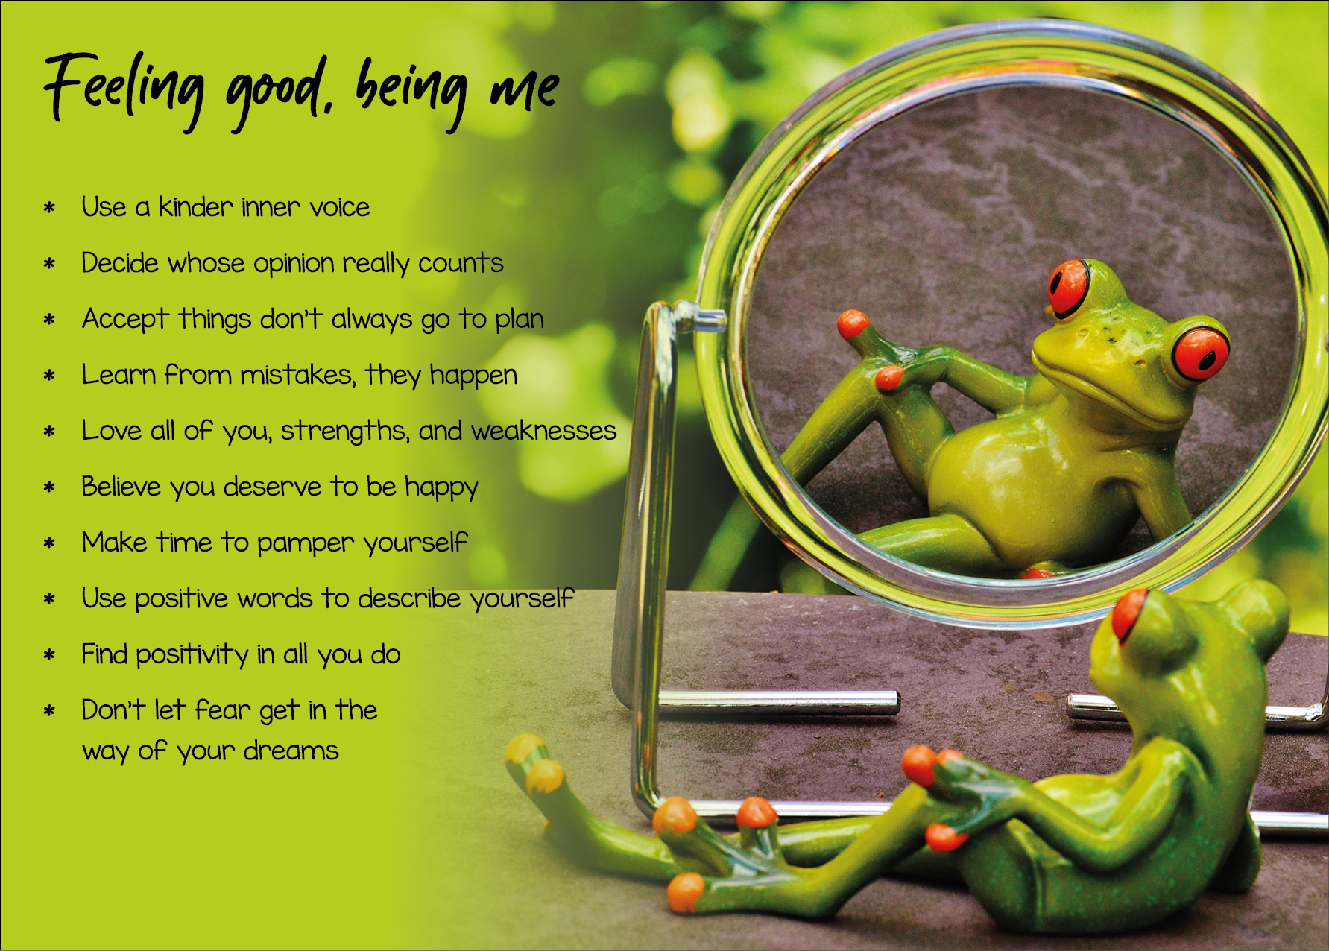
What do you think?
Please complete the following sentence:
One thing I can do to use a kinder inner voice is……….

Slide 9
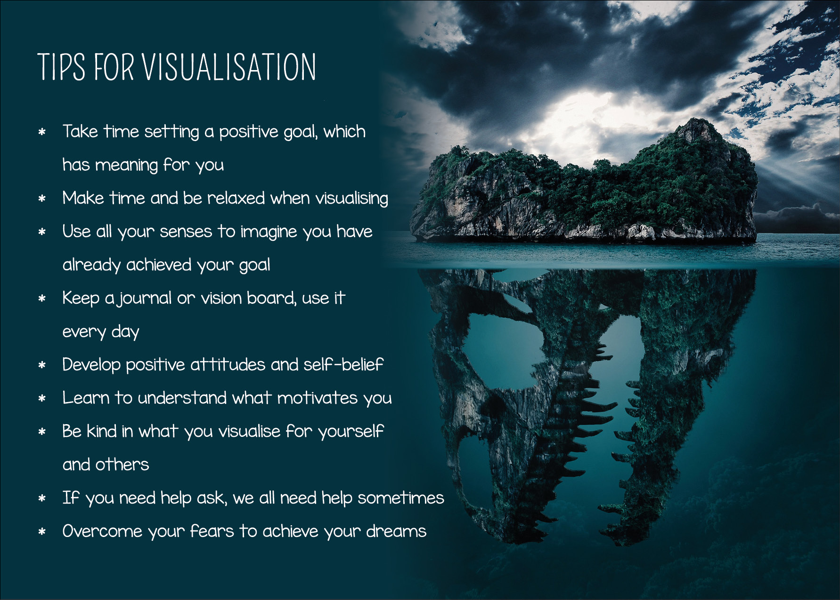
Visualise what you hope the affirmation will take you towards
Creative visualisation is helping use our imagination to help create what we want in our lives
Being confident in our ability to create this new reality matters
Understanding ourselves, in particular our reticular activating system matters. The self-reflection workbook on www.cope-scotland.org may be of interest
Make it matter to you. Visualise the positive which you want to move towards
Imagine with all your senses it has already happened, become aware of how we perceive the world through all our senses. This video may be of interest www.cope-scotland.org/mental-health-videos/entry/using-your-senses-to-relax
Don’t force it
Keep it kind and positive

Slide 10
Why affirmations matter
‘’Affirmations are positive statements that can help you to challenge and overcome self-sabotaging and negative thoughts. When you repeat them often, and believe in them, you can start to make positive changes.’’
www.mindtools.com

Slide 11
Affirmations can be used to…..
Inspire
Boost confidence/overcome self-doubt
Reminder for self-care
Help develop a positive mental attitude
Achieve goals
Look for opportunities
Help mitigate the impact of existential angst
And other ideas which offer you something to smile about

Slide 12
Ideas to write an affirmation time to have a go!
Turn a negative belief/thought about yourself into a positive
01
Keep it short so it’s easier to remember
02
Own it, this is your affirmation so start it with ‘’I’’
03
Write it as if its already happened
04
Include gratitude and appreciation
05
Include a positive emotion
06
Believe it!
07

Slide 13
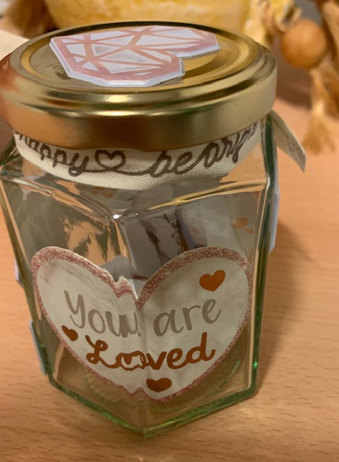
Making an affirmation jar
www.youtube.com/watch?v=TojdTIxoAKc

Slide 14
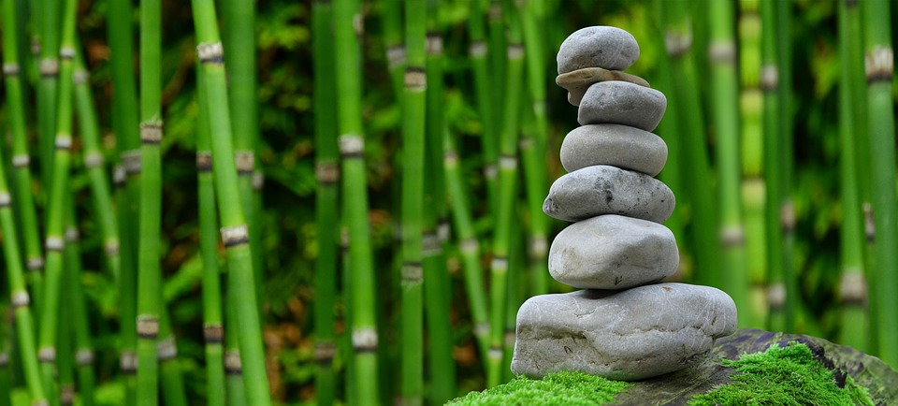
Making a visualisation Board to support affirmations and goals
Enjoy a good clear out
Make time to break from staring at the laptop!
Treasure time outdoors
Maintain balance
Be grateful for fresh dinking water from the tap
Enjoy swimming in the sea of life

Slide 15
What do you think?
Please complete the following sentences:
One thing about me I want to change is……………
One thing I admire about myself is………..
Now which one was the easiest to complete?

Slide 16
Did you Have a go?

Slide 17
Why Journaling can be useful
Can help us set and achieve goals
It’s an excellent reflective tool that helps us get to know ourselves better
It can help us to take what is in our mind, put it on paper so if we are stuck or blocked in some way, see that more clearly, so we are more able to consider what next
Journaling can be used in therapy E.g., trauma therapy, however, this is best done while also receiving professional support
Journaling helps us look at where we are now, where we want to be, and how we may plan to get there

Slide 18
Tips for journaling
Journal on a regular basis, build it into a routine which becomes a habit
A journal can prompt us to take action, rather than continue saying what we ‘need to do’,
Capturing how you feel after taking action can be helpful for learning and motivation
By capturing the steps, we planned to take, the steps we did take, what happened and how that makes us feel, we can see the progress we have made
Understanding visualisation and our goals helps us in journaling as we have clarity about where it is we want to go
Make time to journal where its quiet, you won’t be disturbed, maybe do a relaxation exercise beforehand to clear your mind. Remember your journal is private, even in therapy you choose if you want to share or not, its contents. This is your reflective log
Don’t worry if sometimes what you write doesn’t make perfect sense, you are capturing what you are thinking and feeling at the time, and sometimes we are confused, uncertain so our journal may reflect that
As well as building in time to journal, build in time to reflect on what you have written
Journaling can be its own form of meditation, please don’t see it as a chore, but something which has value for you

Slide 19
Journaling affirmation

Slide 20
What do you think?
Please complete the following sentences:
One benefit of journaling I see is……………
One barrier I see to journaling is………..
One way I could overcome the barrier and make the time for journaling is………..

Slide 21
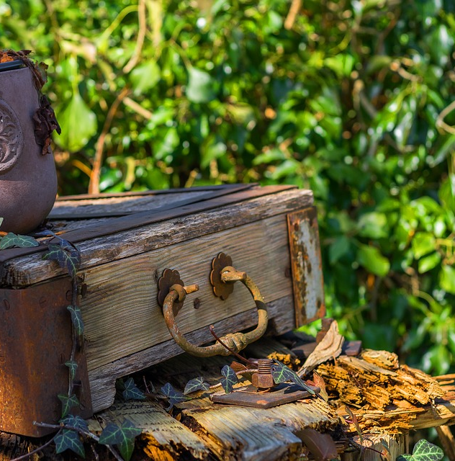
Make your journal your own
You can have
An audio journal
A video journal
A pictorial journal
A written journal
One which you bought there are many available in stores
A memory, ideas and journal box you place things into and reflect back on
A combination of all of the above and whatever else your imagination suggests and that works for you
Journaling is for you, so find a way makes sense in your own circumstances to practice in a way which brings you a feeling that doing this has purpose

Slide 22
Promises
Before making a promise to ourselves, make sure it has meaning for us. If you would like to improve your sense of wellbeing, then that suggests something may need to change. The tools we have shared in these slides can help support that change. Making a promise to ourselves which we write down and referback to can help us take the actions to keep that promise. There are many personal promise cards on www.cope-scotland.org this is one example, or make your own

Slide 23
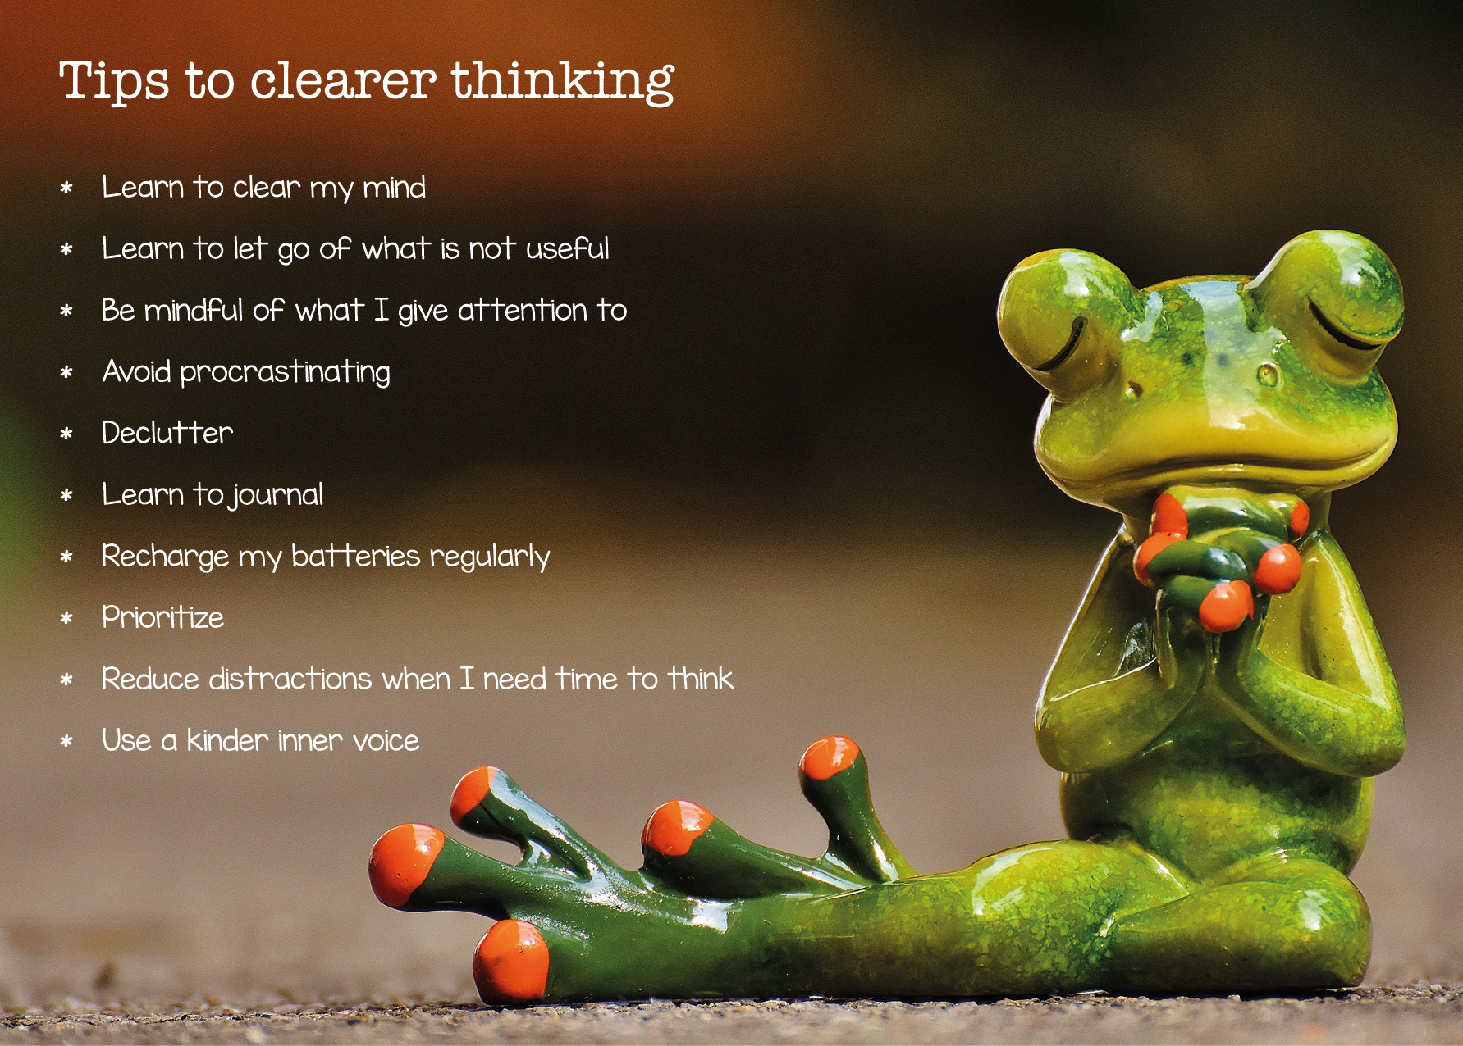
This is one step, not the end point
Personal wellbeing and self-care, is something which we develop to suit our needs, and how we do it can change with our life circumstances. What matters is, we do become aware of our state of wellbeing, have ideas for self-care, and build that into everyday
You may find using one of the workbooks on www.cope-scotland.org of interest
Thank you, remember, you do matter.
www.cope-scotland.org @COPEScotland hilda@cope-scotland.org
Hilda Campbell
Convenor of the staff wellbeing SIG
The Q Community

