Slide 1
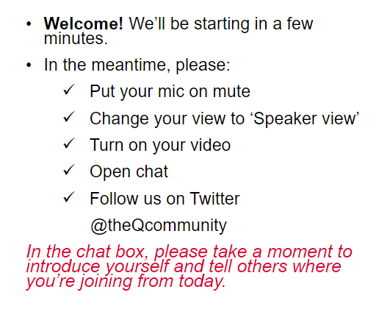
Workshop #1: Introduction to intentional collaborative networks
Notes:
Bill - has the deck on his computer and shares screen. I recommend Bill because he is doing the majority of the content.
This slide is up when people join.

Slide 2
Introduction to Intentional Collaborative Networks
Notes:
Stacey begins her intro. She welcomes participants and then transitions to the next slide on housekeeping.

Slide 3
How we’ll be using the technology
Subtitles are available
Click on the Closed Caption option at the bottom of the page
Message Charlotte Bowden if you would like to join the breakout group that has this functionality
This session is being recorded
Where possible please have your videos on. You only need to have your microphones on for breakout group discussions.
You are welcome to use chat. Anything you miss will be shared in the write up.
Notes:
Stacey
There are a few bits of housekeeping
Firstly - we have subtitles available for anyone who needs them. If you would like to see subtitles, please click on the ‘closed caption’ button at the bottom of the page. Some instructions will also be added to chat now…
Only 1 breakout group will have this functionality – so if you’d like to be in that group, please message Sarah now (host)
Secondly - we are recording today’s session, will be sharing snippets from this on the Q website.
If possible – it’d be great if people can have their videos on. This is particularly helpful when we move to breakout groups – as it’ll improve the quality of conversation that you have together.
We will be using the chat box throughout. There’s a lot of us on the call so please don’t worry if you can’t keep up

Slide 4
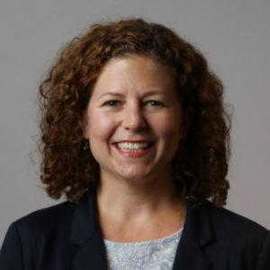
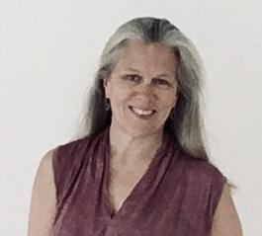
Meet the team
Logistical and technical support
The Strategy Group
William Moore
Principal, The Strategy Group
Senior Fellow, Midwest Center for Nonprofit Leadership
Charlotte Bowden
Kristin Johnstad
Senior Network Consultant, The Strategy Group
Principal, Johnstad and Associates, LLC
Katie Young
Matthew Mezey
Stacey Lally
Notes:
Stacey
Quick walk through who is who and the roles that people are playing across this learning series.
We are bringing this learning series to you with The Strategy Group who will be facilitating, sharing their expertise, skills and knowledge in this area, providing insights as we go and sharing know-how on how to make networks thrive. We are delighted that they are leading this work for Q
Char here is on hand for any logistics and tech support throughout the workshop
Intro Matt and Katie and their roles in the series.
Hand over to Bill and Kristen to get us going.

Slide 5
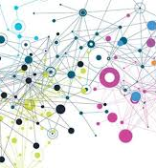
Why Network Weaving?
Networks operating effectively
Facilitating change
Connecting people and deepening relationships
Embedding ‘Network Weaving’ behaviour into our lives
Notes:
Stacey slide
Introduce herself etc.
Words to be drafted, will cover these points – aim to keep at strategic level and the why
The importance of network weaving from a Q perspective
Our offer to members to ensure there are opportunities to develop their skills. It is a privilege to be able to fund this
Something on their role as leaders, something inspirational about where this might take them and how they will use their learning within Q and outside.
Bring in some of the things from the blog - https://q.health.org.uk/blog-post/in-it-together-for-a-common-purpose-developing-effective-network-leadership-skills/
Remind people this is a first for us and evaluation and learning is vitally important for improvement – we want to hear from them.
Question on ground rules and how/who these are covered?

Slide 6
Notes:
Bill will share the workshop series topics.

Slide 7
Workshop Objectives
Notes:
Bill

Slide 8
Workshop Objectives
1. Describe the purposes of networks and their benefits in addressing complex issues.
2. Describe the essential features of networks, reflect on the evolution and value of different types of networks.
3. Describe network leadership roles and the culture that supports network building.
4. Understand how to activate a network to move from talking to action.
5. Discuss the results of the network weaver checklist and how to use the tool and results with others in the Q initiative.
Notes:
Bill
1. Describe the purposes of networks and their benefits in addressing complex issues why networks they are a more effective approach to collaboration and intentional community change when the underlying problems and goals involve complex systems such as health care and social services systems.
2. Describe the essential features of networks, reflect on the evolution and value of different structures, the stages of evolution of networks, the unique elements of an intentional collaboration network, and the key values and behaviors that keep a network healthy and vibrant
Describe network leadership roles and culture that supports network building.
Understand how to activate a network to move from talking to action Understand how to activate a network to move from talking to action
Discuss the results of the network weaver checklist and how and how to use the tool and results with others in the Q initiative.

Slide 9
Notes:
CHAR (or BILL whomever is sharing the deck) - No slide to start community check-ins. We will have cameras on and see the whole community.
Kristin - provides instructions
I will provide instructions for responding to four different sentence stems (exervise comes from Liberating structures) Explain the purpose and connection to network weaving.
Sentence stems: I have to…. If only…. It makes me….. When all is said and done…..
Then explain when all is said and done it is about the relationships.
______
Kristin - provides instructions
Let people know we will have quick paired check-ins. You are invited to meet someone in the network and share your name, where you are joining from today, how’s your spirit and what are you doing to take care of yourself.
CHAR - two rounds of paired check-ins. I will have to give you the timing on the day off. Likely 1 min / person so 2 rounds of pairs
Kristin - come back as a whole group and who discovered something surpising. Explain the value of informal relationship building or incorporating into your existing meetings.
e,
Location,

Slide 10
What is a Network?
Session Objective 1
Notes:
Bill

Slide 11
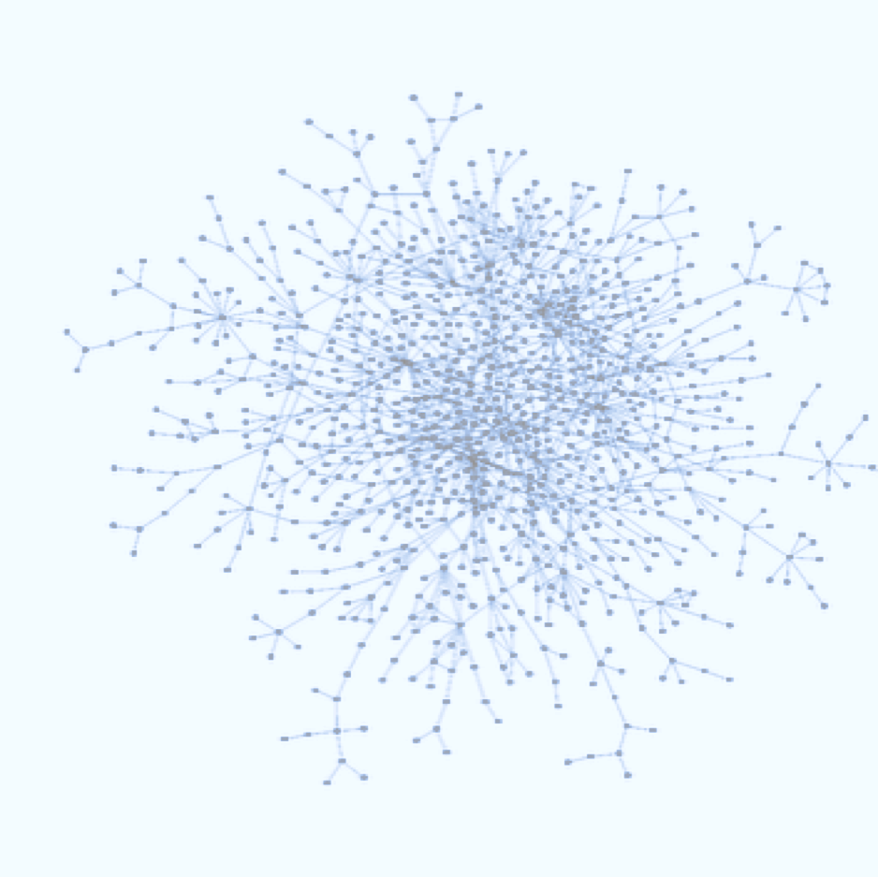
Networks are Patterns of Relationships
Networks are sets of relationships and the patterns they create. The patterns influence the quality of communication and the likelihood of collaboration and innovation in a community or organization…we are embedded in many different networks
Dots are people, lines are the relationships they have
Notes:
Bill - All communities and each person in a community has their own network – some are large and some are small. Social networks – your friends, family, and acquaintances are one kind of network we all have. The more connected you are to your social network the more opportunities there are for solving personal problems, planning fun and different things together, communicating and learning from each other, sharing interests, and making new friends. The same is true for community networks. And, while you may not be looking to grow and expand your own social network . . . community networks are intentional about growing, adding new members who bring new ideas and energy, new potential solutions, and new resources to improving the community. Weaving together a large, connected, and collaborative network of people, organizations, and projects is essential to solving persistent community problems.
What networks do yo belong to and what is the purpose of each network you belong to?

Slide 12
Participants’ objectives for their networks
Draw on the collective power of the network & increase influence
Become more self -sustaining, self -organising & self -actualising
Grow membership
Develop sub -networks
Increase sharing & learning
How participants want their network to improve & develop over the next 1-2 years
Understand impact
Move to collaboration & action
Access more resources
Define a clearer purpose & objectives
Do you share these objectives?
Increase the recognition of the network
Notes:
Bill - All of us in this workshop already have established social, personal and professional networks. We are all part of many networks.
And, many of you see the potential as well as the challenge of realizing the potential of your networks.
Some workshop participants shared with Q their hopes and goals for their primary network and they identified many of the same things all of us hope for with our own networks. You told us that your objectives over the next couple years were to: :
Develop sub networks
Understand impact
Access more resources
Increase the recognition of the network
Move to collaboration and action
Increase sharing and learning
Grow membership
Become more self-sustaining, self organizing and self actualizing
Template by Training for Change • www.trainingforchange.org
Resource:

Slide 13
What are the purposes of networks? Session Objective 1
Notes:
Bill

Slide 14
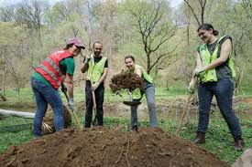
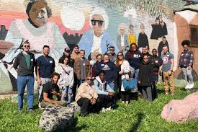
What are the purposes of networks?
Notes:
Bill -
Networks exist for a variety of purposes . . .
To connect and build relationships with others
To learn with and from others
To pursue a shared interest or passion
To execute a specific task or routine set of functions
To propel or compel some change or improvement
and exist in all parts of our lives . . .
Family and extended family
Friends and social relationships
Work – organizational, departmental, and role-based
Recreation and hobbies
Health care

Slide 15
How are networks different from other ways of organizing for action?
Session Objective 1 - What are networks and how are they different from other ways of taking action?
Notes:
Bill

Slide 16
How are networks different than other ways of organizing for action?
Use the chat box to share your ideas
Notes:
Bill - Use the chat box to share your ideas about how networks are different than other ways we organize for action.
1 minute.
Kristin will read out loud some of what people typed into the chat box.

Slide 17
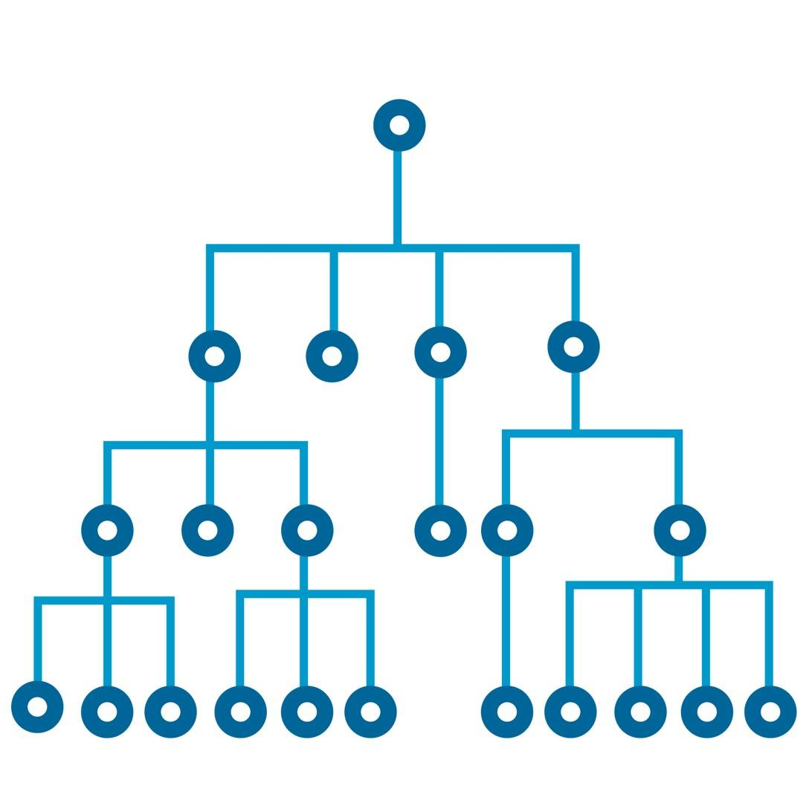
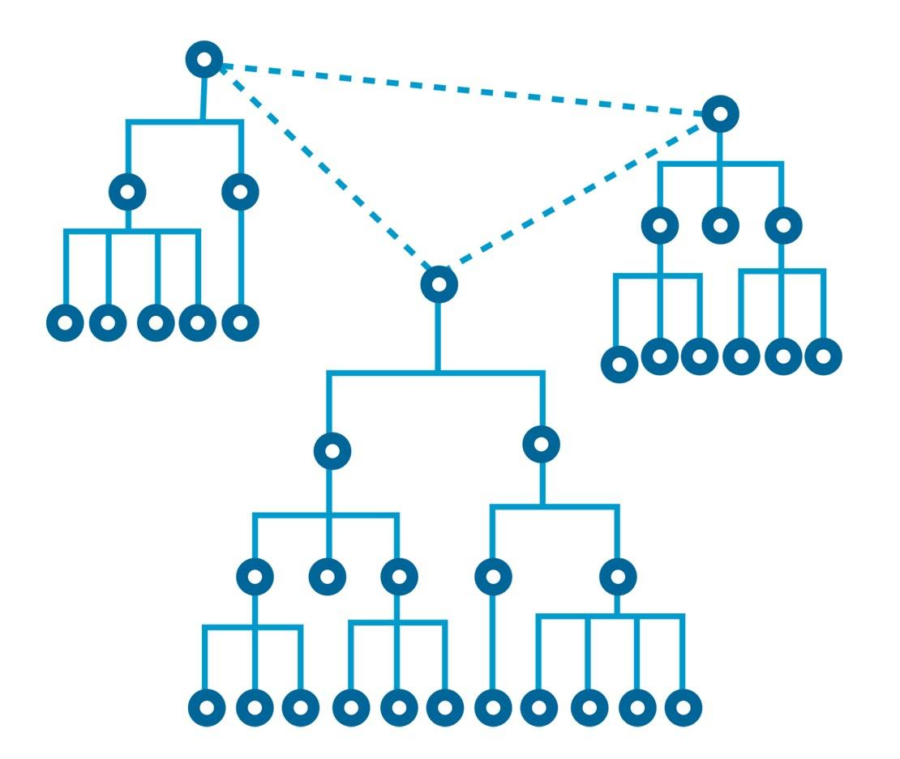
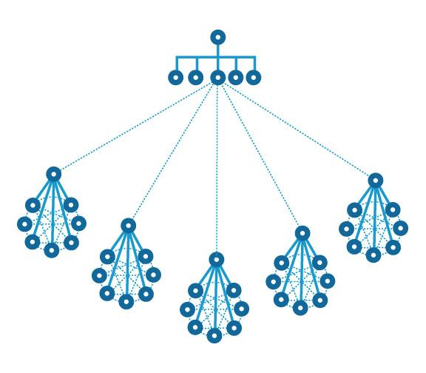
Common ways we organize to do something
ORGANIZATION
COALITION
EMAIL LIST
ONLINE
CAMPAIGN
ORG
CHAPTER ORGANIZATIONS
Notes:
Bill - What are the limitations of these types of structures? What are the limitations of organizations like BP or UniLever?
Limitations of community coalitions ? Have you ever been part of a huge email distribution list? What is a limitation of that form of structure for getting things done?
What about chapter organizations such as Alzheimers Association, Academy for Eating Disorders, and the ALS Association?
Networks can be identified based on their level of centralization and formality
Example of a highly centralized and formal network include staffing within an organization with a Board of Trustees, CEO, VPs, Directors
Example of a highly de-centralized and informal network include Facebook in which your network is connected to many other networks and there is no single authority or “boss” of the networks
Why are networks useful?
Because: they allow for huge amounts of meaningful participation. Because they are able to scale extremely quickly. Because they are able to be broader than other systems. Because they are a return to a more relational autonomy. Because their multi-sectorial to address the complexity of most structural and system-level problems. Because everyone can contribute and lead.

Slide 18
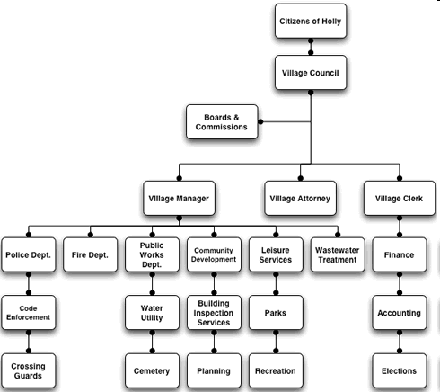
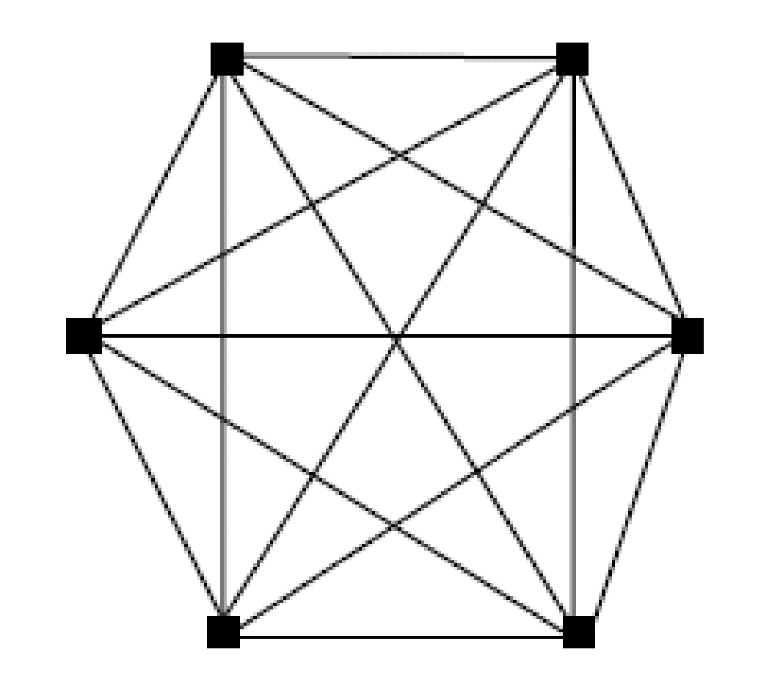
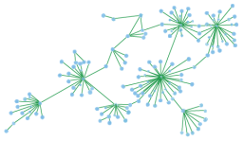
Organization | Coalition or Alliance | Network
Distinct Boundaries Employees Everyone has a boss Boss makes key decisions Jobs well-defined Departments or teams organize the work Planning processes and task orientation GOOD FOR SIMPLE TASKS OR SOLUTIONS | Sets of organizations Boundaries exist Membership narrow Organizational leaders meet to make decisions Focus on big issue Outcome oriented Term-focused (short, medium) GOOD FOR BIG BUT SIMPLE SOLUTIONS | Volunteers, professionals No or permeable boundaries Peers at all ranks meet together to learn and grow the network Diverse and inclusive – all welcome Big, systemic problems Most action happens by smaller subsets of actors Action orientation Long-term (if cultivated) GOOD FOR COMPLEX PROBLEMS WHEN DON’T KNOW SOLUTIONS
Notes:
Bill

Slide 19
Reflection, Share and Stretch
Notes:
KRISTIN

Slide 20
Essential Features of Networks Session Objective 2 - What are the features of networks?
Notes:
Bill

Slide 21
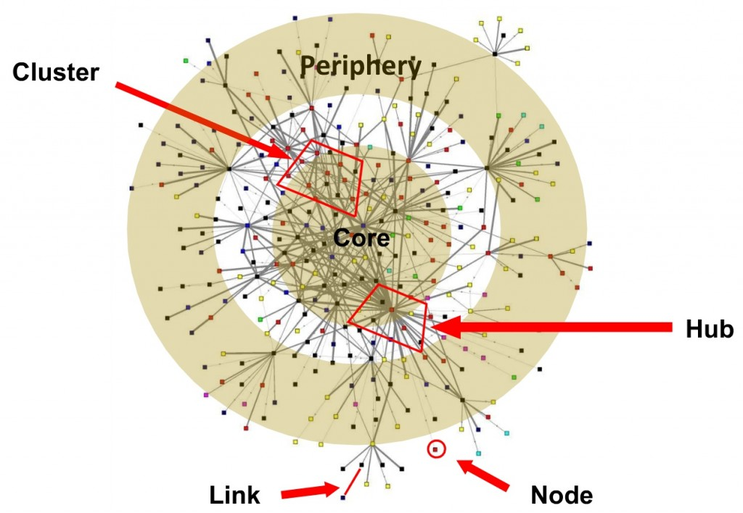
Features of Network
We can create a network that looks like this by:
adding new people
connecting those not currently connected
building trust and understanding
Notes:
Bill
A network of the type we are interested in --- a intentional collaborative network has several features:
1) There is a core - the individuals who have lots of relationships and our connected to many different people, It doesn’t have only one center, but many centers, and they are all connected to each other. Decisions, ideas and information can come from anywhere and travel throughout the group in any direction. The members are more closely connected to each other and hence, more likely to take bolder, riskier forms of actions.
2) The periphery - where important resources and knowledge resides is expanding and constantly bringing in new information and members as it grows.
3) A hub is a person that has many relationships - Hubs can only hold so many relationships before they become less effective
4) A link is some form of connection between two people
5) A node is a single person
6) A cluster is a group of people with some commonality - whether its by their roles, their interests, their geography. Something they have in common.

Slide 22
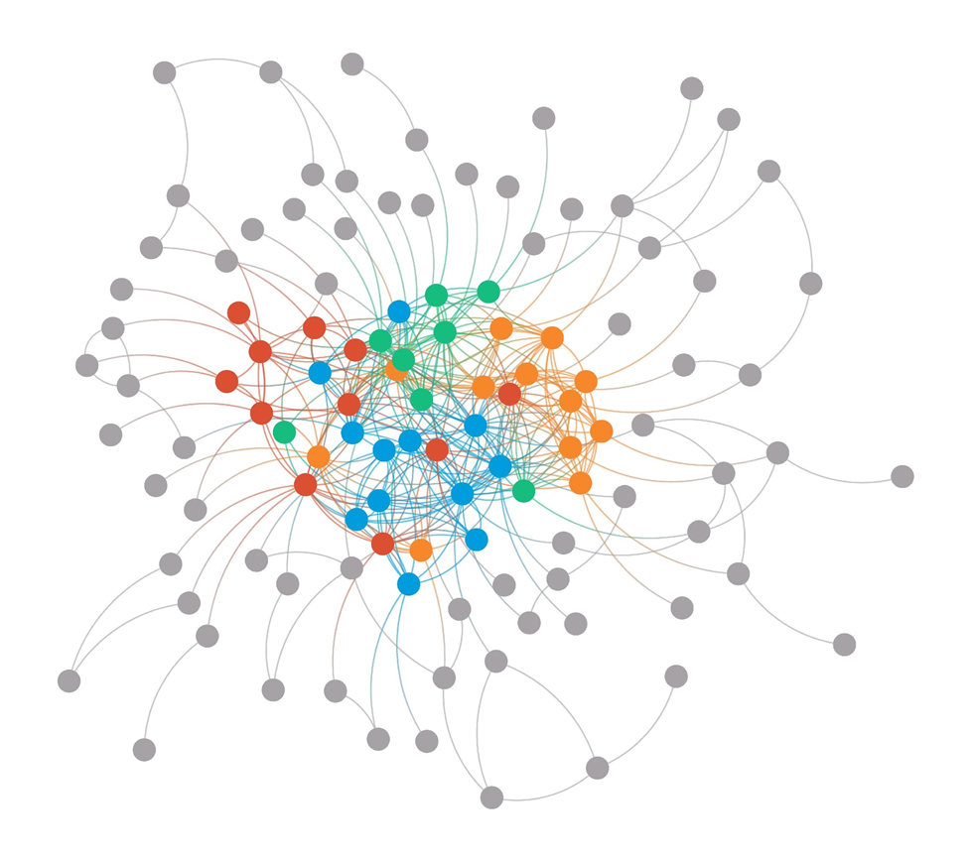
INTENTIONAL COLLABORATIVE NETWORK
Decentralized Core to Expand Leadership & Diversity
Overlapping Clusters of Action
Strong Periphery for New Ideas & Expansion
Notes:
BIll
With intentional collaborative networks you're trying to build the connections that will enable people to make changes - in your case the relationships between health care providers and professionals with each other, their institutions, and the communities they serve.
In some ways the disconnect that has happened for many people and their health care provider is symbolic of larger shifts that have happened in our world and so reconnecting health care providers and their institutions to their communities is part of a very big change in how we all are in the world.
If you want to make that kind of sweeping change, you need lots of people connected and working on the shift. You need lots of leadership not just one organization; you need lots of people working together to experiment to see how to make this change, and you need a periphery to help you continually reach out to new people so you keep getting new ideas about how change might happen and new pathways to invite more people into this issue.

Slide 23
Stages of Development of Networks
Notes:
Bill

Slide 24
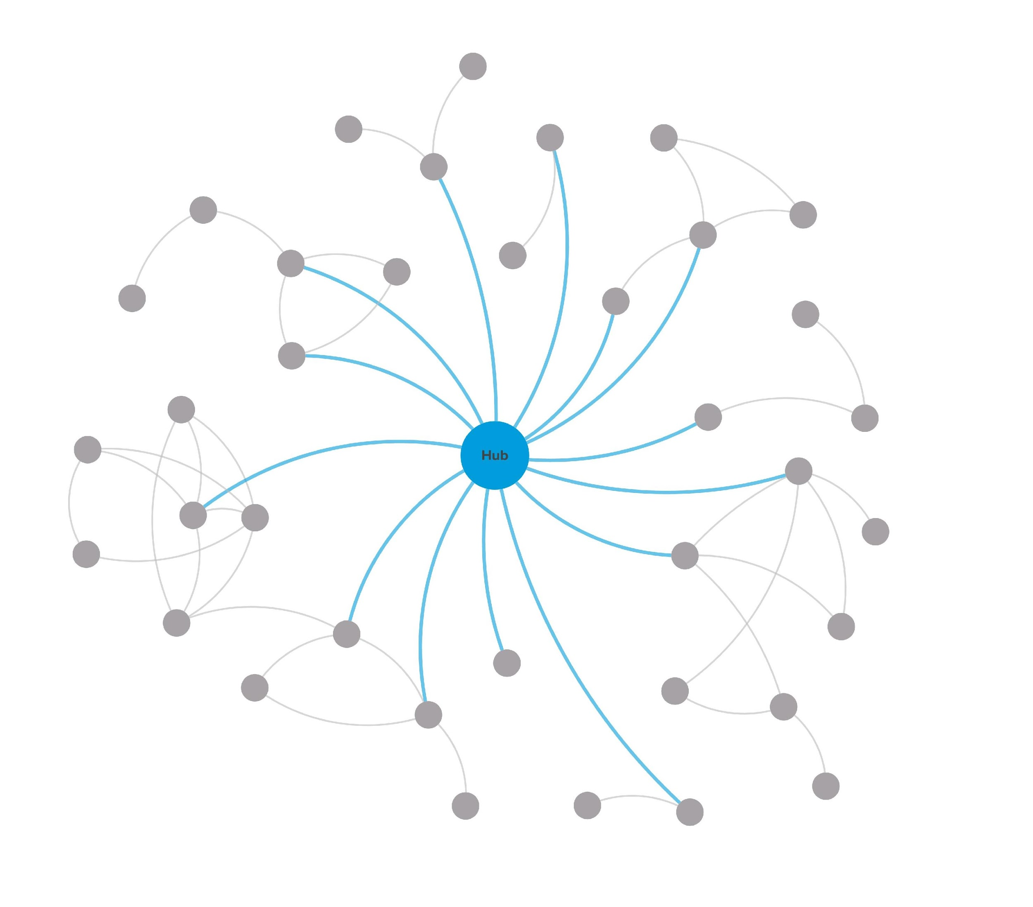
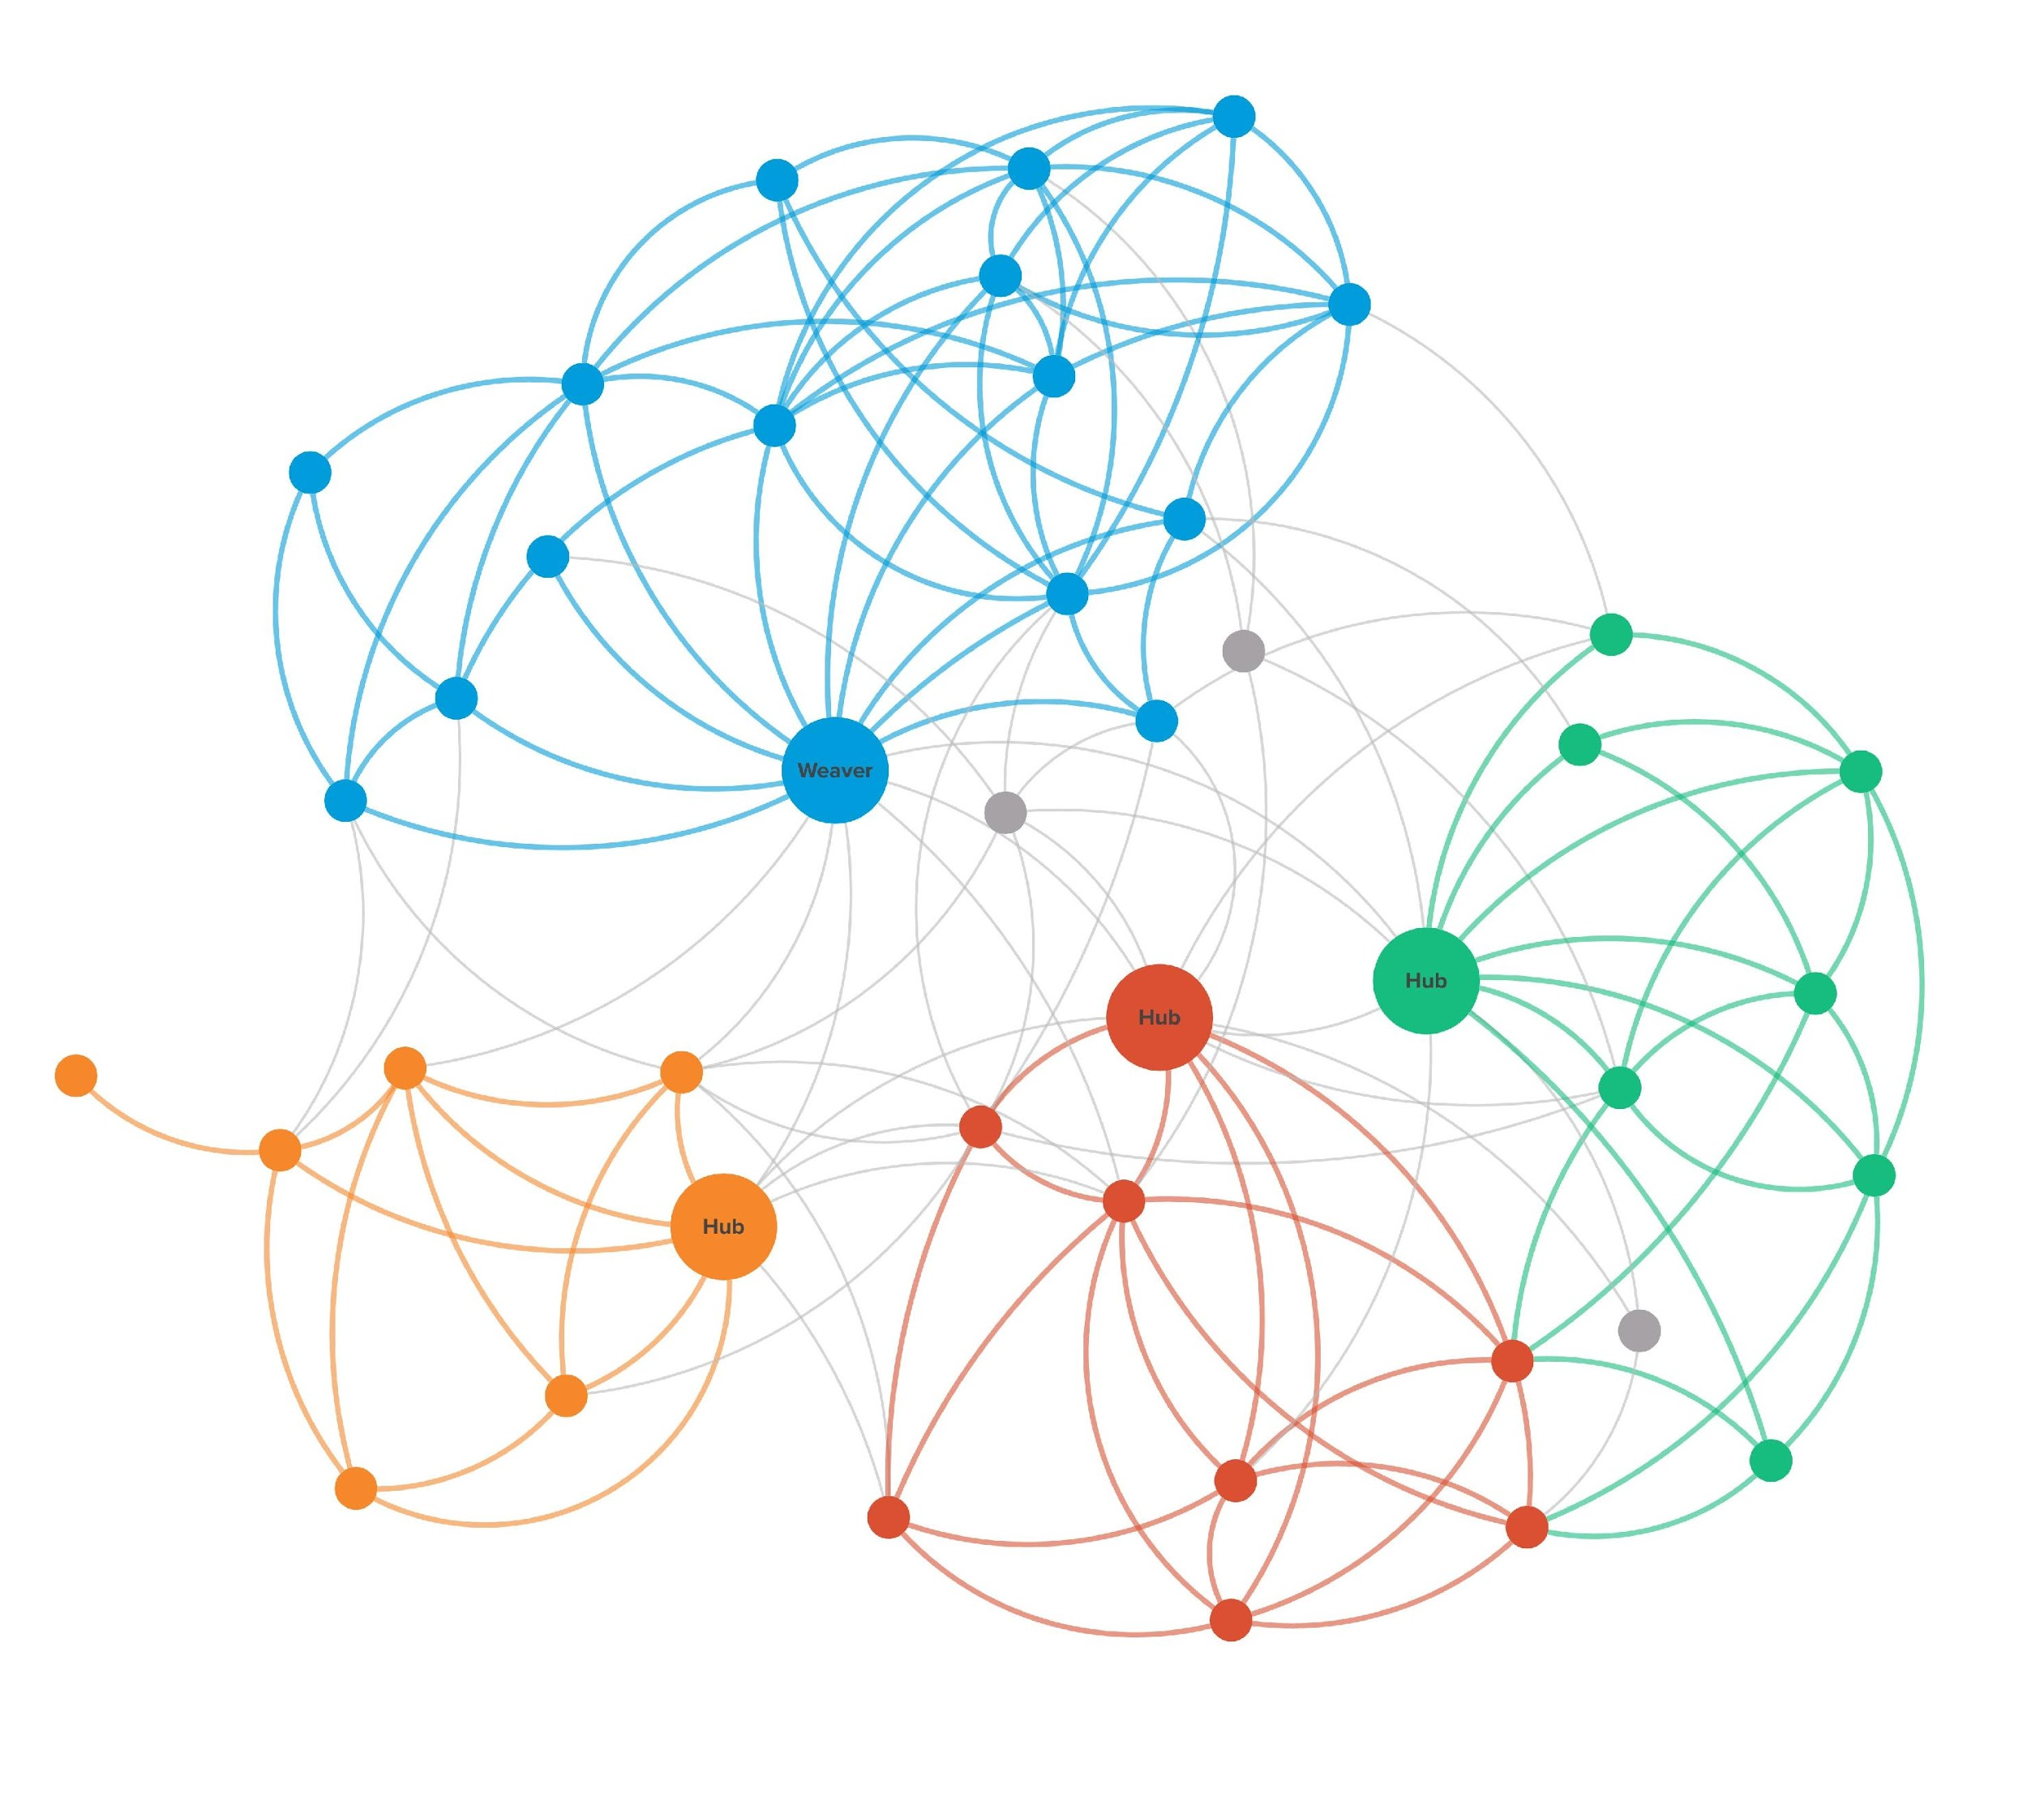
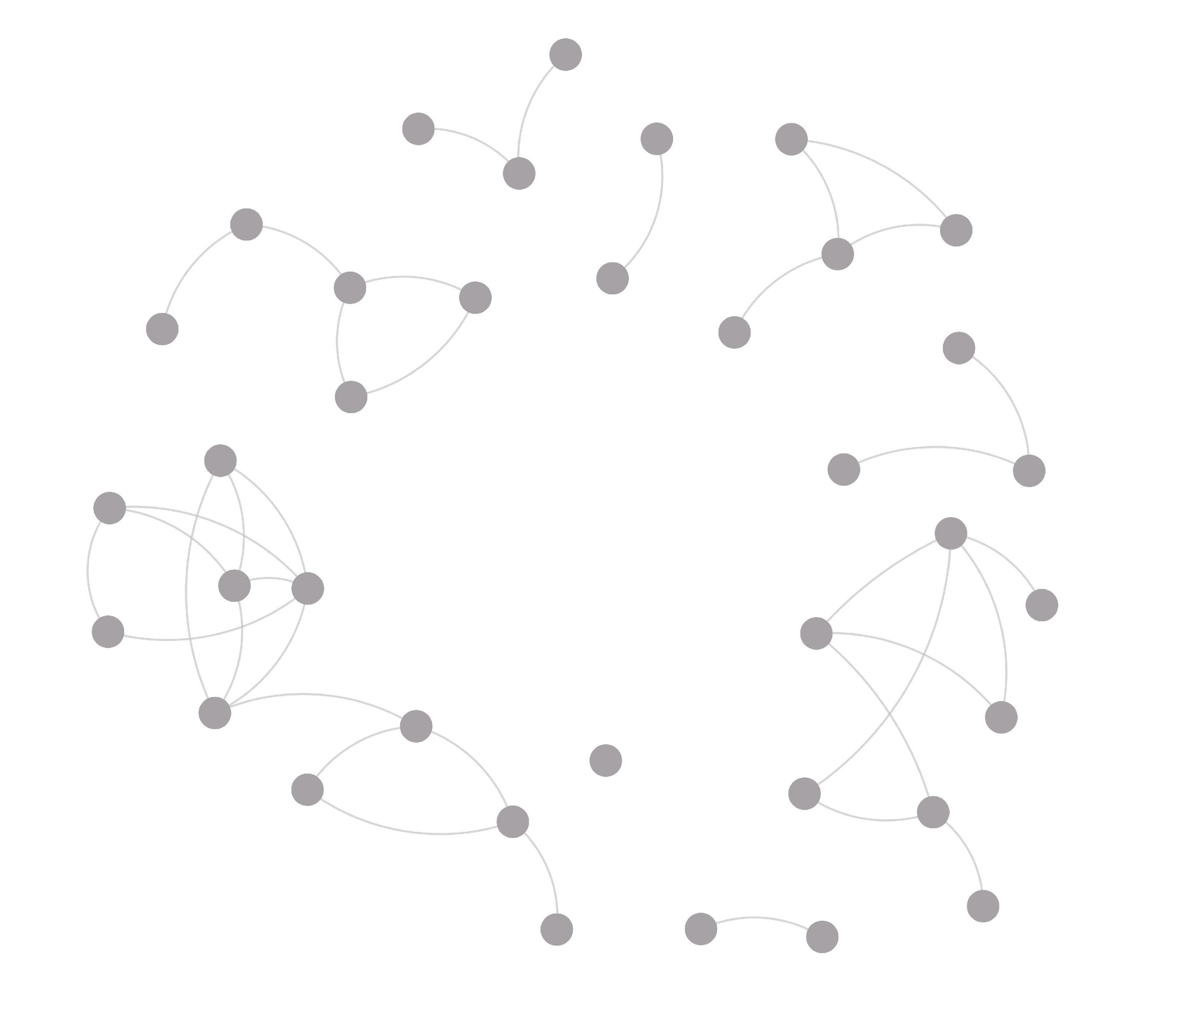
Stages of network development
Scattered clusters
Hub-and-Spoke
Multi-hub
Intentional Collaborative Network
Time
Where most network-building begins
Self-sustaining network
Source of network maps: Jeff Mohr, kumu.io
Notes:
Bill - Networks have definite stages and it often takes a number of years to develop from scratch to a robust community change network. Networks often start as scattered clusters. Then an organization decides to form a network and reaches out to other organizations or individuals. But it’s important not to get stuck at this stage. It’s critical that network weavers connect people to others with similar interests. The most critical stage is the multi-hub stage. This is where network weavers start encouraging people in the network to develop collaborative projects to try out new solutions. We call this self-organizing. This also builds new leadership and expands the network as new people join projects. If there is an adequate network support structure, that helps people learn skills, reflect on what they are doing, and communicate with each other . . . a network can rapidly become a community or systems change network.

Slide 25
Network Mindset
What makes networks different isn’t just their structure . . . it’s how people work together
Notes:
Bill

Slide 26
Leading with a Network Mindset
“Learning to lead with a network mindset is not as simple as acquiring a new skill. Often our deeply held ideas about leadership collide with new ways of leading that are more distributed, relational, and interdependent.
Those who lead with a network mindset practice openness and transparency, let go of controlling processes and outcomes, and believe in the leadership potential of everyone.”
From Networks & Leadership, Deborah Meehan
Notes:
Bill

Slide 27
Values and Principles of Network Leadership
Network leadership has been informed by research conducted by Jan Wei-Skillern. She has identified four principles of collaboration success that network leaders demonstrate:
Trust not control
Humility not brand
Relationships not individuals
Mission not organization
Notes:
Bill

Slide 28
Network Values and Behaviors
DIVERSITY OF VOICES, CULTURES, EXPERIENCE
INTENTIONALLY INCLUSIVE/EQUITY
PEER-BASED
SELF-ORGANIZED ACTION/ACTION-ORIENTED
GROW NEW LEADERS/SUPPORT LEADERS
DECENTRALIZED CONTROL AND LEADERSHIP
EXPERIMENTATION/TESTING/TRYING
LEARNING
SHARING
EXPANDING
SEEK TRANSFORMATION
SYSTEM SHIFTING
Diverse Core
Intentional Collaborative Network
Notes:
Bill - An intentional collaborative network has some very specific characteristics that we have gleaned from studying 100s of networks. These networks have very diverse cores of different types of people with different perspectives, life experiences and expertise.
Such networks are super focused on bringing in people who are often excluded from opportunities to share and decide, often underrepresented.
These networks encourage people to interact as peers and support people to take the initiative to form collaborative projects with others --- which creates many, many more leaders skilled in collaboration.
Such networks are filled with small projects where people take time to look at what they have done, learn from it, and take better next steps. They share what they learn, even their mistakes, with others in the network.
They expand the network by bringing new people into their projects and reaching out to other sectors and other networks. The more they learn and make breakthroughs, the more they can transform and shift the systems they are working to change.

Slide 29
The number one task of network leaders
is to help others become network leaders
Nurturing collaborative action and distributed
networks instead of ownership, competition
and hierarchies
Network leaders transform structural holes into
structural wholes – where are the holes?
Notes:
Bill

Slide 30
BREAKOUT GROUPS
Given what you have heard about networks, how they are structured, and how they evolve over time:
What excites you about developing intentional networks?
How could you apply this information to your work?
What questions do you have so far?
[Open and post in chat if you’d like]
Notes:
KRISTIN - Provide instructions for the breakout groups, roles and the time allocated.
CHAR - Put people into random groups of 5. Send a message at the half way point. Then provide a 1 min wrap up message.

Slide 31
Closing Reflections
Please complete the post-workshop feedback form at this link:
https://www.sli.do/ #networkweaving1
In the chat, please put 1 thing that worked well today (WWW) and 1 thing that could be changed to make it even better if (EBI)
Notes:
Katie will share the link and talk through the post-event feedback process.
Char will share the live results as they are coming in. Char needs to share her screen after participants have begun responding.
Please complete the post-workshop feedback form at this link:
SLIDO LINK
In the chat, please put 1 thing that worked well today and 1 thing that could be changed to make it even better

