Slide 1
Psychological Safety for Improvement
Material produced with support from Q Health Foundation

Slide 2
Psychological Safety for Improvement
A practical guide to help teams and leaders in their improvement work
Notes:
This practical guide focuses on the importance of psychological safety in improvement. It is based on available research and evidence of psychological safety from the last 60 years. It touches on but does not cover the broader rich research/evidence/models of organisational / team effectiveness surrounding organisational change. It can be used with other tools to help leaders, teams and people facilitate or coach for improvement.
Each slide has a take-away message.
The message of the entry point to this presentation would be: Use this guide to help you have the conversations that enable sufficient psychological safety to help teams be creative, innovative and courageous in their improvement work.
This slide deck is animated. In the notes section, each slide contains markers for where we would click when walking an audience through the material.
Moreover, if you go to the View tab and then hit the Notes page button, you’ll get a printable-booklet version of the slide deck in A4 format. The booklet will take you through the psychological safety material – no matter whether you use the guide for learning or (alongside the slide desk) for presenting.

Slide 3
Aims of this Guide to ‘Psychological Safety for Improvement’
To introduce the psychological safety construct
To understand the importance of psychological safety in improvement
To highlight the fundamental need for psychological safety so that teams can work at their best together in their continuous improvement efforts
To offer some suggestions to help leaders to create psychologically safe environments so that teams can focus on improvement work
To offer some tips for people who are facilitating or coaching for improve-ment
Notes:
[The slide is automatically animated. The bullet points appear one by one at a slow pace.]
This guide is constructed as a series of slides with notes to facilitate conversations about the importance of creating psychologically safe environments. These dialogues will enable people to develop/ sustain a mindset for teamwork in either an established team or a team that has come together to focus on a specific improvement endeavour (which include continuous improvements for patient safety, care and outcomes and staff wellbeing).
Take-away message: Psychological safety is a team construct.

Slide 4
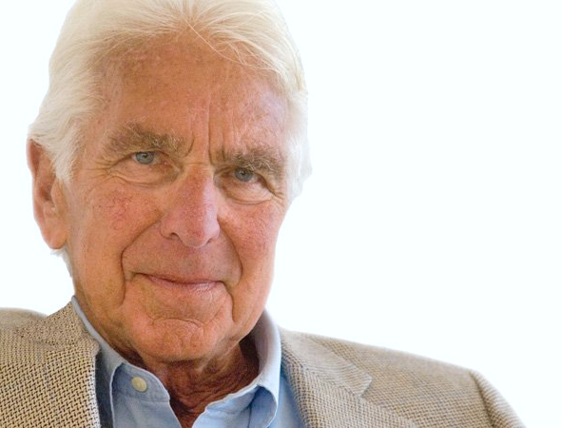
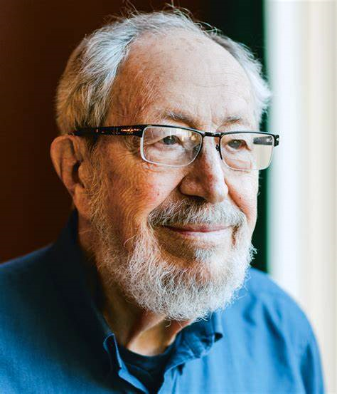
Background
Psychological safety is not a new construct.
However, it is increasingly being recognised as being fundamental to enabling teams to work at their best to deliver safe and effective care and outcomes that matter to patients, families and carers.
Teams who feel they are psychologically safe are more likely to be able to make and sustain improvements in their practice.
Warren Bennis
Edgar Schein
Notes:
[The slide is automatically animated. The bullet points appear one by one at a slow pace.]
Psychological safety is
not a new construct: More than fifty years ago, the concept of “psychological safety” was introduced as a critical factor in helping people learn new behaviours and overcome defensive routines (Schein & Bennis, 1965).
seen as especially important for enabling learning and change in complex contexts which necessitate essential human interaction: Psychological safety today is seen as especially important for enabling learning and change in contexts characterized by high stakes, complexity, and essential human interactions, such as hospital operating rooms (Edmondson, Bohmer, & Pisano, 2001) and intensive care units (Nembhard & Edmondson, 2006).
Take-away message:
Psychological safety is increasingly being recognised as being fundamental to enabling teams to work at their best to deliver safe and effective care and outcomes that matter to service-users, families and carers.
References:
Schein, E. H., & Bennis, W. G. (1965). Personal and Organizational Change through Group Methods: The Laboratory Approach. New York: Wiley
Edmondson A. C., Bohmer, R. M., & Pisano, G. P. (2001). Disrupted routines: team learning and new technology implementation in hospitals. Administrative Science Quarterly, 46(4), 685-716
Nembhard, I. M., & Edmondson, A. C. (2006). Making it safe: the effects of leader inclusiveness and professional status on psychological safety and improvement efforts in health care teams. Journal of Organizational Behavior, 27(7), 941

Slide 5
‘System of Profound Knowledge’
The System of Profound Knowledge is complex. You need to understand the constituent parts of this system and how the constituents interact to be able to facilitate lasting improvement; the core to this is understanding the psychology of change.
Paramount is to have an appreciation for how the parts are interconnected.
Appreciation of a system
Human Behaviour
Variation
Theory of Knowledge
(Deming 1994, Neave 1990)
Notes:
[The slide is automatically animated.]
We need all to understand all 4 components of the System of Profound Knowledge to garner improvement. Psychology for change (or Psychology 4 Improvement) is the means to do that.
Take-away message: “The system of profound knowledge provides a lens. It provides a new map of theory by which to understand and optimize our organizations.” (Deming, Out of the Crisis) You may like to read or refer to:
Deming, E. W. (1994). The New Economics for Industry, Government, Education.. Cambridge, Massachusetts: Massachusetts Institute of Technology. AND Neave, H. R. (1990). Deming ‘88’. Part 3: The 14 Points Revisited (Points 8-14). Total Quality Management, 1 (3), 293-308
Then start introducing the next slide: “What is traditionally very prominent in improvement seminars is variation and, indeed, its understanding is vital before we make any changes.
Just think of, say, Auntie Anna’s heart rate. Would we expect it to be precisely 60bpm every time we check it? No, that would be weird. We’d expect a bit of a variation, and if we monitored it over time, we could work out what’s normal for Anna. But what would we do if we checked the heart rate one day and it was 120bpm? Would you recommend Anna immediately start taking medication or make a drastic lifestyle change based on this single measurement? No – we would try to find out why it was 120 in the first place. Was Anna running around in the garden or up the stairs before taking the measurement? However, what if the heart rate remained at about 120 for a sustained period? Then we’d need to take some action. -- Understanding variation helps us know what measurements are noise and what measurements are signals. Understanding the nature of the variation tells us whether we should be making changes and where we should focus our improvement efforts. This relates to answering the question: Do some patients, wards, teams etc., have different outcomes to others?

Slide 6
How do different systems work & how do they interact with each other?
Who is involved in this system? Where are the bottlenecks/ delays? Where are the areas that work well? Where is care below expectations?
Appreciation of a system
Human side of change
Appreciation of a system
What differences do we observe
in service user needs?
in how services operate?
What do we know about patterns in out- and throughputs, processes and performance over time?
Do we have data to identify patterns and draw conclusions on their significance?
What do different people want to achieve? Who has power & influence? What are peoples’ extrinsic and intrinsic motivators to resist change? Where does it come from and whose support for change is likely?
QI
Human Behaviour
Variation
Theory of Knowledge
Understanding variation
Building knowledge
What evidence exists for good practice? What do you/ the team/ service users think is causing the problems with the knowledge you have of your system? What ideas for change exist locally and what are the theories behind them? This relates to building knowledge through learning from success and failure.
Notes:
[The slide is animated and requires 3 clicks to bring in the descriptions and the puzzle pieces one by one. It automatically starts with VARIATION, then by click BUILDING KNOWLEDGE appears, then by click APPRECIATION OF THE SYSTEM.]
A second prominent issue relates to the KNOWLEDGE we gather about the improvements we want to make. Is there already good evidence that we can draw on? Do people have their own theories about changes that can be made? We can use the QI methodology of PDSA cycles to test out ideas on a small scale and build knowledge about what works step by step.
[click]
It is vital for improvement to understand how the SYSTEM of concern operates. Healthcare systems are not linear (= A implies B, B implies C, and C has no impact on A). Some parts may be very efficient, while others are clunky. Some parts may be impacted by another service. If you change one part of your system, you might have a significant impact elsewhere. Often in healthcare, improvement involves adding something new to a system or tweaking something existing a tiny bit. All of these interventions could have limited influence or make things more complex. By investing in understanding the system, we are trying to work out where we can simplify, increase efficiency and find root causes.
[click]
Why HUMAN BEHAVIOUR? It is essential to consider human behaviour because this impacts how we engage with improvement work. A little thought experiment: If we were going out for dinner and there was a choice of two restaurants, we would possibly look at the online reviews. One place scores 5* for food and 3* for atmosphere. The other score is 5* for atmosphere and 3* for food. Who would choose restaurant 1? Who would instead go to restaurant 2? Anyone looks at different factors when choosing a restaurant. How pricy is the place? Does it involve leaving my local area? What if there was a last-minute change of plan? Would I feel OK with that? Who might feel a bit irritated because they’d have planned their route and already looked at the menu and chosen what they want? Who would feel safe enough to speak up? … and all these questions are only about a night out at a restaurant! Can you imagine how complexity increases when we talk about a full-blown improvement project?
People have different motivations, expectations and reactions to change. At the start of an improvement project, we need to understand all of this to make sure we are working towards a joint goal, a shared understanding of what quality would look like. So we can bring people who may be more anxious about change along with us on the journey and avoid that lack of psychological safety will negatively impact work.

Slide 7
Why is Psychological Safety important?
Psychological safety minimises fear and enables people to be and work at their best in their teams to deliver safe and effective care.
Because …
… ‘the problems fear creates result in bad data, ineffective decision making and the destruction of joy in work.’ (Deming Institute)
Notes:
[The slide is automatically animated.]
Psychological safety is vital given it is a key cognitive state that allows learning processes to occur and contributes to improved work outcomes at different levels of analysis (Edmondson, 1999; Edmondson et al., 2007).
Psychologically safety is essential in work environments where employee and customer safety are paramount, such as healthcare. Here it has shown to be critical in reducing employee errors and enhancing safety (Leroy et al., 2012; Nembhard & Edmondson, 2011) and increasing team and individual learning across multiple organizations (e.g., Liu, Hu, Li, Wang, & Lin, 2014; Ortega, Sanchez-Manzanares, Gil, & Rico, 2010).
Emphasise that Deming’s quote summarises that fear doe not only deteriorate the process of learning but also the data basis for learning!
This topic will be continued on the next slide – hence no take-away ;)

Slide 8
Neither psychological safety is a ‘nice to have’ nor something ‘soft and fluffy’. It requires inclusive leadership to create an environment in which teams can flourish to deliver safe and effective patient care. That is, leadership that draws on the qualities of kindness and humility and the core skills of listening and asking open questions.
‘How very little can be done under the spirit of fear.’ (Florence Nightingale)
This quote shows that psychological safety is not a new phenomenon. We have a responsibility to help create environments within which people can flourish and focus on delivering excellent care and feel joy at work. Creating psychological safety enables us to achieve this.
Notes:
[The slide is animated and requires 1 click.]
In the contemporary business world, organisations are increasingly requiring their employees to contribute to the continuous improvement of processes and practices through behaviours that enable learning (e.g., voicing new ideas, collaborating with other members of the organisation, and experimenting with new ways of doing things; Edmondson, 1999; Nembhard & Edmondson, 2011).
While such activities may potentially benefit the organisation, they carry certain risks for the individual. For example, the voicing of new ideas might challenge the established way of doing things and go against the vested interests of other members of the organisation (Detert & Burris, 2007; Edmondson, Bohmer, & Pisano, 2001). In addition, experimentation with new approaches in the workplace might ultimately be unsuccessful, viewed as a failure, and lead the individuals involved to be seen in a negative light (Van Dyne & LePine, 1998).
As a result, growing evidence indicates that such risks may lead employees not to contribute to learning processes and thereby inhibit both individual and organisational learning (Detert & Burris, 2007).
[click]
Share what we know since the mid 1800s. We have to take care of our workforce.
Take-away message: Psychological safety is being discussed more explicitly. It is a crucial comment of the NHS national patient safety strategy. This is an excellent opportunity to help teams have conversations that could at times be uncomfortable but necessary so that they can focus on what matters to patients, carers, families and staff.

Slide 9
The effect of Psychological Safety
Research tells us that when psychological safety is high,
nurses speak about errors more often.
people are more committed to the organisation and to patient safety.
there is a reduction in work-arounds.
team-based learning in QI is more likely to happen.
engagement and performance is more likely to be high.
organisations are more able to learn from failure.
Notes:
[The slide is not animated.]
When doing improvement work, it is crucial to have sufficient psychological safety.
We speak of a psychologically safe environment when employees feel safe to voice ideas, willingly seek and provide honest feedback, collaborate, voluntarily take risks and experiment.
Then people can learn, “fail” quickly and succeed in making and sustaining positive changes to enable the best patient safety, patient care, patient outcomes and staff wellbeing.
Providing a psychologically safe work environment is one way to overcome barriers to individual and organisational learning (Edmondson, 1999). Possibly watch Amy Edmondson on the topic: https://www.youtube.com/watch?v=SkFohYhIaSQ
Take-away message: Sufficient psychological safety is the essential foundation for improvement and effective teamwork.

Slide 10
Project ‘Aristotle’
Research carried out by Google
‘The five keys to a successful Google team’ by J Rozovsky
Psychological Safety
Team members feel safe to take risks and be vulnerable in front to others.
Dependability
Team members get things done on time and meet Google’s high bar for excellence.
Structure & Clarity
Team members have clear roles, plans and goals.
Meaning
Work is personally important to team members.
Impact
Team members think their work matters and creates change.
https://www.nytimes.com/2016/02/28/magazine/what-google-learned-from-its-quest-to-build-the-perfect-team.html
1
2
3
4
5
Notes:
[The slide is not animated.]
Recent longitudinal work by Google’s People Analytics Unit led to five distinctive metrics that significantly affect team performance. Psychological safety is the essential element -- it was identified as the number one characteristic of successful high-performing teams (Bergmann & Schaeppi, 2016).
The other four factors of team effectiveness only prove to be valuable once a team is psychologically safe.
Take-away message: Learning from this study can be translated into healthcare settings. We know from other research that teams are more likely to feel enabled to focus on improvement if the five elements from the Google study are positively rated.

Slide 11
How to pin down Psychological Safety
Definition
“The belief that the work environment is safe for interpersonal risk taking and that people feel able to speak up with relevant ideas, questions, concerns or mistakes without fear of being punished or humiliated.”
(Edmondson 2018)
TED Talk: Amy Edmondson on Psychological Safety
https://www.youtube.com/watch?v=LhoLuui9gX8
Notes:
[The slide is not animated.]
Take-away message: For some people, psychological safety sounds incredibly fluffy. It is not. It relates to a culture of respectful disagreement and raising important issues. It is not meant to whitewash chronic complainers and those who like to argue. It intends to remove the fear of having to face negative consequences when speaking up.

Slide 12
Psychological Safety and Accountability
High
Comfort Zone People enjoy working together, don’t feel very challenged, seldom work very hard | Learning Zone Focus on collaboration, learning and improvement
Apathy Zone People tend to fulfil function of their role and not very motivated to work collaboratively, may jockey for position rather than focus on shared goals | Anxiety Zone People don’t feel safe to offer ideas for fear of ridicule, getting “it” wrong, afraid to ask for help
Psychological Safety
Low
(Edmondson 2012)
Accountability & Motivation
Low
High
Notes:
[The slide is animated and requires 1click.]
Amy Edmondson suggests that spontaneous human co-operation is key in Volatile, Unpredictable, Complex, Ambiguous (VUCA) environments. She calls this ‘teaming’ – a dynamic activity determined by mindset rather than design and structures of effective teams. A team’s mindset is essential in improvement work as most healthcare services are delivered by complex MDTs across a disjointed system. A teaming mindset is an enabler of improvement.
[click]
When ‘teaming’ works, it builds trust instantaneously out of necessity. Psychological safety is the condition that enables this to occur. There are many innovative examples of this. We observed innovations throughout the pandemic when people came together to solve problems and make improvements, using QI methodology across systems such as patient and staff Covid testing and vaccinations.
Take-away message: Leaders and facilitators/team coaches for improvement have a role to help a team think about what allows them to be in the learning zone (to focus on their improvement work). You can use tools such as Edmondson’s 7 questions for psychological safety and the Psychological Safety Index (PSI), referenced in the following slides. However, the skill is in helping the team have conversations that enable them to improve their sense of psychological safety to feel empowered to focus on learning and improvement without fear. Within our complex working environments, it is not surprising that teams move around the zones. What is important to understand is what pushes a team into a particular zone, how they need to be, how they can use their learning about how safe they feel and what they may want to do differently to move between zones. This framework has been used successfully in practice to help create a level playing field and for teams to surface difficulties that have been barriers to working together for improvement (such as power, inequality and inequity). Having the courage to have the conversations has helped teams to overcome barriers and focus on improvement and delivery of clinical services.

Slide 13
Tools to help teams assess their level of psychological safety
Edmondson’s 7 questions
How safe is it to take a risk on this team? – Please, read the notes below for instructions on how to effectively use Edmondson’s scale.
If you make a mistake in your team, is it held against you?
Are you able to bring up problems and tough issues?
Do people on the team sometimes reject others for being different?
Is it safe to take a risk?
Is it difficult to ask other team members for help?
Do people on the team deliberately act to undermine your efforts?
Are your unique skills and talents valued and utilised?
Tool 1
(Edmondson 1999)
Notes:
[The slide is not animated.]
Edmondson’s scale is designed for use by individuals to be completed anonymously, then results aggregated for the team and used for team discussion. Using it as a group discussion where people feel unsafe will not facilitate honest answers. Questions are taken from
Edmondson A (1999): Psychological Safety and Learning Behavior in Work Teams. Administrative Science Quarterly, 44, 350-383.
Take-away message: Using a coaching approach (either as a leader or an improvement facilitator/coach) when facilitating the team discussion can help because it assists in staying curious and suspending judgement. This allows the team to be at their most resourceful level to do the work. The unit can be creative and courageous.

Slide 14
Open Conversation
The Psychological Safety Index (PSI) tool can be utilised as an approach to help teams have a conversation to optimise the ability to be in the Learning Zone.
Tool 2
Willingness to Help
Inclusion & Diversity
Definition
Teams become unsafe when people are not able to help each other or feel appreciated by team members.
Definition
When team members feel included, they are more inclined to speak up, contribute and add to the group.
Attitude to Risk & Failure
Definition
Teams that hold mistakes against each other risk a lack of control and forward momentum.
Definition
A team that has open and candid conver-sations is able to tackle hard problems better.
http://fearlessorganisation.com
Notes:
[The slide is not animated.]
This is one of several tools you can use to help frame the conversation when working with a team to prepare for improvement work. Emphasise tat the PSI tool comes with a cost!
Take-away message: The skill is how you approach the exercise. Using a coaching approach (either as a leader or an improvement facilitator/coach) can help because it assists in staying curious and suspending your judgement. This allows the team to be at their most resourceful level to do the work. The unit can be creative and courageous.

Slide 15
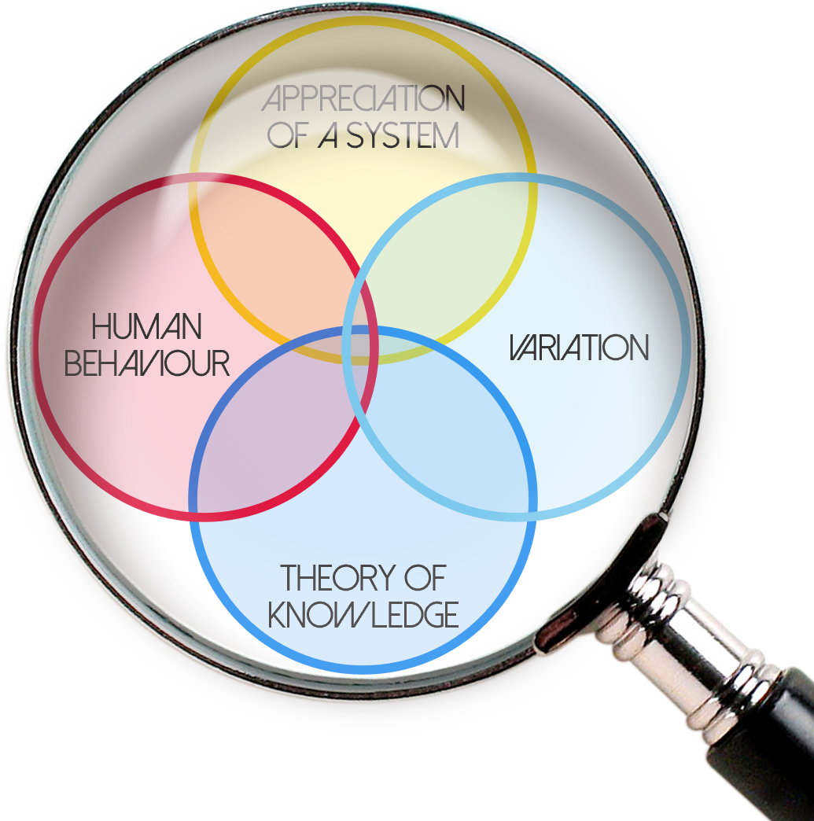
To summarise, psychologically safe work environ- ments are a necessity for improvement as they …
encourage speaking up without concern about how others react to you.
enable clarity of thought because there is no fear which impedes thinking.
support productive conflict which enables more timely conversations to surface differences to enable effective decision-making and action.
mitigate failure leading to earlier reporting of errors and more timely learning.
promote innovation and encourage novel ideas.
reduce learning anxiety which encourages learning behaviours and, where needed, changes in practice.
reduce survival anxiety and motivate people to focus on the achievement of performance goals and removing obstacles to pursuing these goals.
increase accountability and enable people to be candid and take interpersonal risks.
(Schein 1999, Edmondson 2018)
Notes:
[The slide is not animated.]
Take-away message: Leaders, team members and facilitators/coaches all have a responsibility to think about what they bring into the team space, how the team needs to be and what the team needs to do to create a sense of psychological safety so that it can focus on the improvement efforts in service of their communities.

Slide 16
So how does the creation of a psychologically safe environment help with improvement work?
Psychological safety is critical for established teams that know each other well with clear boundaries and structures.
It is also critical for what Amy Edmondson calls “teaming”, i.e., working with teams of people who are organised around a temporary purpose (e.g., a shift, a project).
TED talk on teaming:
How to turn a group of strangers into a team | Amy Edmondson - YouTube
Appreciation of a system
Understanding variation
Human side of change
Building knowledge
Notes:
[The slide is not animated.]
Refer back to slide 8.
Take-away message: Creating psychological safety is worth the time and effort as the pay-off is huge for patients, carers, families and staff.

Slide 17
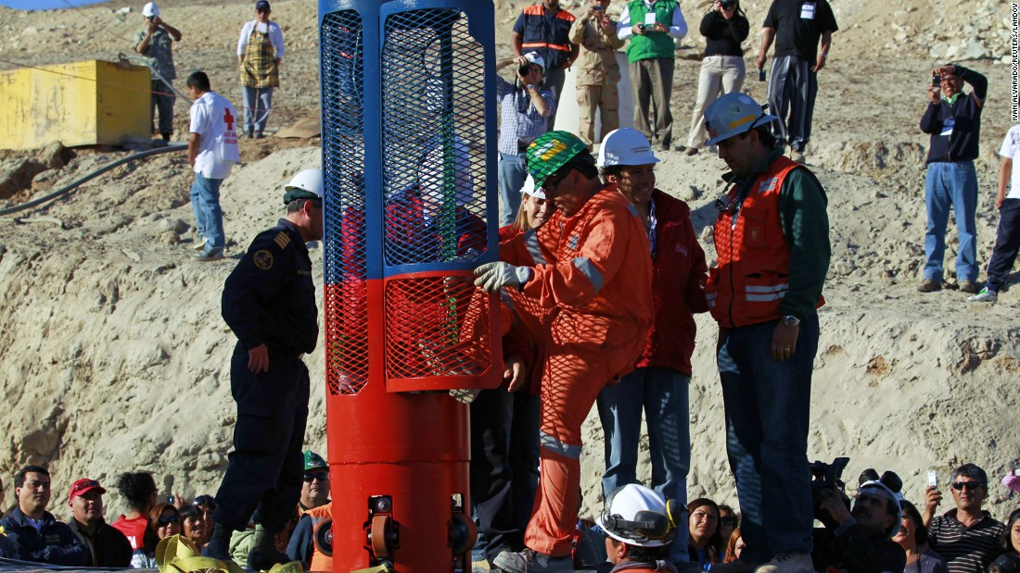
Notes:
[The slide is not animated.]
This is the team that came together to rescue the Chilean miners.
You made like to read of the story from March 2012 here: https://knowledge.wharton.upenn.edu/article/the-chilean-miner-rescue-a-lesson-in-global-teamwork/

Slide 18
What leaders can do to create a psychologically safe environment in which individuals and teams can flourish
Be visible, curious and approachable – it encourages productive conversations.
Demonstrate humility by admitting lacking of knowledge and asking open questions.
Be open and willing to display fallibility & acknowledge failures – it will help others speak up.
Value active participation from staff, service users & carers – it facilitates engagement.
Use straightforward language – it encourages clarity and enables learning.
Set boundaries, be clear about what is acceptable & what not – it helps people to feel safe.
Hold people accountable – this facilitates follow through.
Frame work as learning problems, as opposed to execution problems – it reduces fear and deepens the learning.
(Schein 1999, Edmondson 2018)
Notes:
[The slide is not animated.]
A growing body of research at both the individual and team level has examined the effects of supportive leadership behaviours on work outcomes through psychological safety. For example, at the individual level, empirical work has established that leader inclusiveness (Bienefeld & Grote, 2014; Carmeli et al., 2010), support (May et al., 2004), trustworthiness (Madjar & Ortiz-Walters, 2009), openness (Detert & Burris, 2007) and behavioural integrity (Palanski & Vogelgesang, 2011) strongly influence employee perceptions of psychological safety, which in turn, drive employee outcomes including voice behaviours, involvement in creative work, job performance and engagement. Similarly, at the team level, employees’ collective perceptions of support and coaching forwarded by the team leader (Edmondson, 1999; Roberto, 2002), leader inclusiveness (Hirak et al., 2012; Nembhard & Edmondson, 2006), trust in the leader (Li & Tan, 2012; Schaubroeck, Lam, & Peng, 2011), and the behavioural integrity of the leader (Leroy et al., 2012) have been found to foster team-level outcomes such as team learning behaviour, team performance, engagement in quality improvement work, and reduction in errors amongst team members through the development of psychological safety. Other work has found that positive leadership styles such as transformational leadership (Nemanich & Vera, 2009), ethical leadership (Walumbwa & Schaubroeck, 2009), change-oriented leadership (Ortega, Van den Bossche, Sanchez-Manzanares, Rico, & Gil, 2014) and shared leadership (Liu et al., 2014) are positively and strongly related to such outcomes as employee voice behaviour, team learning, and individual learning through the mediating mechanism of psychological safety.
Based on social learning theory (Bandura, 1977), researchers have argued that by listening, forwarding support, and providing clear and consistent directions to subordinates, the leader can model to subordinates that it is safe to take risks and engage in honest communication (e.g., Hirak et al., 2012; Liu et al., 2014; Nemanich & Vera, 2009; Walumbwa & Schaubroeck, 2009).
Take-away message: Leadership is key to establishing & maintaining psychological safety, particularly role modelling inclusivity, risk-taking, fallibility & honest communication.

Slide 19
Your leadership style is key to build psychological safety …
Humility
Frame the work
Curiosity
Invite Engagement
Empathy
Respond Productively
Humility: Framing the work builds shared understanding of the complex, uncertain, novel nature of the work, making it clear why everyone’s voice matters.
Curiosity: Inviting engagement is about asking good questions and seeking divers perspectives.
Empathy: Responding productively means appreciation, listening and focusing forward.
adapted from Amy Edmondson
Notes:
[The slide is not animated.]
Take-away message: Your leadership style is crucial. It’s not about being perfect. It’s about reflecting on the impact you have in your team. A level of emotional intelligence is key, and there are many resources you can use to help reflect on your style, and whether it is serving you, the team and your improvement work well.
A very accessible resource by Louise Evans (20 min TED talk) may help you in your reflections: https://www.bing.com/videos/search?q=louise+evans+own+your+behaviors&view=detail&mid=127032EEEFE62DFC632B127032EEEFE62DFC632B&FORM=VIRE

Slide 20
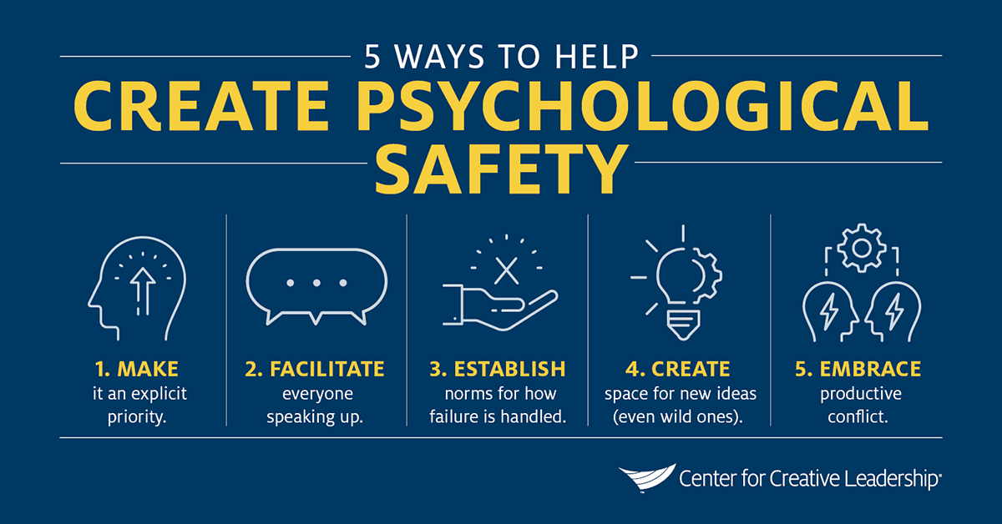
Notes:
[The slide is not animated.]
This slides helps to make things more concise. Humility, (honest) curiosity and empathy are key – still it helps to have a strategy relating not only to the necessary mindset but also to some actions. Please note that actions never replace the mindset and the associated leadership style.
The infographic is taken from https://www.ccl.org/articles/leading-effectively-articles/what-is-psychological-safety-at-work/.
Take-away message: This slide gently takes the audience for the discussion of the mindset of leaders to some questions to be asked if you want to encourage your team (or a team) to open up.

Slide 21
Some simple questions asked by a leader …
… can help individuals begin to dip their toes in the water and realise it’s a puddle and not a deep pool. The realisation enables these individuals to take a risk and begin to feel a (little more) psychologically safe. Leaders need to feel able to role-model this.
Acknowledge your vulnerability! | Offer your time to really listen and ask simple powerful questions!
I don’t know. | What would help?
I need help. | How can I help?
I have failed. | What have you learned?
I have made an error. | What is the learning, what do you need to do?
I am sorry. | What can we do differently?
I have learned. | How can we share this learning?
(adapted from Edmondson 2019)
Notes:
[The slide is not animated.]
Take-away message: Good open short questions for leaders, team members and or facilitators/coaches to ask; can open up conversation and help to create a positive, safe space for learning and improvement.

Slide 22
Some more simple questions
Curiosity − inviting engagement Empathy − Respond productively | Offer your time to really listen and ask simple powerful questions!
Be fully present and listen without distraction. | I wonder if you can tell me more?
No “preaching, politicking, prosecuting”. | That is so interesting, how did you come to that view?
Hold the neutral space. Are you preoccupied with your own issues if so take a few minutes to focus? | Reflect back what you have heard, e.g., and so you said you think? Feel??
Be aware of your assumptions and check they are not getting in the way of you listening. | What do you think? Can I check what I think I have heard?
Help the person you are working with to test their assumptions. | What might other team members say if they were in the room with us?
(Schein 1999, Kegan & Lahey 2009, Kline 2015, Evans 2021, Grant 2021)
Notes:
[The slide is not animated.]
Take-away message: More again, good open short questions for leaders, team members and or facilitators/coaches to ask can open up conversation and help create a positive, safe space for learning and improvement. Using a coaching style is super helpful, and it will make that level playing field that encourages equality and equity.

Slide 23
Theory of Change
Based on experience and research, if the following principles and practices are adopted, we can expect a positive impact on:
Clinical outcomes – honest and open conversations support more robust decision-making in relation to care provision
Safety – more timely reported errors, thereby reduction of serious incidents
Teamwork – people raising concerns with their teams and managers rather than externally, thereby reduction of grievances and incidents of whistleblowing
Patient satisfaction – patients and staff engage in discussions about care provision
Staff satisfaction – reflected in the staff survey results in terms of engagement, support, morale, inclusivity and retention
Notes:
[The slide is not animated.]
Take-away message: This theory of change has been developed based on research we reviewed and on experience, feedback and results of working with teams to achieve improvements.

Slide 24
And so to what end should there be a focus on psychological safety for improvement?
Appreciation of a system
It helps to build a mindset for teamwork which encourages teams to
speak up.
check assumptions.
collaborate.
experiment.
reflect.
fail well.
learn and continue to improve.
focus on results.
(Covey 2006; Schein 2013; Kings Fund 2015; Edmondson 2020)
Human side of change
Understanding variation
Building knowledge
Notes:
[The slide is not animated but transitions into the next one to show what is the outcome of creating psychological safety looks like. I.e. without psychological safety it is unlikely bringing the four components of Profound Knowledge together.]
Take-away message: It's not about being perfect, and it's about everyone being fully present and willing to learn. Leaders need to have humility, exquisite listening and questioning skills. High levels of psychological safety are likely to lead to engaged staff with high levels of well-being, who are improving and delivering safe care. The resulting better patient experience will lead to better outcomes.

Slide 25
And so to what end should there be a focus on psychological safety for improvement?
It enables people to learn without fear and to achieve positive change by using improvement methodology effectively.
It helps to build a mindset for teamwork which encourages teams to
speak up.
check assumptions.
collaborate.
experiment.
reflect.
fail well.
learn and continue to improve.
focus on results.
(Covey 2006; Schein 2013; Kings Fund 2015; Edmondson 2020)
Appreciation of a system
Understanding variation
Human side of change
Building knowledge
Deming’s System of Profound Knowledge
Notes:
[The slide is not animated.]
Take-away message: It's not about being perfect, and it's about everyone being fully present and willing to learn. Leaders need to have humility, exquisite listening and questioning skills. High levels of psychological safety are likely to lead to engaged staff with high levels of well-being, who are improving and delivering safe care. The resulting better patient experience will lead to better outcomes.

Slide 26
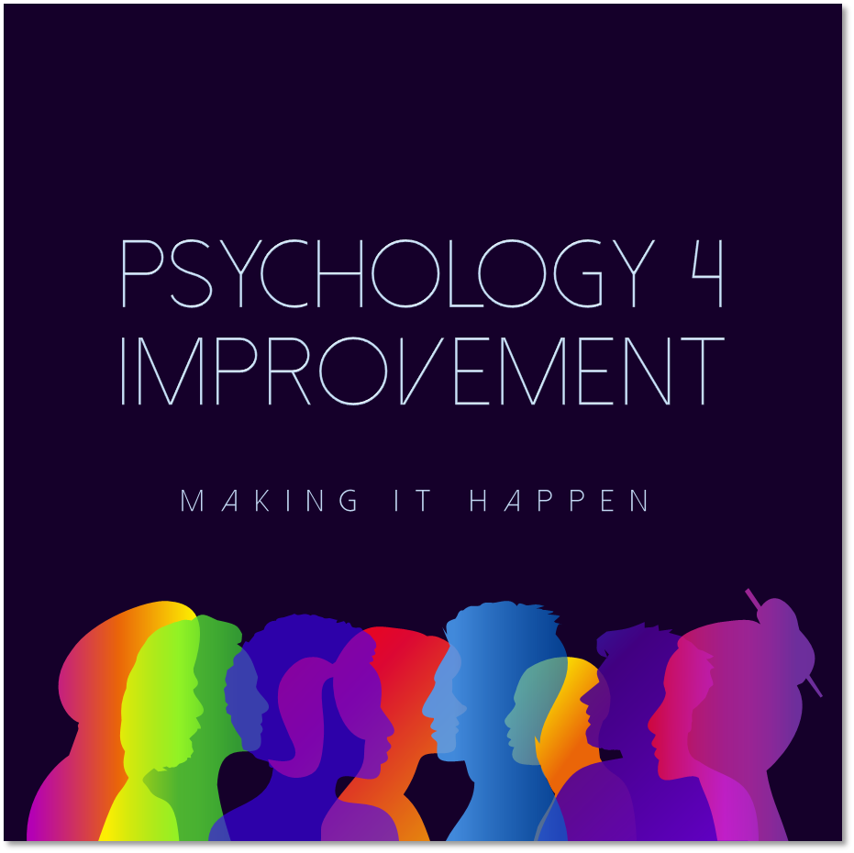
Notes:
Thank you guys – and have fun on the learning journey!
We provide additional material to complement the slide deck which is available via the QCommunity website:
REACH Coaching framework
Building Safer Spaces booklet

Slide 27
Reading & Resource list
A little appendix for keen learners
Notes:
Material compiled by Anna Lewis, doctoral research student at Swansea University and P4I steering group member

Slide 28
Psychological Safety and Quality Improvement
Reading and Resources List
The psychology 4 improvement is a wide-ranging field, within which there is the concept of psychological safety – a willingness to take interpersonal risk at work. QI is all about learning together as a team. We can’t learn if we don’t feel safe with each other to raise ideas or concerns or simply to contribute.
This list of reading and resources is split according to different needs so that you can access what is most relevant to you. It is suitable for anyone who has an interest in QI. This is a growing subject area, so if we’ve missed something that you’d like to recommend to others, just let us know and we’ll add it.
A. Easily accessible resources (mostly free of charge online)
Videos
Edmondson A. | TEDx Talk – Building a psychologically safe workplace (2014) https://www.youtube.com/watch?v=LhoLuui9gX8 TED Talk - How to turn a group of strangers into a team (2017) https://www.ted.com/talks/amy_edmondson_how_to_turn_a_group_of_strangers_into_a_team?utm_campaign=tedspread&utm_medium=referral&utm_source=tedcomshare
Podcasts
Psychological safety in teams – a leader’s perspective. Currently six episodes with a different leader each time. Many other podcasts cover psychological safety as a single episode – just search within your podcast app and see what comes up. Here’s an example from HBR IdeaCast ‘Creating Psychological Safety in the Workplace’ (22 Jan 2019).
Articles & papers
Edmondson A. (1999) | Psychological safety and learning behaviour in work teams (the original Edmondson paper – not free) https://journals.sagepub.com/doi/abs/10.2307/2666999
Duhigg C. (2016) | What Google learnt from its quest to build the perfect team https://www.nytimes.com/2016/02/28/magazine/what-google-learned-from-its-quest-to-build-the-perfect-team.html
Notes:
Material compiled by Anna Lewis, doctoral research student at Swansea University and P4I steering group member

Slide 29
Guidance
Hilton K. & Anderson A. (2018) | IHI Psychology of Change Framework http://www.ihi.org/resources/Pages/IHIWhitePapers/IHI-Psychology-of-Change-Framework.aspx | IHI Psychology of Change Framework http://www.ihi.org/resources/Pages/IHIWhitePapers/IHI-Psychology-of-Change-Framework.aspx
Lucas B. (2015) | The Habits of an Improver. The Health Foundation https://www.health.org.uk/publications/the-habits-of-an-improver | The Habits of an Improver. The Health Foundation https://www.health.org.uk/publications/the-habits-of-an-improver
NHS Horizons (2021) | A practical guide to the art of psychological safety in the real world of health and care http://horizonsnhs.com/wp-content/uploads/2021/06/A-practical-guide-to-the-art-of-psychological-safety-in-the-real-world-of-health-and-care-.pdf | A practical guide to the art of psychological safety in the real world of health and care http://horizonsnhs.com/wp-content/uploads/2021/06/A-practical-guide-to-the-art-of-psychological-safety-in-the-real-world-of-health-and-care-.pdf
Books
Edmondson A. (2019) | The Fearless Organisation – Creating psychological safety in the workplace for learning, innovation & growth (book) www.fearlessorganization.com (incl. free PS organisational scan)
Reitz M. & Higgins J. (2019) | Speak Up. Say what needs to be said and hear what needs to be heard
Clark T.R. (2020) | The Four Stages of Psychological Safety
B. Academic publications (often requires database access which you may be able to get through your employer or university)
Albritton, J. A., Fried, B., Singh, K., Weiner, B. J., Reeve, B., & Edwards, J. R. (2019). The role of psychological safety and learning behavior in the development of effective quality improvement teams in Ghana: an observational study. BMC Health Services Research, 19(1), 385
Aranzamendez, G., James, D., & Toms, R. (2015). Finding Antecedents of Psychological Safety: A Step Toward Quality Improvement. Nursing Forum, 50, 171-178.
Carmeli, A., & Gittell, J. H. (2009). High-quality relationships, psychological safety, and learning from failures in work organizations. Journal of Organizational Behavior, 30(6), 709-729
Notes:
Material compiled by Anna Lewis, doctoral research student at Swansea University and P4I steering group member

Slide 30
Choo, A. S., Linderman, K. W., & Schroeder, R. G. (2007). Method and psychological effects on learning behaviors and knowledge creation in quality improvement projects. Management Science, 53(3), 437-450
Curry, L. A., Brault, M. A., Linnander, E. L., McNatt, Z., Brewster, A. L., Cherlin, E., Flieger, S.P., Ting, H.H., & Bradley, E. H. (2018). Influencing organisational culture to improve hospital performance in care of patients with acute myocardial infarction: a mixed-methods intervention study. BMJ Quality & Safety, 27(3), 207-217
Dixon, N., & Wellsteed, L. (2019). Effects of team-based quality improvement learning on two teams providing dementia care. BMJ Open Quality, 8(2)
Edmondson, A. C. (1999). Psychological safety and learning behavior in work teams. Administrative Science Quarterly, 44, 350-383
Edmondson A. C., Bohmer, R. M., & Pisano, G. P. (2001). Disrupted routines: team learning and new technology implementation in hospitals. Administrative Science Quarterly, 46(4), 685-716
Edmondson, A. C., & Mogelof, J. P. (2005). Explaining psychological safety in innovation teams: Organizational culture, team dynamics, or personality? Creativity and Innovation in Organizational Teams, 109-136
Edmondson, A. C., Higgins, M., Singer, S., & Weiner, J. (2016). Understanding Psychological Safety in Health Care and Education Organizations: A Comparative Perspective. Research in Human Development, 13, 65-83
Gibson, R., Armstrong, A., Till, A., & McKimm, J. (2017). Learning from error: leading a culture of safety. British Journal of Hospital Medicine (17508460), 78(7), 402-406
Grailey, K. E., Murray, E., Reader, T., & Brett, S. J. (2021). The presence and potential impact of psychological safety in the healthcare setting: an evidence synthesis. BMC Health Services Research, 21(1).
Gittell, J. H., Edmondson, A. C., & Schein, E. (2011). Learning to coordinate: A relational model of organizational change. Paper presented at the San Antonio, TX: Academy of Management
Gittell, J. H., Godfrey, M., & Thistlethwaite, J. (2013). Interprofessional collaborative practice and relational coordination: Improving healthcare through relationships. Journal of Interprofessional Care, 27(3), 210-213
Notes:
Material compiled by Anna Lewis, doctoral research student at Swansea University and P4I steering group member

Slide 31
Halbesleben, J. R. B., & Rathert, C. (2008). The role of continuous quality improvement and psychological safety in predicting work-arounds. Health Care Management Review, 33(2), 134-144
Hirak, R., Peng, A. C., Carmeli, A., & Schaubroeck, J. M. (2012). Linking leader inclusiveness to work unit performance: The importance of psychological safety and learning from failures. The Leadership Quarterly, 23(1), 107-117
Hunt, D. F., Bailey, J., Lennox, B. R., Crofts, M., & Vincent, C. (2021). Enhancing psychological safety in mental health services. International Journal of Mental Health Systems, 15(1).
Javed, B., Naqvi, S. M. M. R., Khan, A. K., Arjoon, S., & Tayyeb, H. H. (2019). Impact of inclusive leadership on innovative work behavior: The role of psychological safety. Journal of Management & Organization, 25(1), 117-136
Montgomery C., P. S., Chisholm A., Locock L. (2020). 'Team capital' in quality improvement teams: findings from an ethnographic study of front-line quality improvement in the NHS. BMJ Open Quality, 9
Nembhard, I. M., & Edmondson, A. C. (2006). Making it safe: the effects of leader inclusiveness and professional status on psychological safety and improvement efforts in health care teams. Journal of Organizational Behavior, 27(7), 941
O’Donovan, R., & McAuliffe, E. (2020a). A systematic review of factors that enable psychological safety in healthcare teams. International Journal for Quality in Health Care
O’Donovan, R., & McAuliffe, E. (2020b). A systematic review exploring the content and outcomes of interventions to improve psychological safety, speaking up and voice behaviour. BMC Health Services Research, 20(1), 1-11
O’Donovan, R., Van Dun, D., & McAuliffe, E. (2020). Measuring psychological safety in healthcare teams: developing an observational measure to complement survey methods. BMC Medical Research Methodology, 20(1).
O'Donovan, R., De Brún, A., & McAuliffe, E. (2021). Healthcare Professionals Experience of Psychological Safety, Voice, and Silence. Frontiers in Psychology, 12.
Ortega, A., Van den Bossche, P., Sánchez-Manzanares, M., Rico, R., & Gil, F. (2014). The Influence of Change-Oriented Leadership and Psychological Safety on Team Learning in Healthcare Teams. Journal of Business and Psychology, 29(2), 311-321
Notes:
Material compiled by Anna Lewis, doctoral research student at Swansea University and P4I steering group member

Slide 32
Rathert, C., & May, D. R. (2008). Person-centered work environments, psychological safety, and positive affect in healthcare: a theoretical framework. Organizational Ethics : Healthcare, Business, and Policy : OE, 4(2), 109-125
Remtulla, R., Hagana, A., Houbby, N., Ruparell, K., Aojula, N., Menon, A., & Meyer, E. (2021). Exploring the barriers and facilitators of psychological safety in primary care teams: a qualitative study. BMC Health Services Research, 21(1).
Rowland, P., Lising, D., Sinclair, L., & Baker, G.R. (2018). Team dynamics within quality improvement teams: a scoping review. International Journal for Quality in Health Care, 30(6), 416-422
Sanner, B., & Bunderson, J. S. (2015). When feeling safe isn’t enough: Contextualizing models of safety and learning in teams. Organizational Psychology Review, 5(3), 224-243
Schein, E. H., & Bennis, W. G. (1965). Personal and Organizational Change through Group Methods: The Laboratory Approach. New York: Wiley
Shipton, H., Armstrong, C., West, M., & Dawson, J. (2008). The impact of leadership and quality climate on hospital performance. International Journal for Quality in Health Care, 20, 439-445
Tucker, A., & Edmondson, A. (2003). Why hospitals don't learn from failures: Organizational and psychological dynamics that inhibit system change. California Management Review
Wu, F., Dixon-Woods, M., Aveling, E.-L., Campbell, A., Willars, J., Tarrant, C., Bates, D. W., Dankers, C., Mitchell, I., Pronovost. P., & Martin, G. P. (2021). The role of the informal and formal organisation in voice about concerns in healthcare: a qualitative interview study. Social Science & Medicine, 114050.
Notes:
Material compiled by Anna Lewis, doctoral research student at Swansea University and P4I steering group member

Slide 33
C. Other resources
www.psychsafety.co.uk – a great round-up of all things psychological safety, including a toolkit, updated every week via a free newsletter and you can join its Slack community.
Search tools – if you don’t have academic database access, you can find lots of resources via Google Scholar which are free to access.
www.connectedpapers.com is a great and fast way to find related publications, using a single paper to build a visual graph of others.
Research Gaps
Some examples of questions that the literature hasn’t yet fully addressed in relation to psychological safety and QI:
Can team psychological safety really be untangled from other aspects of the team learning climate? If not, where does that leave us in developing effective interventions?
(Subject to the first question) What interventions can QI leaders use to improve psychological safety and how might they fit with the improvement mindset and practice?
What happens to psychological safety over the lifespan of a team, especially one that is convened for a specific time-limited purpose like a QI programme?
Does psychological safety have an impact on patient (quality) outcomes?
Are changes in the way we work impacting on the role or relevance of psychological safety – e.g. what does it mean for self-managing teams; virtual teams?
What is the role of psychological safety in enabling participation in QI across traditional hierarchies and professional boundaries?
What is the role of QI team members (as opposed to team leaders) in enabling or sustaining psychological safety?
Notes:
Material compiled by Anna Lewis, doctoral research student at Swansea University and P4I steering group member

Slide 34
Notes:
Thank you guys – and have fun on the learning journey!
We provide additional material to complement the slide deck which is available via the QCommunity website:
REACH Coaching framework
Building Safer Spaces booklet

