Slide 1
The value of network weaving in supporting integrated care pathways Working together to improve outcomes

Slide 2
Welcome and update

Slide 3
Take a moment to arrive in the zoom!

Slide 4
Overview of the session
Why finding ways to work together across sectors and nontraditional boundaries matters
Introduction to a suite of resources which can support building cross sector working relationships towards common goals
Discussion using TRIZ
What else is happening in the 3rd sector SIG

Slide 5
Systems work better when we work better together
People and communities are at the heart of everything the NHS does. Working with people and communities is critical if we are to create a health and care service which offers personalised care, is tailored to the needs of each individual, and which works for everyone.
The Health and Care Act 2022 is designed to enable a more joined up, collaborative system. System leaders from across health and local government told us they wanted to work better together to tackle the big challenges in health and care. The Act ensures that every part of England is covered by an Integrated Care System, which brings together NHS, Local Government and wider system partners to empower them to put collaboration and partnership at the heart of planning. To achieve real impact, we need systems to look beyond those who are typically involved – building partnerships across traditional boundaries and working with people, communities and those who represent them to create real change.
Edward Argar, Minister of State for Health

Slide 6
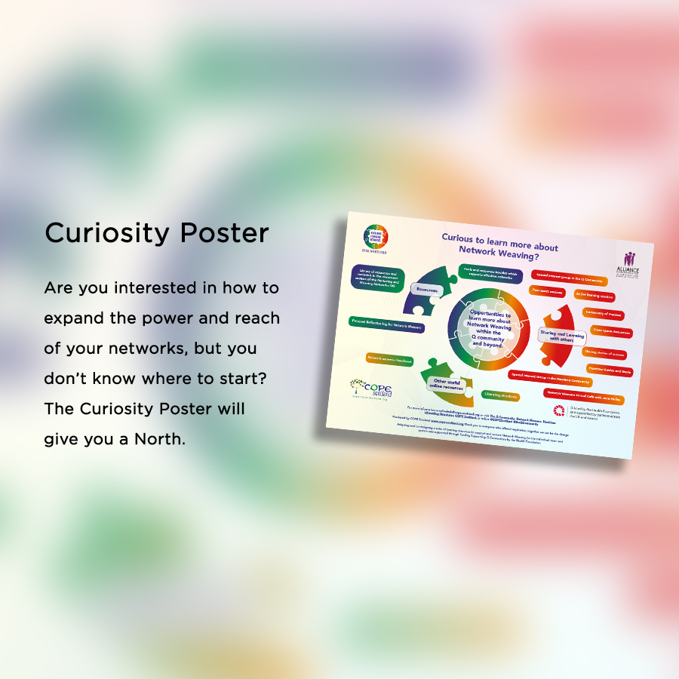
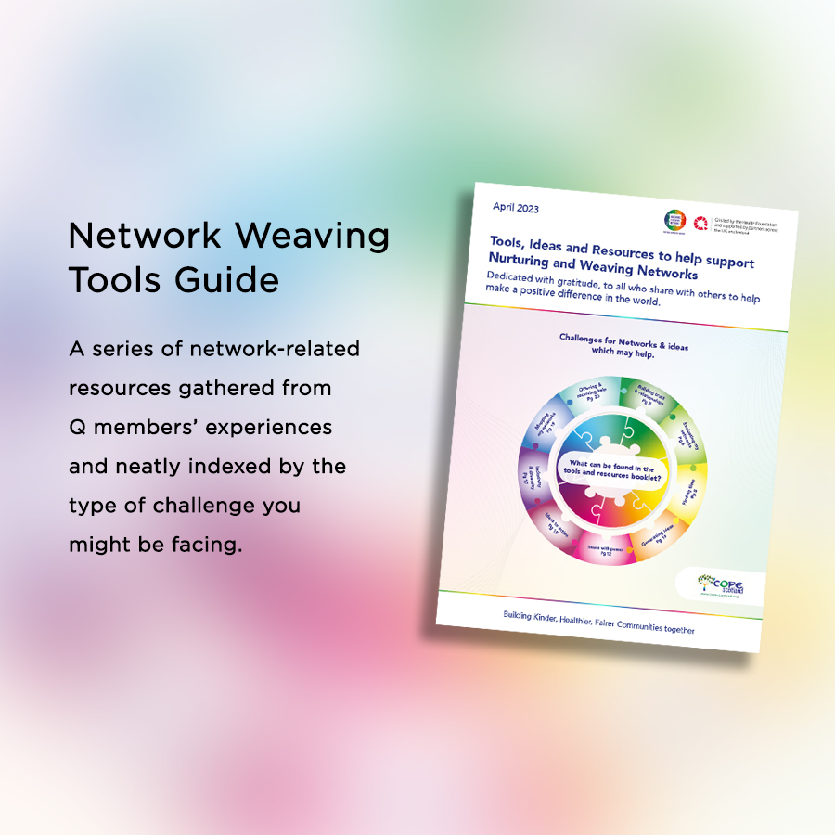
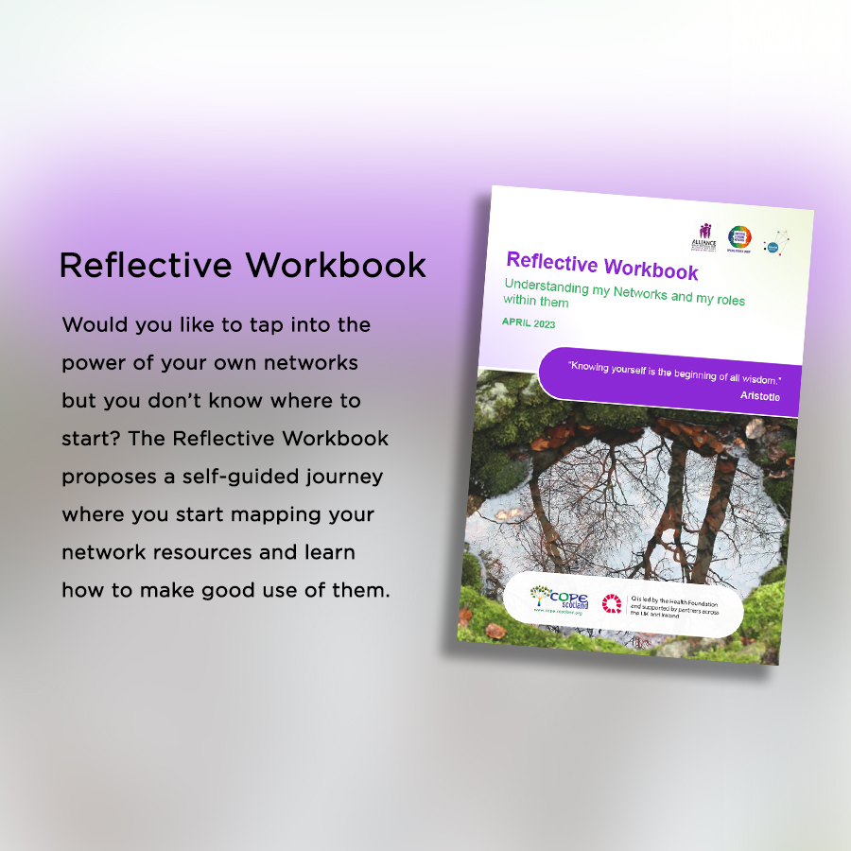
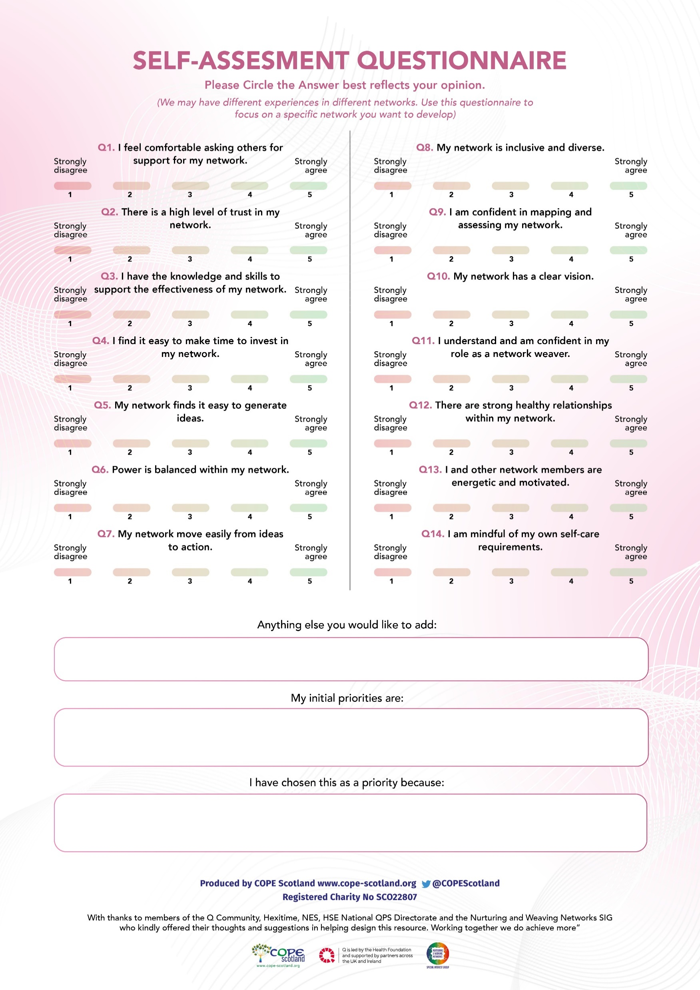
Resources to help support working together towards a common vision
Download from www.cope-scotland.org
Nurturing and weaving networks SIG document page
For more information hilda@cope-scotland.org

Slide 7
BREAKOUT SESSION: TRIZ
Say hello and introduce yourself (2min)
Make a list of all you can do to make sure that you achieve the worst result imaginable with respect to working with other sectors (use Yellow post its) 8min
Go down this list item by item and ask yourselves, ‘Is there anything that we are currently doing that in any way, shape, or form resembles this item?’ Be brutally honest to make a second list of all your counterproductive activities/programs/procedures. (change the post its you identify with /new ones you may add to pink) 8min
Go through the items on your second list and decide what first steps will help you stop what you know creates undesirable results? (change the post it’s of the items which are currently pink to green) 12 min
You may also find using the LS 15% solutions helpful to reflect on the things within your control https://www.liberatingstructures.com/7-15-solutions
https://www.liberatingstructures.com/6-making-space-with-triz/
Main group discussion 10min
In the chat, please complete the sentence:
One thing I will do from today to improve working across sectors will be……..

