Slide 1
A brief overview of Network Weaving
For more information visit www.networkweaver.com

Slide 2
Overview of the slides
Time to pause as we need to create space to take on something new
Different reasons why we may connect with others
Exploring the idea of network weaving
What network weaving can offer
Why networks matter
Who to contact if you are interested in learning some of the activities which support networks and your development as a network weaver

Slide 3
Time to pause

Slide 4
What do you think?
Please complete the following sentence
I think a network is…………..
I think a meeting is……….
I think a forum is…………
Network weaving to me suggests……….

Slide 5
What is a network versus network weaving versus a meeting or forum?
Network
‘’A group or system of interconnected people or things’’ Intentionally building effective relationships towards a shared goal or to build a movement’’
Network weaving
‘’Is carried out by people who take responsibility for helping the networks around them become more effective, including helping network members to become network weavers’’
A meeting
‘’ An assembly of people for a particular purpose, especially for formal discussion’’
A forum
‘’ A meeting or medium where ideas and views on a particular issue can be exchanged’’

Slide 6
What do you think?
The reasons I want to connect with others are………..
The most effective connections I have with others is by…………………
Challenges in connecting include………..
I overcome these challenges by……….

Slide 7
Going in circles does any of this feel familiar
Why am I here? I want to be here versus I was told to be here its my job
Let’s have a meeting to discuss why we are meeting
Let’s create terms of reference. Here is one I made earlier
There is a deadline on………we need to meet and see what we are going to do about it
We are starting a forum, here is the agenda
We are starting a network. No, you can’t’ do that we need to see what the network think
This policy needs implemented let’s plan action

Slide 8
Networking does not mean we need to agree on everything before we move forwards

Slide 9
Network weaving all a bit quantum
Networks can change systems, but an understanding of existing systems which are impacting on change need to be understood, otherwise the existing networks maintaining how things are now will prevail
Don’t be afraid to fail, sometimes we need to bang into a few walls before we find the door
New voices are heard usually silent as marginalised and through power differentials are often missing from the discussion
Being curious and comfortable with uncertainty
Measuring success comes more from the power of stories than statistics alone
Network members are energetic and enthused and feel a mutual ownership and responsibility
Diversity of experience and opinion welcome, people connect to each other as opposed to organisations connecting (even when as a result of those connections organisations do connect, it starts with individual relationships)
Network weaving offers tools which help groups be more self organising and inclusive
People choose to be Network Weavers; it matters to them and connect with others who may have a different background but similar vision

Slide 10
Networks address power imbalance
Networks encourage peer relationships – relationships based on acknowledging the value of every individual and the contribution they can make to co-creating a better world.
In networks, everyone is a leader, encouraged to connect to others and initiate collaborative action; power is distributed not concentrated.
Networks require inclusion of all stakeholders to generate effective solutions. Those impacted by the problem, in fact, are essential participants since they have the deepest understanding of how the system works (and doesn’t work).

Slide 11
What do you think?
From what I have heard so far, I think network weaving is………

Slide 12
So what is network weaving!
Learning new ways to catalyse networks you are a member of by practicing using tools and activities which can support network ways of being and behaving

Slide 13
So what are these tools and activities?
Support understanding of existing networks
Support understanding of ourselves as network members
Enable change through practice of different techniques which encourage collaboration
Enable change by reviewing network membership and supporting it to become self organising
Exploring the interconnectedness of what we are doing and why
Creating curiosity and enthusiasm for network weaving
Engaging people and bringing joy to working together
Being there for each other & increasing peer support

Slide 14
Why networks matter…what we can learn from trees
Redwood trees grow so tall and strong as they intermingle their roots. Their roots grow out, not down and they support each other
Juniper trees roots will spread out in search of water, their roots exposed to the elements as they cling on against the odds, finding anchor points offering stability if a part of the soil were to fall away, while also holding the soil together where it can
Effective networking can help us understand ourselves & the world around us as well as help build resilience to the challenges we, our communities, our world faces

Slide 15
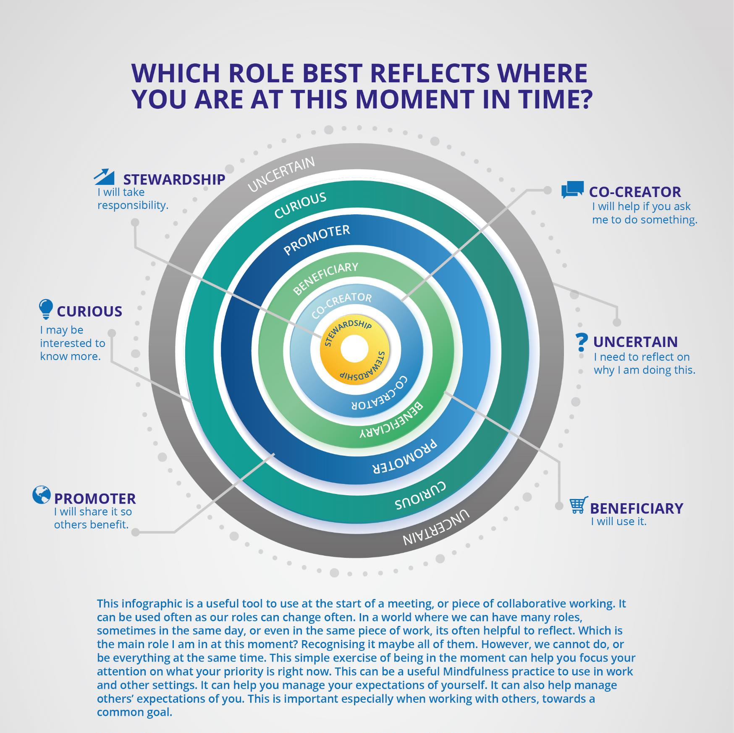
We all have a role in bringing about change
Catalysts have an idea; others may help bring that idea into the world, and others benefit from the idea becoming something tangible we can share with the world.
At different points, we can all be stewards, co-creators and beneficiaries, depending on the idea and our other time commitments.
What matters is, we know where we stand at any point in time, and others do too. This helps build relationships.

Slide 16
Would you like to share some of your experiences of networking?

Slide 17
What do you think?
This session on network weaving has left me feeling…………

Slide 18
Nurturing networks and Network weaving

Slide 19
Links and resources
COPE Scotland (A Scottish Charity dedicated to working with others to finding ways where people and the planet suffer less) www.cope-scotland.org
Hexitime (Healthcare skills exchange time bank) hexitime.com
The Health and Social Care Alliance (Scotland) the ALLIANCE (The national third sector intermediary for a range of health and social care organisations in Scotland). www.alliance-scotland.org.uk/
The Q Community (A connected community working together to improve health and care quality across the UK and Ireland.) www.q.health.org.uk

Slide 20
Links and resources
Jigsaw lid
Available from www.cope-scotland.org
Network Weavers Handbook and other resources
Available from networkweaver.com
Network weaver roles
Available from networkweaver.com
What is my role right now infographic
Available from www.cope-scotland.org

Slide 21
Thank you
For more information on the Nurturing and Weaving Networks SIG please contact hilda@cope-scotland.org
www.cope-scotland.org
@COPEScotland
For further information on Network Weaving please visit
networkweaver.com
These slides were inspired by June Holley’s Network Weavers Handbook with thanks also to other network weavers for their comments and insights

