Slide 1
QI Summer Series: Workshop 4
Carrying out QI
Wednesday 19th August 9:30-11:30
Welcome everyone- please type in the chat box. Tell us your name, role and where you are joining us from today.
Please mute your microphone to avoid background noise.
@WEAHSN
#WEAHSNAcademy
Notes:
in introduction explain our 25 min structure
Copy of slides will come out in follow up email- with links newsletters and networks to join
Twitter hashtag- be mindful registration didn’t include photo permission

Slide 2
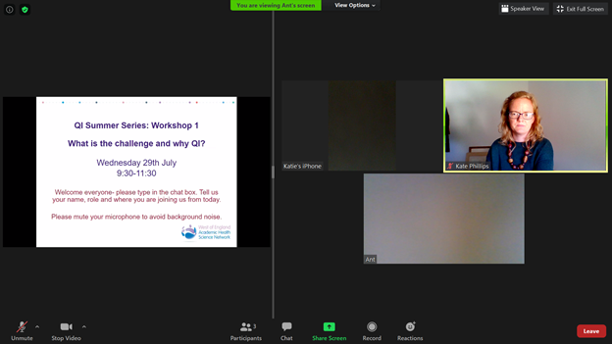
Click on “View Options” and select “side by side mode”
Experiment between speaker view or gallery view. This screenshot is with gallery view.
Hover over the grey line in the middle and drag it to the side. This will expand and shrink the slide view.
Turn your microphone on and off. Please keep your mic turned off to limit background noise
Turn your camera on and off. Please keep your camera turned on if you can- we’d like to see you if we can :D
Open the chat box and use it to communicate with the event hosts and participants.

Slide 3
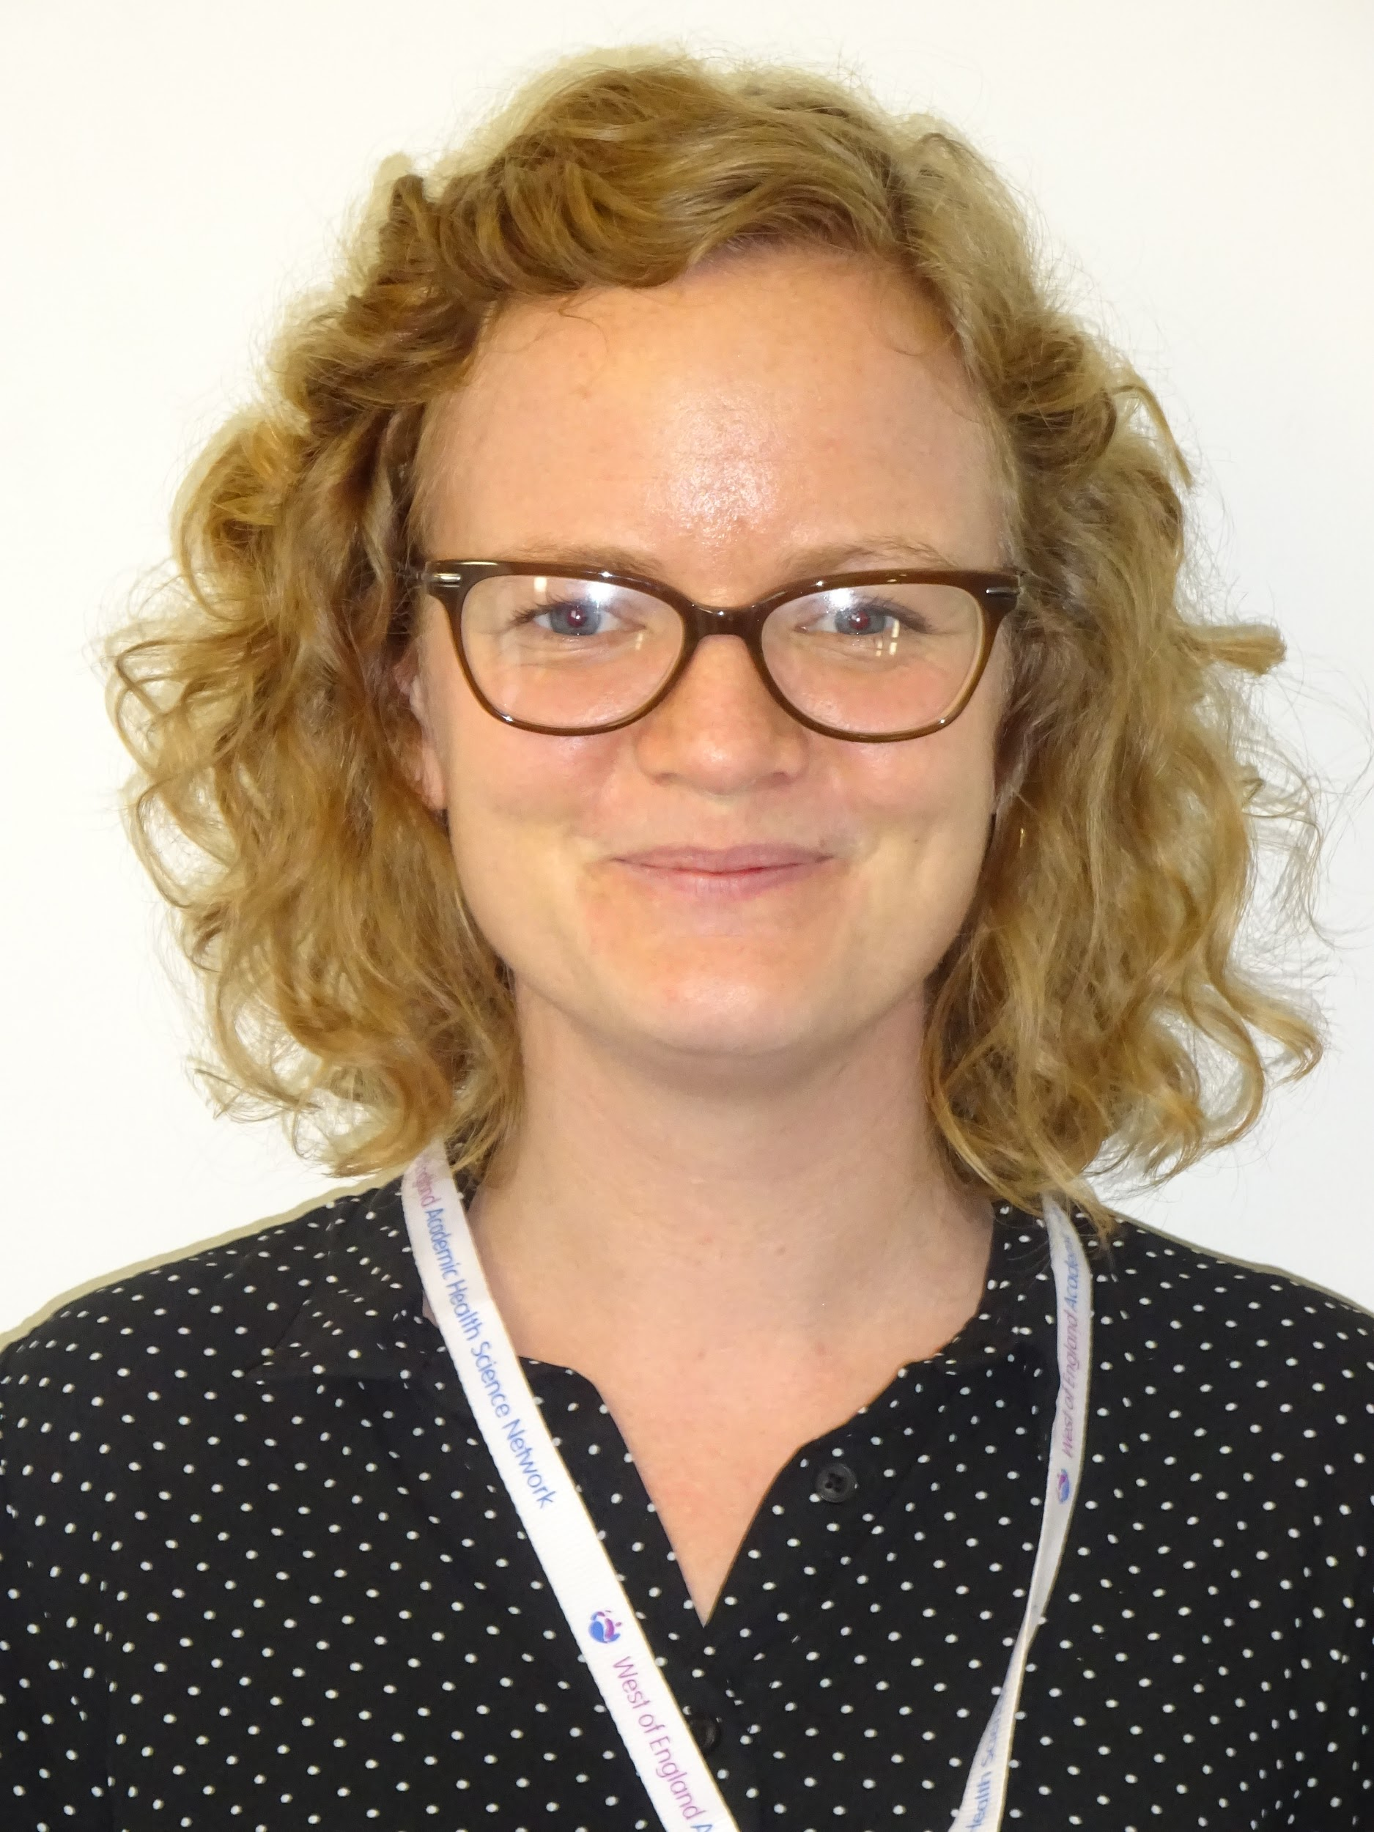
Vardeep Deogan- Quality Improvement Practitioner North Bristol NHS Trust
Kate Phillips- Project Manager

Slide 4
The West of England Academic Health Science Network
Notes:
https://www.youtube.com/watch?v=w2yyGrX4wlY&t=27s 2 min video

Slide 5
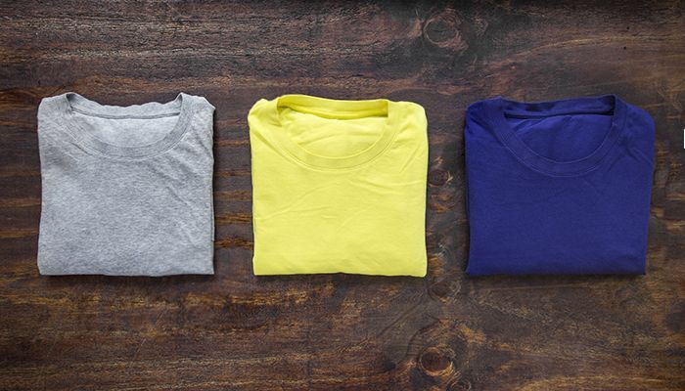
PDSA- T-shirt folding
Notes:
Same approach- PDSA and model for improvement. Working in teams. Note in session plan.
Desired outcome: Perfectly folded T Shirt
Time and quality to be measured:

Slide 6
PDSA: T- Shirt rules
6 Minutes in breakout rooms
Task:
Collect a ‘base line’
Carry out 1 – 2 change idea PDSAs
4 people per group – Allocate one roll each
T-Shirt folder
System and quality checker
Timer
Data recorder
Notes:
Plan– the change to be tested or implemented
Do– carry out the test or change
Study– based on the measurable outcomes agreed before starting out, collect data before and after the change and reflect on the impact of the change and what was learned
Act– plan the next change cycle or full implementation.

Slide 7
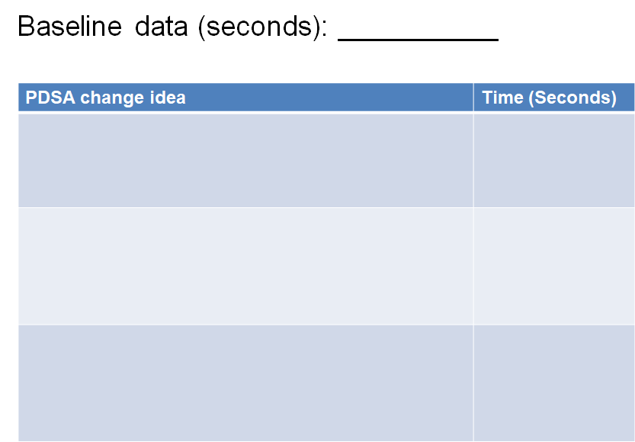
Quality (0-5)

Slide 8
Post in the chat box:
Tell us your best time
What was your best change idea?

Slide 9
PDSA- T-shirt folding
How did you get on??
Notes:
Tell us some of your change ideas and how did it make a difference to the ‘perfectly folded T shirt’?
Did change the way you folded it? Did you do anything to prepare before dropping the T-shirt? Did you change your environment?

Slide 10
In break out rooms (4 mins) discuss...
How do you feel about the model for improvement?
Do you think you’ll be able to use it in your current role and can you think of an example for putting PDSAs in to practice?
Return to the main group- share ideas in the chat box.
Notes:
Facilitate discussion in groups: Think of a challenge at work, could you use a PDSA approach to improve it?
Share some ideas,

Slide 11
Poll
Using the model for improvement and PDSA cycles, I believe I could:
@WEAHSN
#WEAHSNAcademy

Slide 12
Notes:
2 minutes of music
Post survey monkey link in chat
Funded MOOC places- complete the survey monkey- those that do in the hat to win sponsored QI MOOC and certificate

Slide 13
Thank you and well done
@WEAHSN
#WEAHSNAcademy
Notes:
Next week- which session? See you then?

