Slide 1
Network Weaving 101
Twin Cities Network Weaver Community of Practice

Slide 2
What is a network?
An intentional network is a network of people and/or organizations that are working on the same issue or vision.
Parents sharing childcare
Food Access Network
National Network for Youth
Alumni networks

Slide 3
Network weaving is the practice of:
intentionally building effective relationships
around a common issue area
to accomplish a set of goals or
build a movement.
Notes:
Kristin

Slide 4
Network Weaving is different than Networking…

Slide 6
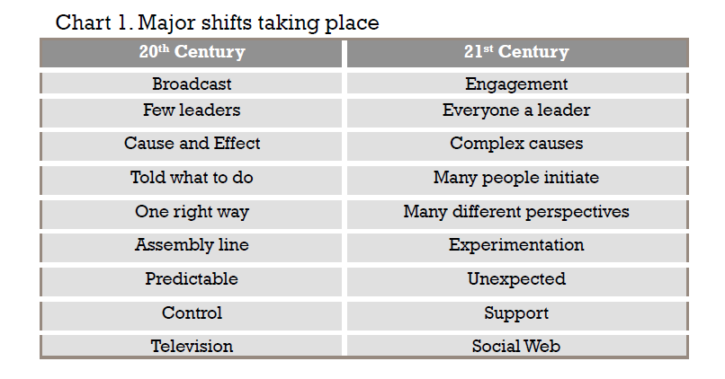
Source: Network Weaver Handbook Introduction

Slide 7
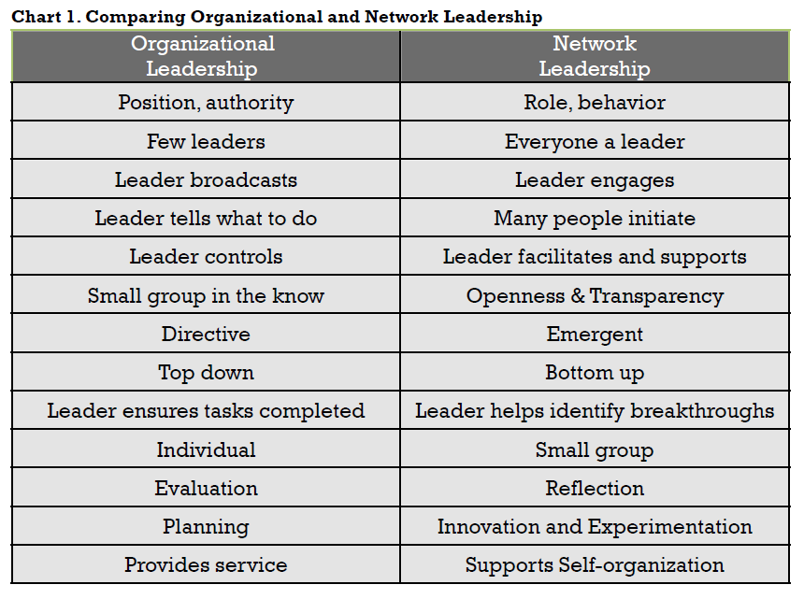
Source: Network Weaver Handbook, Chapter 2: Network Leadership

