Slide 1
Network Maturity Matrix
Slide deck to use in virtual meetings

Slide 2
Network Maturity Matrix
(if large group do in breakout rooms)
Where are we at?
    Using the network maturity matrix we will review this network
    Each of the 8 headings will be put in chat – add your suggested score
    We will reach a consensus score for each heading (if between 2 scores choose lowest. Can state working towards the next level e.g. 3 working towards 4)
Where do we need to focus next?
    Based on conversation +/- the scores we will establish which of the headings we need to focus on
How do we get there?
    Group discussion

Slide 3
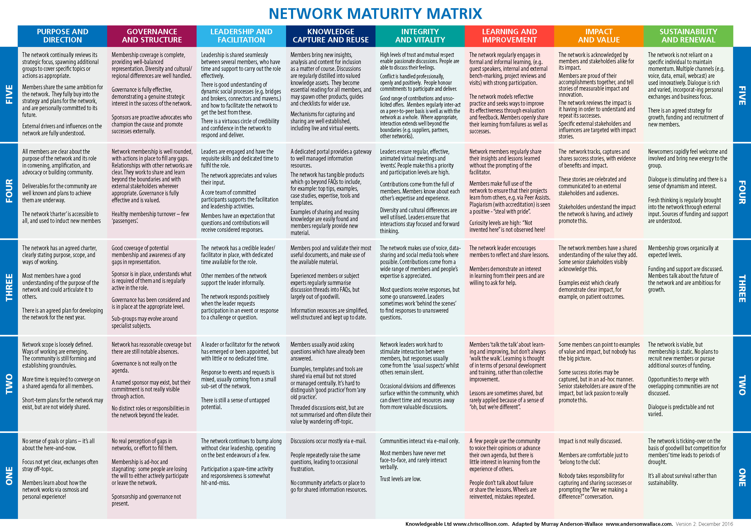

Slide 4
 | Purpose and Direction
Five | The network continually reviews its strategic focus, spawning additional groups to cover specific topics or actions as appropriate. Members share the same ambition for the network. They fully buy into the strategy and plans for the network and are personally committed to its future.
Four | All members are clear about the purpose of the network and its role in convening, amplification, and advocacy or building community. Deliverables for the community are well known and plans to achieve them are underway. The network ‘charter’ is accessible to all, and used to induct new members
Three | The network has an agreed charter, clearly stating purpose, scope, and ways of working. Most members have a good understanding of the purpose of the network and could articulate it to others. There is an agreed plan for developing the network for the next year.
Two | Network scope is loosely defined. Ways of working are emerging. The community is still forming and establishing groundrules. More time is required to converge on a shared agenda for all members Short-term plans for the network may exist, but are not widely shared
One | No sense of goals or plans – its all about the here-and-now. Focus not yet clear, exchanges often stray off-topic. Members learn about how the network works via osmosis and personal experience!

Slide 5
 | Governance and Structure
Five | Membership coverage is complete, providing well-balanced representation. Diversity and cultural/regional differences are well handled. Governance is fully effective, demonstrating a genuine strategic interest in the success of the network. Sponsors are proactive advocates who champion the cause and promote successes externally.
Four | Network membership is well rounded, with actions in place to fill any gaps. Relationships with other networks are clear. They work to share and learn beyond the boundaries and external stakeholders wherever appropriate. Governance is fully effective and is valued. Healthy membership turnover – few ‘passengers’.
Three | Good coverage of potential membership and awareness of any gaps in representation. Sponsor is in place, understands what is required of them and is regularly active in the role. Governance has been considered and is in place at the appropriate level. Sub-groups may evolve around specialist subjects.
Two | Network has reasonable coverage but there are still notable absences. Governance is not really on the agenda. A named sponsor may exist, but their commitment is not really visible through action. No distinct roles or responsibilities in the network beyond the leader.
One | No real perception of gaps in networks, or effort to fill them. Membership is ad-hoc and stagnating: some people are losing the will to either actively participate or leave the network. Sponsorship and governance not present.

Slide 6
 | Leadership and Facilitation
Five | Leadership is shared seamlessly between several members, who have tie and support to carry out the role effectively. There is good understanding of dynamic social processes (e.g. bridges and brokers, connectors and mavens.) and how to facilitate the network to get the best from these. There is a virtuous circle of credibility and confidence in the network to respond and deliver.
Four | Leaders are engaged and have the requisite skills and dedicated time to fulfil the role. The network appreciates and values their input. A core team of committed participants supports the facilitation and leadership activities. Members have an expectation that questions and contributions will receive considered responses.
Three | The network as a credible leader/facilitator in place, with dedicated time available for the role. Other members of the network support the leader informally. The network responds positively when the leader requests participation in an event or response to a challenge or question.
Two | A leader or facilitator for the network has emerged or been appointed, but with little or no dedicated time. Response to events and requests is mixed, usually coming from a small sub-set of the network. There is still a sense of untapped potential.
One | The network continues to bump along without clear leadership, operating on the best endeavours of a few. Participation a spare-time activity and responsiveness is somewhat hit-and-miss.

Slide 7
 | Knowledge Capture and Use
Five | Members bring new insights, analysis and content for inclusion as a matter of course. Discussions are regularly distilled into valued knowledge assets. They become essential reading for all members, and may spawn other products, guides and checklists for wider use. Mechanisms for capturing and sharing are well established, including live and virtual events.
Four | A dedicated portal provides a gateway to well managed information resources. The network has tangible products which go beyond FAQs to include, for example: top tips, examples, case studies, expertise, tools and templates. Examples of sharing and reusing knowledge are easily found and members regularly provide new material.
Three | Members pool and validate their most useful documents and make use of the available material. Experienced members or subject experts regularly summarise discussion threads into FAQs, but largely out of goodwill. Information resources are simplified, well structured and kept up to date.
Two | Members usually avoid asking questions which have already been answered. Examples, templates and tools are shared via email but not stored or managed centrally. It’s hard to distinguish ‘good practice’ from ‘any old practice’. Threaded discussions exist but are not summarised and often dilute their value by wandering off-topic.
One | Discussion occur mostly via e-mail. People repeatedly raise the same questions, leading to occasional frustration. No community artefacts or place to go for shared information resources.

Slide 8
 | Integrity and Vitality
Five | High levels of trust and mutual respect enable passionate discussions. People are able to discuss their feelings. Conflict is handled professionally, openly and positively. People honour commitments to participate and deliver. Good range of contributions and unsolicited offers. Members regularly iner-act on a peer-to-peer basis as well as with the network as a whole. Where appropriate interaction extends well beyond the boundaries (e.g. suppliers, partners, other networks.)
Four | Leaders ensure regular, effective, animated virtual meetings and ‘events’. People make this a priority and participation levels are high. Contributions come from the full of members. Members know about each other’s expertise and experience. Diversity and cultural differences are well utilized. Leaders ensure that interactions stay focused and forward thinking.
Three | The network makes use of voice, data-sharing and social media tools where possible. Contributions come from a wide range of members and people’s expertise is appreciated. Most questions receive responses, but some go unanswered. Leaders sometimes work ‘behind the scenes’ to find responses to unanswered questions.
Two | Network leaders work hard to stimulate interactions between members, but responses usually come from the ‘usual suspects’ whilst others remain silent. Occasional divisions and differences surface within the community, which can divert time and resources away from more valuable discussions
One | Communities interact via email only. Most members have never met face-to-face and rarely interact verbally. Trust levels are low.

Slide 9
 | Learning and Improvement
Five | The network regularly engages in formal and informal learning, (e.g. guest speakers, internal and external benchmarking, project reviews and visits) with strong participation. The network models reflective practice and seeks ways to improve its effectiveness through evaluation and feedback. Members openly share their learning from failures as well as successes.
Four | Network members regularly share their insights and lessons learned without the prompting of the facilitator. Members make full use of the network to ensure that their projects learn from others e.g. via Peer Assists, Plagiarism (with accreditation) and seen a positive – “steal with pride”. Curiosity levels are high: “Not invented here” is not observed here!
Three | The network leader encourages members to reflect and share lessons. Members demonstrate an interest in learning from their peers and are willing to ask for help.
Two | Members ‘talk the talk’ about learning and improving, but don’t always ‘walk the walk’. Learning is thought of in terms of personal development and training, rather than collective improvement. Lessons are sometimes shared but rarely applied because of a sense of “oh, but we’re different”.
One | A few people use the community to voice their opinions or advance their own agenda, but there is little interest in learning from the experience of others. People don’t talk about failure or share lessons. Wheels are reinvented, mistakes repeated.

Slide 10
 | Impact and Value
Five | The network is acknowledged by members and stakeholders alike for its impact. Members are proud of their accomplishments together and tell stories of measurable impact and innovation. The network reviews the impact it is having in order to understand and repeat its successes. Specific external stakeholders and influencers are targeted with impact stories.
Four | The network tracks, captures and shares success stories, with evidence of benefits and impact. These stories are celebrated and communicated to external stakeholders and audiences. Stakeholders understand the impact the network is having, and actively promote this.
Three | The network members have a shared understanding of the value they add. Some senior stakeholders visibly acknowledge this. Examples exist which clearly demonstrate clear impact, for example, on patient outcomes.
Two | Some members can point to examples of value and impact, but nobody has the big picture. Some success stories may be captured, but in an ad-hoc manner. Senior stakeholders are aware of the impact but lack passion to really promote this.
One | Impact is not really discussed. Members are comfortable just to ‘belong to the club’. Nobody takes responsibility for capturing and sharing successes or prompting the “Are we making a difference?” conversation.

Slide 11
 | Sustainability and Renewal
Five | The network is not reliant on a specific individual to maintain momentum. Multiple channels (e.g. voice, data, email, webcast) are used innovatively. Dialogue is rich and varied, incorporating personal exchanges and business focus. There is an agreed strategy for growth, funding and recruitment of new members.
Four | Newcomers rapidly feel welcome and involved and bring new energy to the group. Dialogue is stimulating and there is a sense of dynamism and interest. Fresh thinking is regularly brought into the network through external input. Sources of funding and support are understood.
Three | Membership grows organically at expected levels. Funding and support are discussed. Members talk about the future of the network and are ambitious for growth.
Two | The network is viable, but membership is static. No plans to recruit new members or pursue additional sources of funding. Opportunities to merge with overlapping communities are not discussed. Dialogue is predictable and not varied.
One | The network is ticking-over on the basis of goodwill but competition for members’ time leads to periods of drought. It’s all about survival rather than sustainability.

Slide 12
Where do we need to focus next?
Based on conversation +/- the scores we will establish which of the headings we need to focus on
How do we get there?
    Group discussion
Purpose and Direction | Governance and Structure | Leadership and Facilitation | Knowledge Capture and Reuse | Integrity and Vitality | Learning and Improvement | Impact and Value | Sustainability and Renewal

