Slide 1
Q LS User Group-
virtual meetup # (Nov 2023)
‘Myth Turning’

Slide 2
Welcome + workshop purpose
To trial structures
Meetup principles
To share approaches to virtual workshops
To support the growing network of Q LS users - *please introduce yourself in the chat*
Notes:
Trial structures - set up psychological safety to fail. Explain we are learning together
Meetup principles
This is an experiment, we’re all learning
Treat this as a playground
What happens in the meetup stays in the meetup (Chatham House)
Be generous with feedback

Slide 3
What are Liberating Structures?
Simple social workshop designs that distribute participation more widely, while drawing out greater difference and variation within groups
A repertoire of techniques that reliably generate novelty
A collection for organising groups to collaborate and mutually shape their work together
Tools & facilitation techniques that share a similar logic or organising structure
Tiny methods that make it possible to benefit from complexity instead of flattening, ignoring, and pushing it away
Notes:
Matthew - potted history of LS for Q

Slide 4
Q helping to spread Liberating Structures…
2017: workshops at Q national event (eg TRIZ, Min Specs)
2018 Three full-day LS immersion workshops (with Keith, Fisher, Anna)
Zoe Lord LS workshop at Q national event
Q’s LS group hosted Juanita Guidera and Rob Cunney - trailblazing LS to power QI in Ireland for 6 years; also Keith McCandless (2019)
Qs started first LS User Group in Scotland (Dan Harley, Kirsty Ellis)
2020: Lots of Q/NHS taking up free places on Happy’s LS immersions
2020: Q member Neil Dunford suggests this new user group for Q.
Notes:
Matthew - potted history of LS for Q

Slide 5
Today
Lyse Edwards (LS user since 2018) & Ian Merrick (Self proclaimed LS Novice)
A structure in development neither have actually ever done before
With thanks to Christiaan Verwijs (The Liberators) for his description of Myth Turning here

Slide 6
Myth Turning Challenge beliefs and open new perspectives LS in Development

Slide 7
Myth Turning
Myth Turning exists to gently challenge the beliefs and assumptions that guide the decisions we make, either as individuals or as a group.
It invites creative destruction by putting those beliefs to the test in a way that opens up new perspectives and possibilities.
Myth Turning invites participants to ask powerful, open questions to challenge a belief of a person or a representative of a group willing to do so.
Notes:
What is myth turning? The stability of myths in organisations Institutions develop powerful myths that develop into unwritten rules and isomorphic structures. These can confound development and improvement in the organisation.
Myth turning can gently challenge beliefs and assumptions and invite creative destruction that opens up new perspectives and possibilities.
Myth Turning invites participants in the process to ask powerful, open questions to challenge a belief of an individual or a representative of a group who is willing to challenge their own thinking.

Slide 8
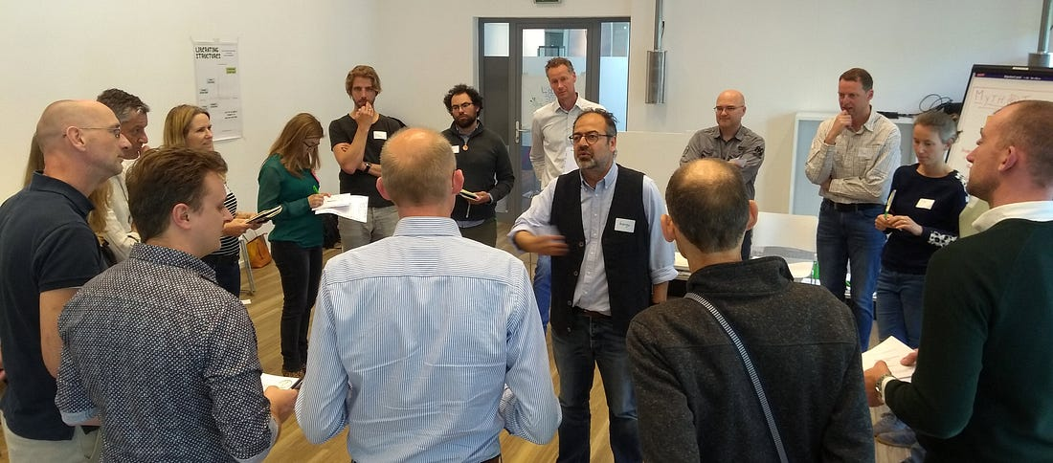
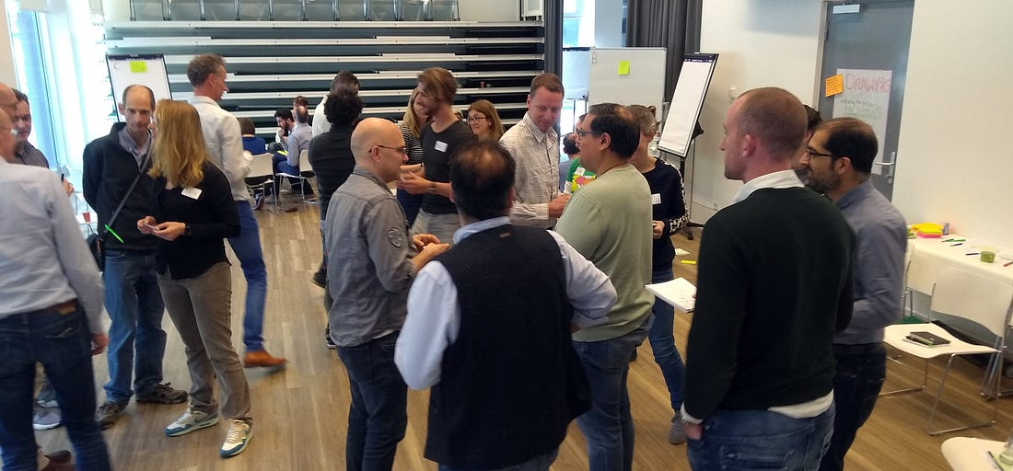
A note about Logistics – Physical to Digital
Myth turning as described ‘F2F’ is very physical and involves
Cards with questions on them to be picked at random
Participants standing in a circle – with participants taking it in turn to go in the middle to share their ‘myth’, participants on the outside move round until the person in the middle signals ‘stop’ – the person opposite them then asks the question on their card

Slide 9
How we are adapting for the digital environment
Using wheel of names to generate our random questions (rather than picking from a pack of cards)
Wheel of names also nicely reflects the ‘turning’ that is otherwise done by the group physically moving around the participant in the centre of the circle

Slide 10
How this will work
We will use Wild Tea in Chat (chatterfall) to help us generate myths
We will think alone and then in pairs to finalise the myth you would like to explore further today in ‘myth turning’
We will try Myth Turning – digitally (with some adaptations to the F2F version!)
We will use spiral journal reflect individually on the experience of myth turning and what it enabled

Slide 11
Generating Myths
Myths are not usually ‘top of mind’ in the sense that you can easily express them.
Some examples of beliefs that can be put to the test are “I believe that when making a decision, everyone should agree”, “I believe that in order to make a bigger impact on an organization, I have to climb the corporate ladder” and “I believe that people always resist ideas they didn’t come up with”.
We hope this Wild Tea may help you come up with a myth to turn!

Slide 12
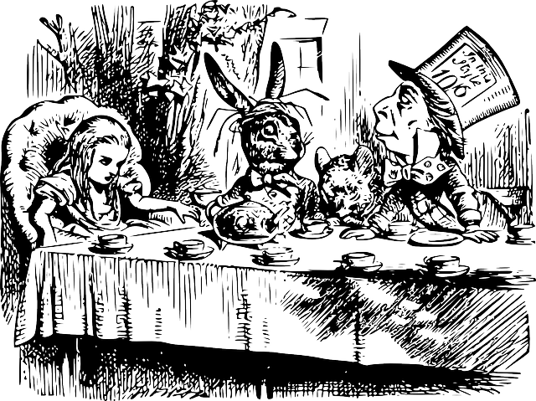
Wild (M**) Tea Party Etiquette 1) Stay curious, dig deep, have fun 2) Don’t overthink answers 3) Finish each of the open sentences with a short phrase!

Slide 13
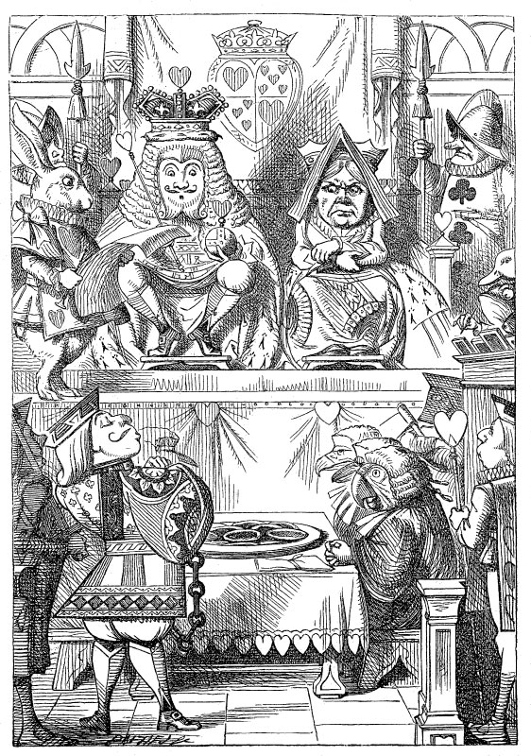
The King quotes Rule 42, which states, “All persons more than a mile high to leave the court.” Everyone turns to Alice, who denies she is a mile high and accuses the King of fabricating the rule.
Notes:
The King then claims that it is the oldest rule in the book, to which Alice replies, “then why is it not Rule Number 1?”
The point here is that people will turn to myths rather than exploring or debating in detail. This is a short cut to getting an outcome that you may think that you want, rather than a means to get the right outcome. Myths can be surprisingly resilient and are an effective way of preventing change.
http://pixabay.com/en/girl-child-alice-in-wonderland-miss-29409/

Slide 14
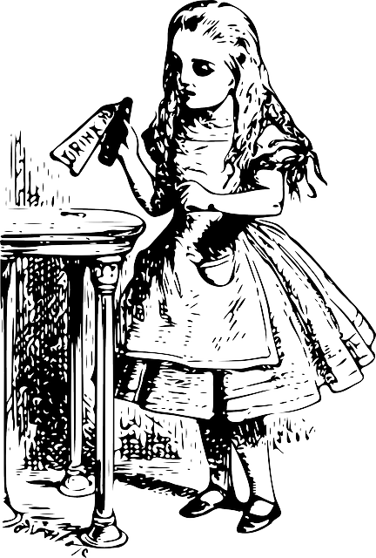
I believe that to change culture you must....
Image: http://pixabay.com/en/girl-child-alice-in-wonderland-miss-29409/
Notes:
http://pixabay.com/en/girl-child-alice-in-wonderland-miss-29409/

Slide 15
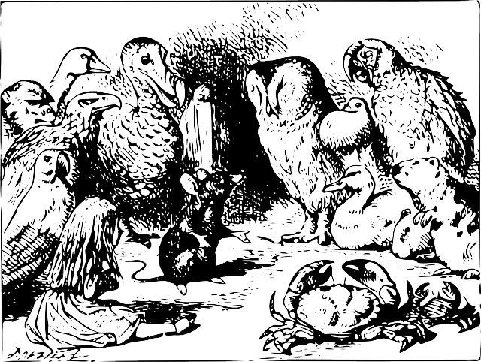
I believe people are most productive when....
Image: http://pixabay.com/en/girl-child-alice-in-wonderland-miss-29409/
Notes:
http://pixabay.com/en/alice-in-wonderland-card-men-drawing-303997/

Slide 16
I believe working with groups is...
Image: http://pixabay.com/en/girl-child-alice-in-wonderland-miss-29409/
Notes:
http://pixabay.com/en/alice-in-wonderland-animals-tale-30130/

Slide 17
I believe quality improvement is...
Image: http://pixabay.com/en/girl-child-alice-in-wonderland-miss-29409/
Notes:
http://pixabay.com/en/alice-in-wonderland-card-men-drawing-303997/

Slide 18
I believe that meetings must....
Image: http://pixabay.com/en/girl-child-alice-in-wonderland-miss-29409/
Notes:
http://pixabay.com/en/girl-child-alice-in-wonderland-miss-29409/

Slide 19
I believe the NHS is...
Image: http://pixabay.com/en/girl-child-alice-in-wonderland-miss-29409/
Notes:
http://pixabay.com/en/alice-in-wonderland-animals-tale-30130/

Slide 20
Reflecting on the wild tea, or something else that comes to mind:
“What is a belief or an assumption that has shaped or guided you in your professional journey, but that you are starting to question, may be a false notion or may be holding you back?”.
Select one belief that you are willing to question, making sure to state it as “I believe that ….”.
Make sure that this is a belief you actually still hold

Slide 21
Pair and Share
If anyone needs help coming up with a myth we will pair and share

Slide 22
Myth Turning Steps
We will create breakout rooms of 5
Find the Wheel that corresponds to your room number (otherwise chaos will ensue!)
One person will stand in the centre of the imaginary circle (maybe put up your digital hand?)
You will state your belief to the group “I believe that …” [1 min]
Other participants will take it in turns to spin the wheel of names and pose the question that ‘pops up’ to the person who has stated their myth. The question should be responded to by the ‘myth holder’ as quickly as possible. This is not a conversation or a debate.
Pass on the wheel by saying ‘I pass to’ x
Repeat about until about 5 minutes is up
Repeat this for other people in the group, each ‘moving to the [imaginary] middle’ ~ 5 minutes per person
Notes:
Break out rooms of 5
Numerous copies of wheel of names go to wheel that aligns with room number
5 minutes per participant to share their myth and have questions asked.
One person will stand in the centre of the imaginary circle (maybe put up your digital hand?)
You will state your belief to the group “I believe that …” [1 min]
Other participants will take it in turns to spin the wheel of names and pose the question that ‘pops up’ to the (metaphorical) "person in the middle of the circle". That "person in the middle" should answer the quickly as possible. This is not a conversation or a debate.
Pass on the wheel spinning by saying ‘I pass to’ x, next person spin the wheel
Repeat about until about 5 minutes is up (hopefully you will have all spun at least once)
Repeat this for other people in the group, each ‘moving to the [imaginary] middle’ ~ 5 minutes per person

Slide 23
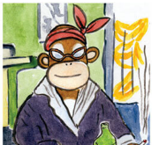
Spiral Journal Calmly prepare for the work ahead while sharpening observational precision. Inspired by Lynda Barry

Slide 24
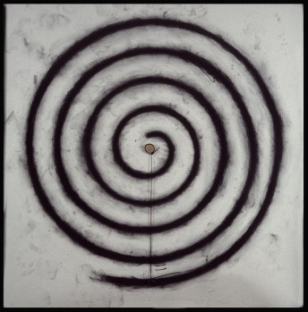

Slide 25
A new perspective I have on my belief now is…

Slide 26
A new perspective I have on my belief now is…
One advantage of letting go of my belief is...

Slide 27
A new perspective I have on my belief now is…
One advantage of letting go of my belief is...
Some thing else I could explore to let go of this myth or make it feel safer is...

Slide 28
Myth turning enabled....
A new perspective I have on my belief now is…
One advantage of letting go of my belief is...
Some thing else I could explore to let go of this myth or make it feel safer is...

Slide 29
Debrief
What did Myth Turning Enable?
When could you use it?
How would you adapt it?
What other LS would it work well with?

