Slide 1
Q SIG primary care
www.twitter.com/theQcommunity
Nov 2018 EMF

Slide 2
My name is………………………
Liz Fisher

Slide 3
Why a special interest group in Q ?

Slide 4
What have we done so far? 55 members

Slide 5
Regular webinars

Slide 6
in this PC SIG for Q we have……..
Lecturers, clinical academics AHSN director
Matrons
Royal College leaders
Nurse leaders
students
Pharmacists
Programme managers
Nurses
Innovation experts
Information specialists
Patient experts
GPs
Practice managers

Slide 7
How can we work with patients to deliver QI?
This Photo by Unknown Author is licensed under CC BY

Slide 8
Can you make a difference?
This Photo by Unknown Author is licensed under CC BY
This Photo by Unknown Author is licensed under CC BY-NC

Slide 9
Can we be the catalyst for QI in primary care?
Talk to the person next to you and ask them
Can you be a catalyst where you work?
How could you do this?

Slide 10
Joining Q ………Easy to apply…….

Slide 12
What’s trending ? Huddles…..

Slide 13
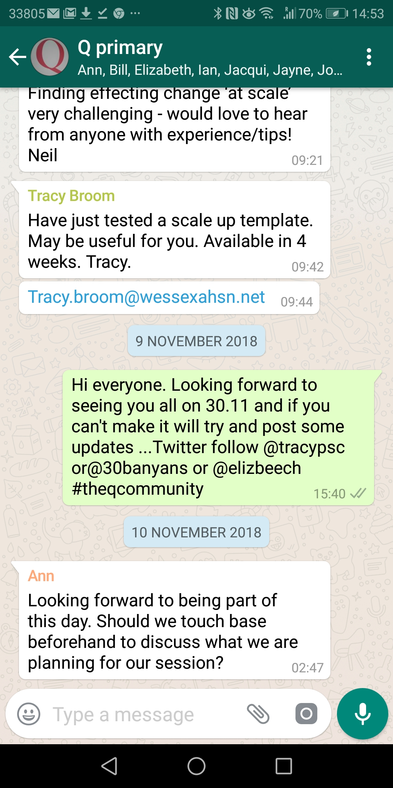

Slide 14
Thanks
www.twitter.com/theQcommunity
……………@30banyans
…WhatsApp Message Liz on
07952686557

Slide 15
Introducing Dr Berwick’s video
https://www.dropbox.com/s/sak8wed1m2k64gu/Don%20Berwick%20Q%20Event.mp4?dl=0

Slide 16
Pause tape at 10.54

Slide 17
Ideas from the presentation
Read
1999 to Err is human
2001 Crossing the Quality Chasm
A New Health System for the 21st century
https://www.ncbi.nlm.nih.gov/books/NBK222273/
The Triple Aim: Care, Health And Costs Health Affairs www.healthaffairs.org/doi/full/10.1377/hlthaff.27.3.7

Slide 18
Please form groups
To discuss
What have you learned so far?
With Crossing the Quality Chasm what were the six main aims ?
And the three aims from the IHI Triple Aim?
Adding an additional factor in 2018 ?
Can we look to develop a charter for PC Q SIG?

Slide 19
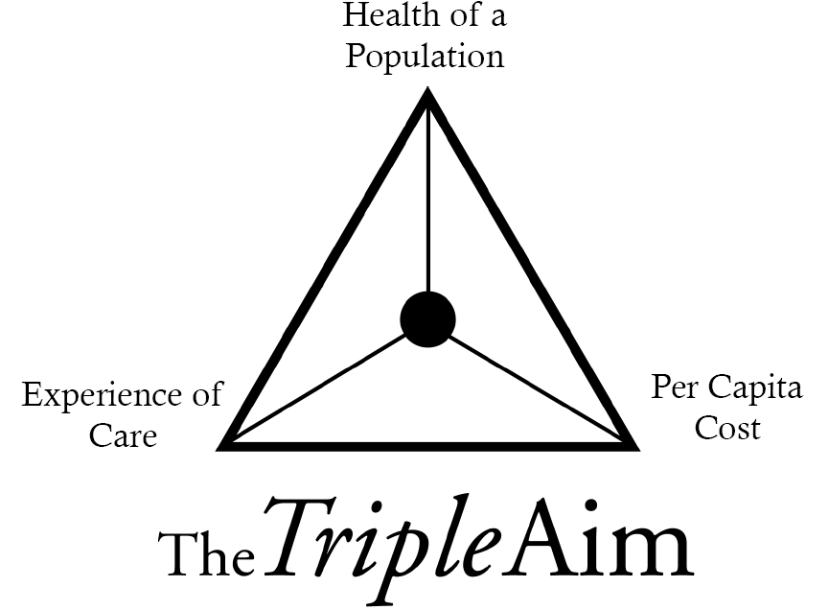
Patient Safety
Effectiveness
Patient Centredness
Timeliness
Efficiency
Equity
This Photo by Unknown Author is licensed under CC BY-SA-NC

Slide 20
And
Integrity

Slide 21
Start tape at 10.54

Slide 22
Invite speakers or visit!
Lord Nigel Crisp KCB

Slide 23
Alaska Native Medical Centre
Anchorage Alaska
Non-profit Health Centre
158 000 Alaska Natives

Slide 24
Testing
Find an idea
Try it out
Try it out fast
Try it out now
Try it out with an open mind
Take some risks

Slide 25
Invite The Patients In
Invite them
Be authentic
Be embracing
Work together to co-design
We are not producing a toaster!
This Photo by Unknown Author is licensed under CC BY-SA-NC

