Slide 1
Joy in Work

Slide 3
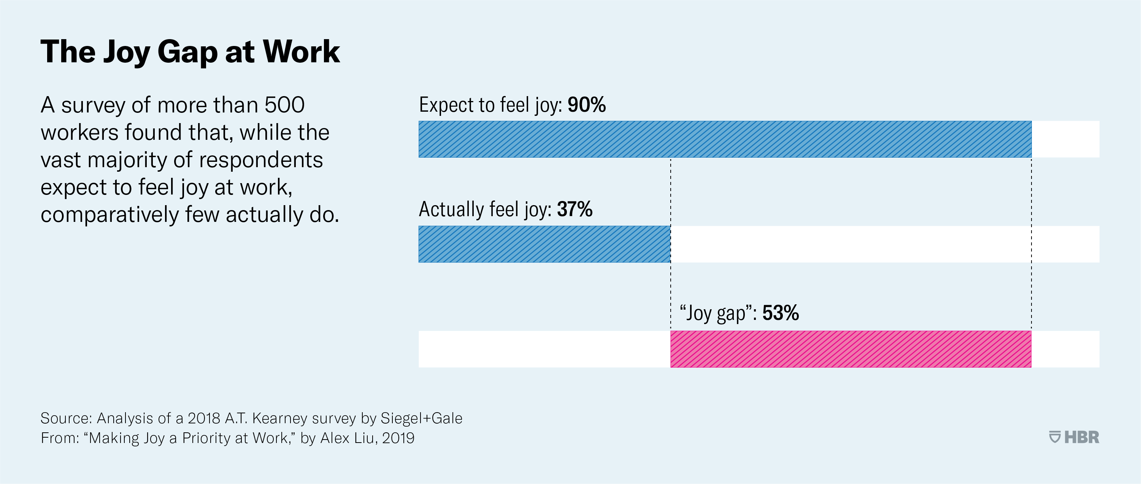
Why Joy in Work?
The average person spends 90,000 hours at work in their lifetime.

Slide 4
What brings you joy at work?

Slide 5
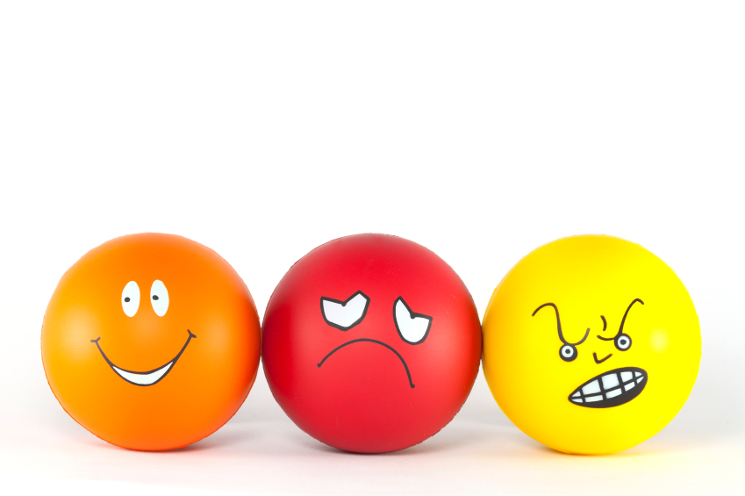
What makes you sad or irritated at work?

Slide 7
Why Joy in Work?
Purpose driven work increases engagement but can also lead to an increased risk of burnout When Passion Leads to Burnout (hbr.org)
Trusts with more engaged staff tend to have higher patient satisfaction, with more patients reporting that they were treated with dignity and respect Staff engagement (The Kings Fund)
High levels of stress are associated with errors that can harm patient care, and in the acute sector it is associated with higher levels of mortality Michael West
Incivility: Civil environments matter because they reduce errors, reduce stress and foster excellence Civility Saves Lives
Stressors at work can lead to anxiety, anger, unethical behaviour, poor decision making and chronic exhaustion and burnout To Cope with Stress, Try Learning Something New (hbr.org)
Stress is contagious Making Sure Your Stress Isn’t Contagious (hbr.org)

Slide 8
Why Joy in Work?
Chronic work stress is associated with cardiovascular disease, hypertension, heart attacks, addictions, cancer, diabetes, and more severe mental health problems including depression Michael West
Compassion Fatigue: Those most at risk of compassion fatigue are those medical and mental health providers who are caring day after day for patients Psych Hub
In the NHS the most reported reason for sickness absence is anxiety/stress/depression/other psychiatric illnesses NHS Sickness Absence Rates April 2020, Provisional Statistics - NHS Digital

Slide 9
Stress: Do any of these apply to you?
Stresslaxing
Being so stressed that relaxing makes you more stressed because you’re not working on what’s making you stressed.
(Urban Dictionary, 2020)
Microstress
Being bombarded with numerous small stressors throughout the day (sometimes 20 – 30), which can ultimately build up and have a big impact.
(Rob Cross, Jean Singer, Karen Dillon 2020)
Metastress
When you are stressed about having stress.
(Kristi Hedges, 2019)
Created by:
www.juliawood.co.uk

Slide 10
Negativity bias
We are hardwired to focus on negative things

Slide 11
Inequalities of happiness
Intentional activities
Research paper: Pursuing Happiness: The Architecture of Sustainable Change (S. Lyubormirsky, K.M. Sheldon & D. Schkade 2005)
The Hedonic Treadmill – overtime revert to your ‘set point’ (Brickman & Campbell, 1971)
10%
Circumstances

Slide 13
Two important facts about happiness
Fact 1: Happiness leads to success
Conventional wisdom has always had us believe that success leads to happiness, but extensive research has shown that it’s actually the other way round. (HBR 2012 & University of Warwick 2015)
Fact 2: We’re not happy when we’re chasing happiness
We’re happiest when we’re not thinking about it, but when we’re enjoying the present moment. (HBR 2015)

Slide 14
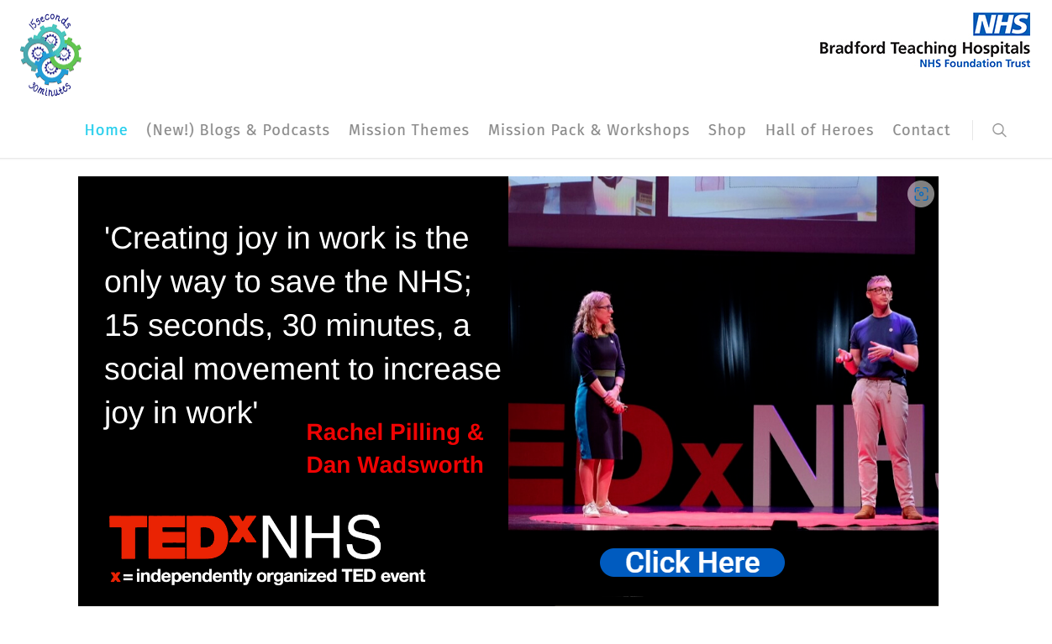
Home - 15 Secs 30 Mins (15s30m.co.uk)
IHI Framework for Improving Joy in Work | IHI - Institute for Healthcare Improvement

Slide 15
15s30m welcome - YouTube

Slide 16
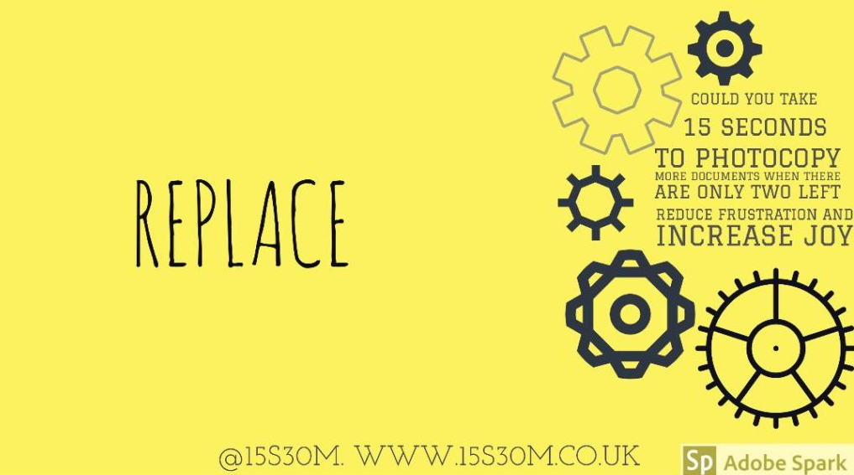
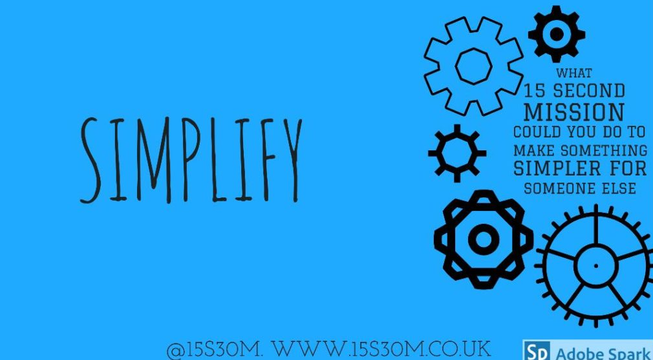
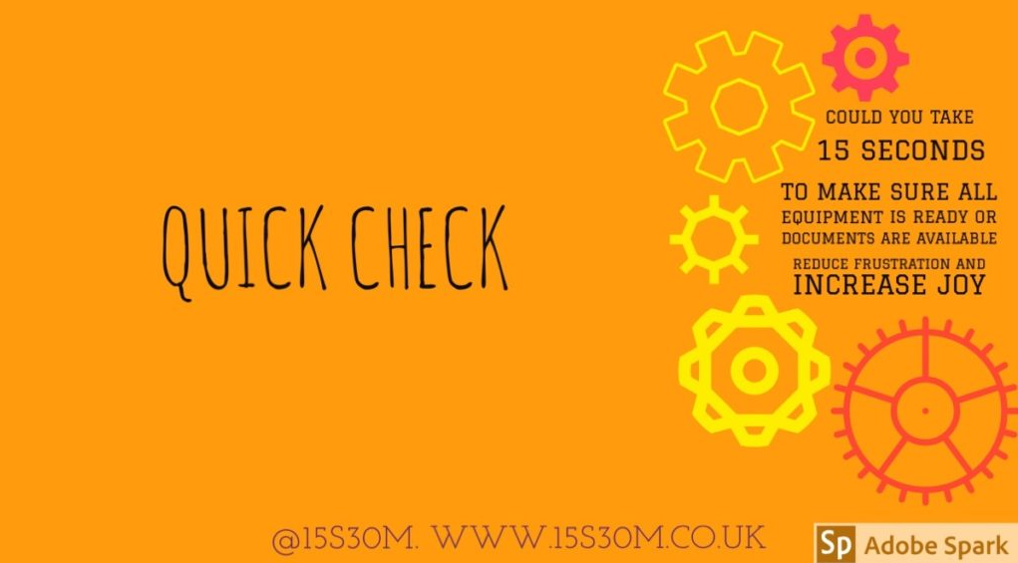
15s30m Missions

Slide 17
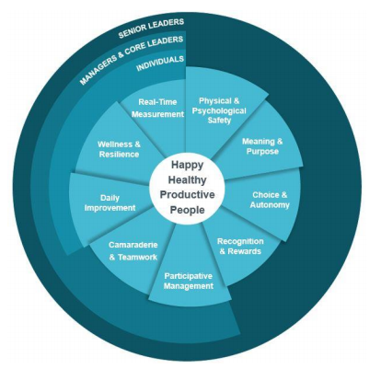
IHI Framework for improving Joy in work

Slide 18
Pebbles in your shoes

Slide 19
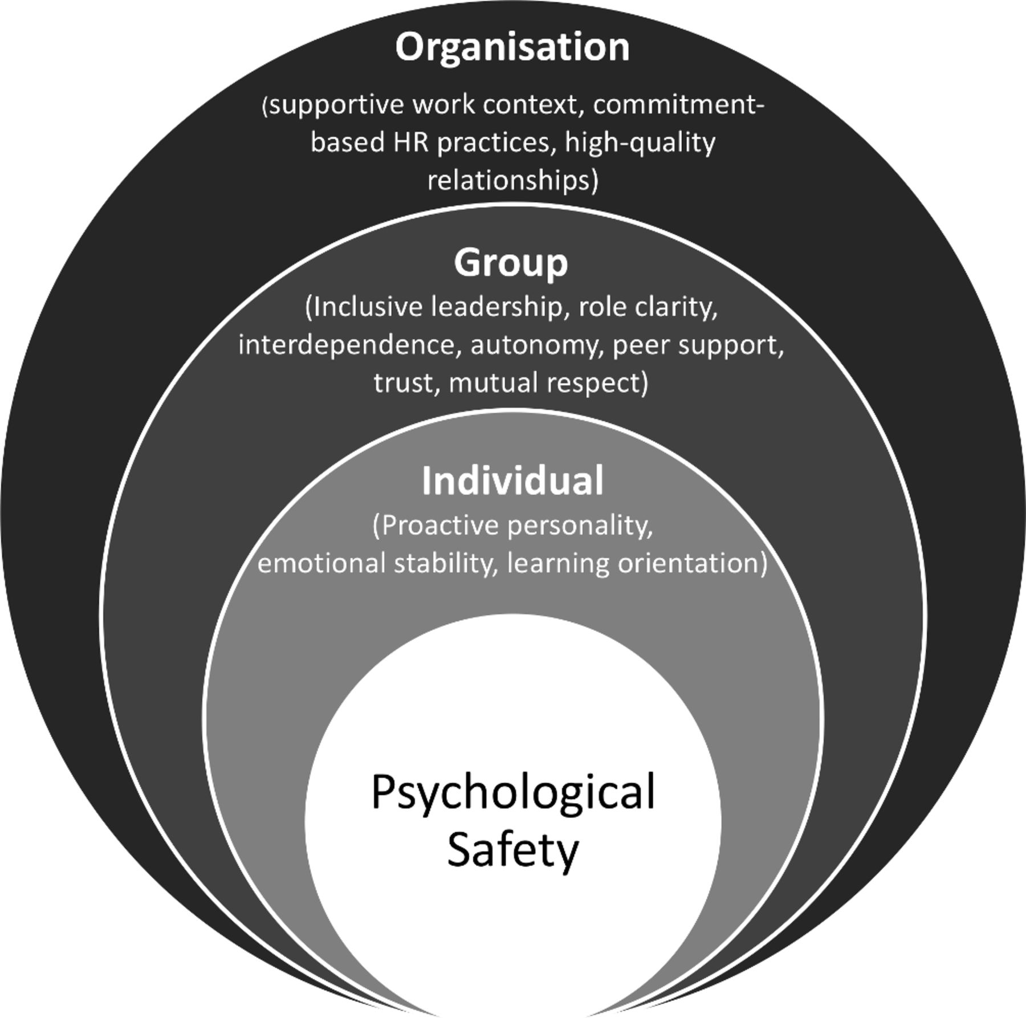
Physical and Psychological Safety
Managing psychological safety in debriefings: a dynamic balancing act | BMJ Simulation & Technology Enhanced Learning (2020)

Slide 20
Choice and Autonomy
Staff feel like they have some choice in how they go about their daily responsibilities
They have a voice in the way things are done in daily work
Staff are part of the decisions on processes, changes, and improvements that affect them
The courage of compassion: Supporting nurses and midwives to delivery high-quality care Sept 2020)
word template (kingsfund.org.uk)

Slide 21
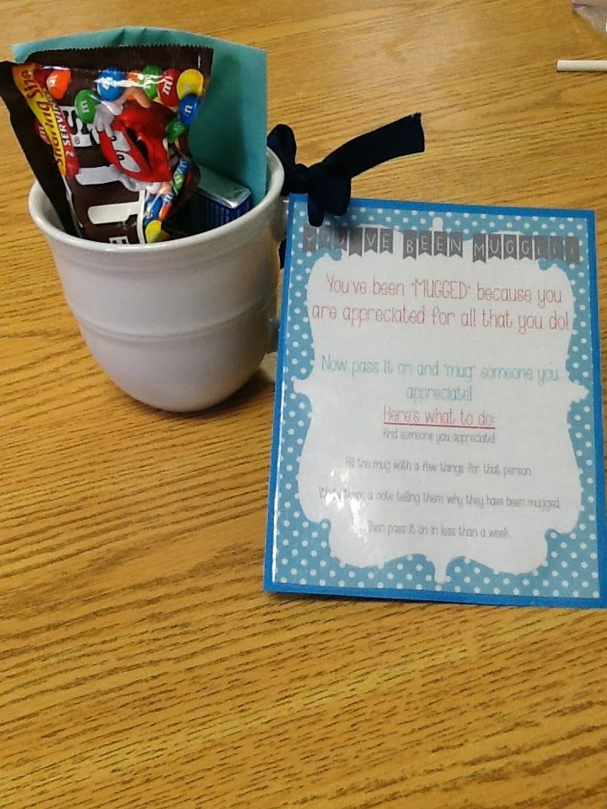
Recognition and rewards
Who the recognition comes from
Timing
Make it public
Details matter
Research: A Little Recognition Can Provide a Big Morale Boost (hbr.org) March 21

Slide 22
Camaraderie and Teamwork
Social cohesion is generated through productive teams, shared understanding and trusting relationships
Do you and your team:
provide mutual support and companionship?
feel you are all part of a team, working together towards something meaningful?
regularly express appreciation for each other’s work?

Slide 23
Daily Improvement
Aim: What are we trying to accomplish?
Measures: How will we know if a change is an improvement?
Change: What changes can we make that will result in an improvement?
Plan
Study
Act
Do
Use of quality improvement tools and techniques to identify, test, and implement improvements

Slide 24
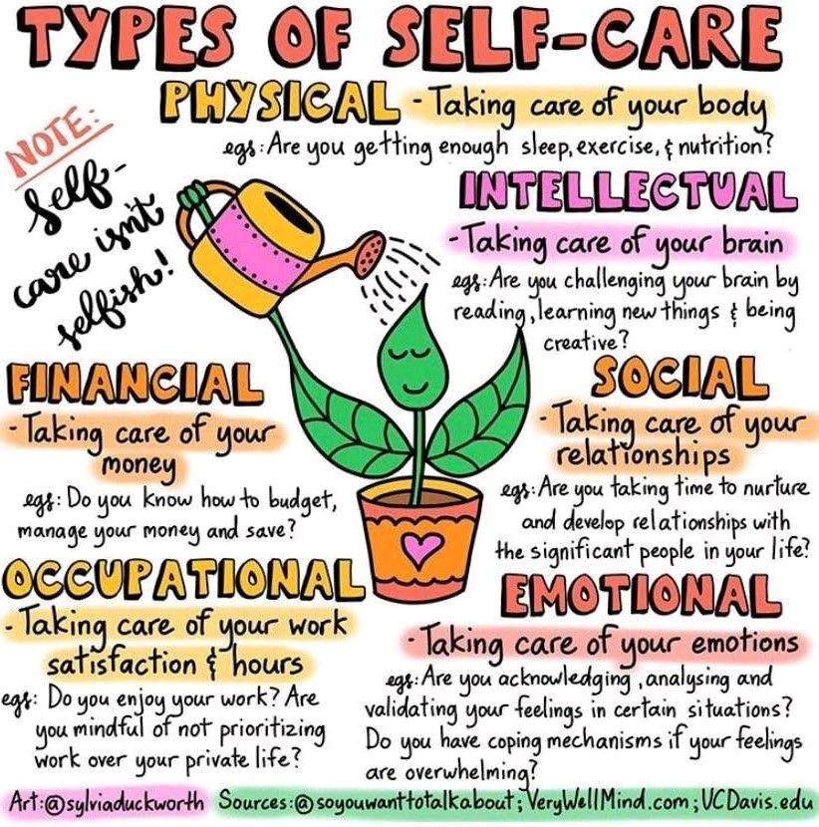
Wellness and Resilience

Slide 25
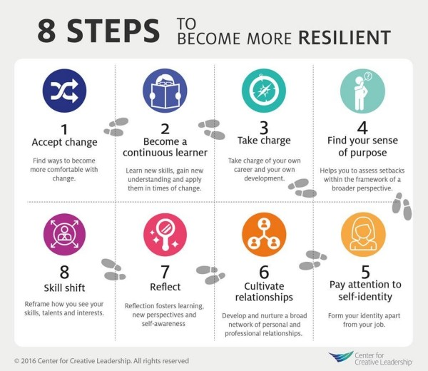
Wellness and Resilience

Slide 26
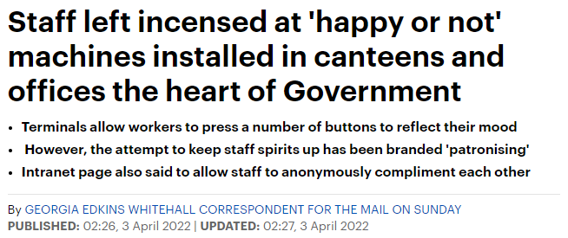
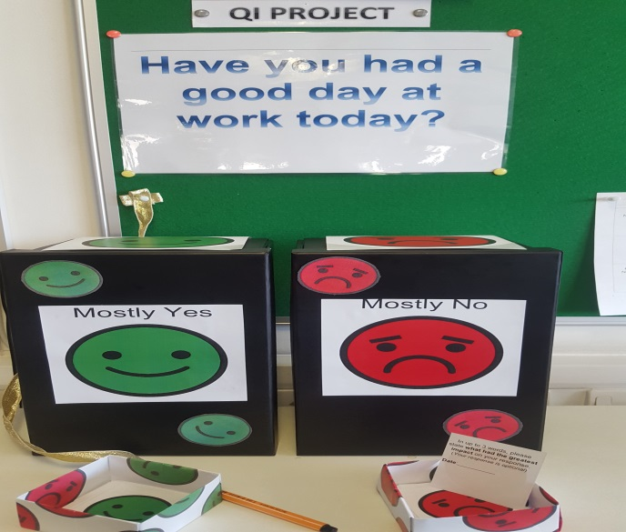
Measurement
Long Term System-level measures:
Turnover
Retention
Sickness/absence
Staff survey (yearly)
Short term measures:
Counters
Questionnaires
Apps
East London Foundation Trust

Slide 27
Example questionnaire questions
 | Strongly disagree | Disagree | Neither agree or disagree | Agree | Strongly agree
I am treated with respect every day by everyone who works within my team
People generally support one another in the team within which I work
Overall I believe I work in an excellent team
I feel I have control over my daily work
I have the resources I need to do my job well
My manager encourages me to suggest ideas for improvement
My manager treats me with respect
I regularly feel burned out from my work

Slide 28
Getting started
Ask staff, “What matters to you?”
Identify frustrations (pebbles in your shoes)
Use improvement science to test approaches to improving joy in work
Commitment to making joy in work a shared responsibility

Slide 29
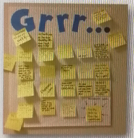
Identifying frustrations and root causes

Slide 30
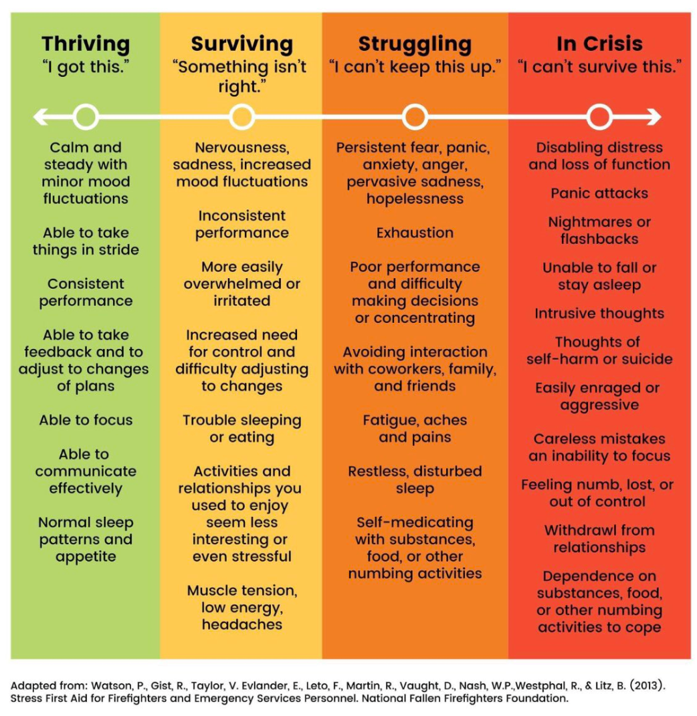
Notes:
Firefighters

Slide 32
Making changes
Smile more today
Smiling makes us feel happier
A number of research studies have discovered that smiling, whether it’s natural or forced, causes our brains to interpret that physical reaction as positive and will then recognise whatever activity we are doing as being enjoyable.
Time to put on a cheesy grin!

Slide 33
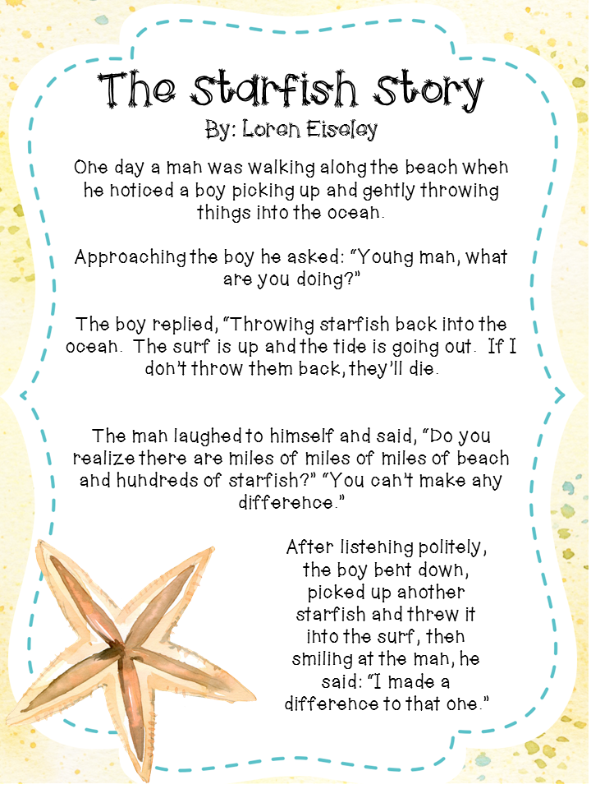

Slide 34
What will you do now?

Slide 35
Twitter: @JuliaWoodQI Email: hello@juliawood.co.uk

