Slide 1
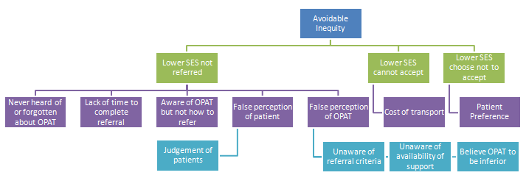
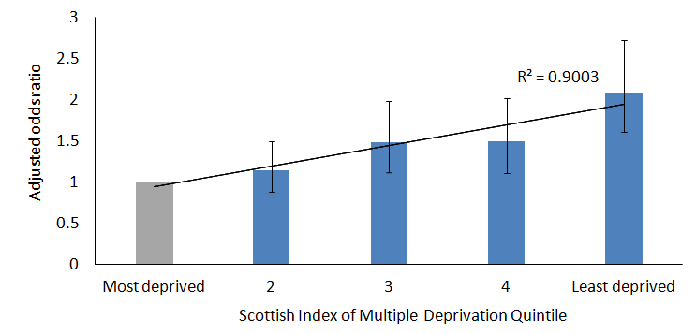


Fair access to Outpatient Antimicrobial Therapies Colin Sumpter, Specialty Registrar, Public Health and Policy
Quality issue / initial problem
One of the founding principles of the NHS is that services be provided on the basis of need, not ability to pay. Staff at OPAT felt that there was inequity in the service with wealthier patients more likely to access. We aimed to uncover why, and plan to reduce this inequity over time through Quality Improvement.
Driver Diagram
SES = Socioeconomic Status, measured by SIMD 2016
Data used to understand system
Someone admitted for cellulitis from the wealthiest areas of Lothian is twice as likely to be referred to OPAT.
Adjusted odds ratio of OPAT referral by deprivation
Transport is a major barrier to accepting an OPAT referral
Qualitative patient interviews x 10 with current patients:
Referrals are from a narrow range of sources and do not reflect where OPAT amenable conditions are seen
“I spend £20 a day on taxis, my entire student budget for the day, but it is worth it to get home”
“The leaflet told me about PTS (Patient Transport) but I would not qualify, my husband drives me”
“Without [a car and] guaranteed parking I would not have been able to come on my own”
“I estimate it will cost around £170 over the 3 weeks. There was no offer of financial help for transport”
“Positives are being surrounded by your home comforts, on your own sofa, with your family”
Proposed improvement
Quality improvement will be led by OPAT Team. Ideas for testing include new information for wards; work with primary care; and attending ward rounds. Longer term: business case for patient transport and community expansion.
Lessons learned and message for others
Providing a good service to those who come in the door is important, but even more important is making sure the door is open to everyone. Unequal access to the NHS is still a major and hidden driver of health inequality.

