Slide 1
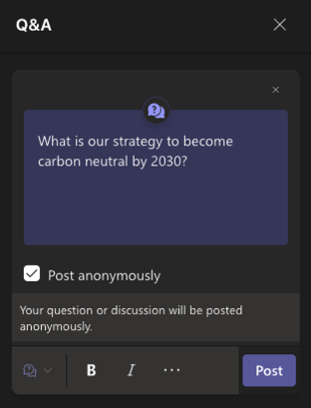
Housekeeping
Recording
Mute unless talking
Camera on!
Chat
Q&A
Reactions
Notes:
Please remain on mute unless talking
We plan to record this session so we can share the video after the event on the FAB website.
Please keep your cameras on, it’s really nice for presenters to see you when they are
The Q&A function has been enabled. Please use it if you have any questions. The hosts on this call will bring them in at the end of this presentation. We’re using the Q&A function today as sometimes questions can get lost in the chat when there are a lot of comments. We will be monitoring both the chat and Q&A but the latter will be the most effective place to put your question for us to bring up again at the end. If you would prefer to ask your question at the end directly simply pop your hand up using the raise hand function. Please only raise your hand once the presentation has finished.
Please also use your reactions, they are a great way to support the presenter!
1

Slide 2
Ways to mitigate climate crisis despair and inspire action
Hilda Campbell MBE FRSA COPE Scotland
www.cope-scotland.org
@COPEScotland

Slide 3
The session will cover
Ideas which can support climate actions within your control and the control of your teams and organisations using the tool ‘Jigsaw Lids’ ©COPEScotland for climate action
Ideas to maintain your own energy levels and those of your teams and networks and not feel overwhelmed by climate anxiety using the ‘Battery exercise’ © COPEScotland
COPE Scotland has a Grove in ‘Trees for Life’ named ‘Against the odds’ We shall make 3 tree dedications following the session.
All the materials can be downloaded from www.cope-scotland.org or email hilda@cope-scotland.org © to COPEScotland but we are happy to share for others to use for free.
Notes:
Please remain on mute unless talking
We plan to record this session so we can share the video after the event on the FAB website.
Please keep your cameras on, it’s really nice for presenters to see you when they are
The Q&A function has been enabled. Please use it if you have any questions. The hosts on this call will bring them in at the end of this presentation. We’re using the Q&A function today as sometimes questions can get lost in the chat when there are a lot of comments. We will be monitoring both the chat and Q&A but the latter will be the most effective place to put your question for us to bring up again at the end. If you would prefer to ask your question at the end directly simply pop your hand up using the raise hand function. Please only raise your hand once the presentation has finished.
Please also use your reactions, they are a great way to support the presenter!
3

Slide 4
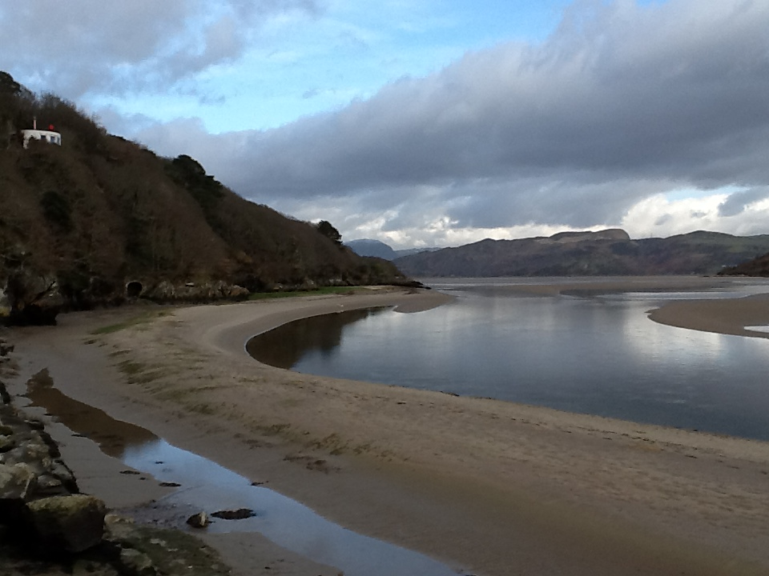
Take a moment to pause
Notes:
Please remain on mute unless talking
We plan to record this session so we can share the video after the event on the FAB website.
Please keep your cameras on, it’s really nice for presenters to see you when they are
The Q&A function has been enabled. Please use it if you have any questions. The hosts on this call will bring them in at the end of this presentation. We’re using the Q&A function today as sometimes questions can get lost in the chat when there are a lot of comments. We will be monitoring both the chat and Q&A but the latter will be the most effective place to put your question for us to bring up again at the end. If you would prefer to ask your question at the end directly simply pop your hand up using the raise hand function. Please only raise your hand once the presentation has finished.
Please also use your reactions, they are a great way to support the presenter!
4

Slide 5
Notes:
Please remain on mute unless talking
We plan to record this session so we can share the video after the event on the FAB website.
Please keep your cameras on, it’s really nice for presenters to see you when they are
The Q&A function has been enabled. Please use it if you have any questions. The hosts on this call will bring them in at the end of this presentation. We’re using the Q&A function today as sometimes questions can get lost in the chat when there are a lot of comments. We will be monitoring both the chat and Q&A but the latter will be the most effective place to put your question for us to bring up again at the end. If you would prefer to ask your question at the end directly simply pop your hand up using the raise hand function. Please only raise your hand once the presentation has finished.
Please also use your reactions, they are a great way to support the presenter!
5

Slide 6
What do you think?
In the chat box please complete the following sentence
The climate action over which I have 15% control is……………….
The climate action my workplace can exert 15% control is…………..
It matters we find ways to act and not fall into despair because………………
https://www.liberatingstructures.com/7-15-solutions/
Notes:
Please remain on mute unless talking
We plan to record this session so we can share the video after the event on the FAB website.
Please keep your cameras on, it’s really nice for presenters to see you when they are
The Q&A function has been enabled. Please use it if you have any questions. The hosts on this call will bring them in at the end of this presentation. We’re using the Q&A function today as sometimes questions can get lost in the chat when there are a lot of comments. We will be monitoring both the chat and Q&A but the latter will be the most effective place to put your question for us to bring up again at the end. If you would prefer to ask your question at the end directly simply pop your hand up using the raise hand function. Please only raise your hand once the presentation has finished.
Please also use your reactions, they are a great way to support the presenter!
6

Slide 7
Our People Our Planet Jigsaw lid

Slide 8
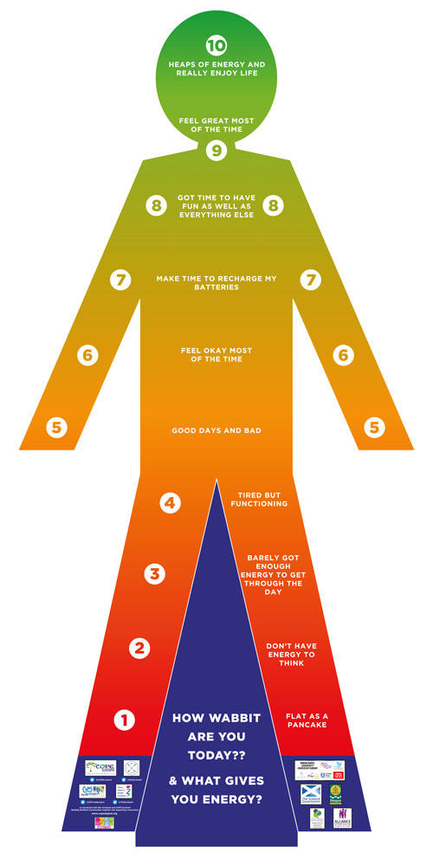
Notes:
Please remain on mute unless talking
We plan to record this session so we can share the video after the event on the FAB website.
Please keep your cameras on, it’s really nice for presenters to see you when they are
The Q&A function has been enabled. Please use it if you have any questions. The hosts on this call will bring them in at the end of this presentation. We’re using the Q&A function today as sometimes questions can get lost in the chat when there are a lot of comments. We will be monitoring both the chat and Q&A but the latter will be the most effective place to put your question for us to bring up again at the end. If you would prefer to ask your question at the end directly simply pop your hand up using the raise hand function. Please only raise your hand once the presentation has finished.
Please also use your reactions, they are a great way to support the presenter!
8

Slide 9
Notes:
Please remain on mute unless talking
We plan to record this session so we can share the video after the event on the FAB website.
Please keep your cameras on, it’s really nice for presenters to see you when they are
The Q&A function has been enabled. Please use it if you have any questions. The hosts on this call will bring them in at the end of this presentation. We’re using the Q&A function today as sometimes questions can get lost in the chat when there are a lot of comments. We will be monitoring both the chat and Q&A but the latter will be the most effective place to put your question for us to bring up again at the end. If you would prefer to ask your question at the end directly simply pop your hand up using the raise hand function. Please only raise your hand once the presentation has finished.
Please also use your reactions, they are a great way to support the presenter!
9

Slide 10
Contact details.
hilda@cope-scotland.org
www.cope-scotland.org
@COPEScotland
Staff wellbeing SIG the Q Community https://q.health.org.uk/community/groups/staff-wellbeing-and-quality-health-care/
For more information on the Q Community https://q.health.org.uk/
Q&A
Notes:
10

