Slide 1



Patient safety: new issues, ideas and innovations
10 October, 2017
Birmingham, England
Jeffrey Braithwaite, PhD,
FAIM, FCHSM, FFPHRCP, FAcSS, Hon FRACMA
Professor and Director
Australian Institute of Health Innovation
Director
Centre for Healthcare Resilience and Implementation Science

Slide 2

Australian Institute of Health Innovation
Our mission is to enhance local, institutional and international health system decision-making through evidence; and use systems sciences and translational approaches to provide innovative, evidence-based solutions to specified health care delivery problems.
www.aihi.mq.edu.au

Slide 3



Australian Institute of Health Innovation

Slide 4
Australian Institute of Health Innovation
  Professor Jeffrey Braithwaite
  Foundation Director, AIHI; Director, Centre for Healthcare Resilience and Implementation Science
  Professor Enrico Coiera
  Director, Centre for Health Informatics
  Professor Johanna Westbrook
  Director, Centre for Health Systems and Safety Research

Slide 5
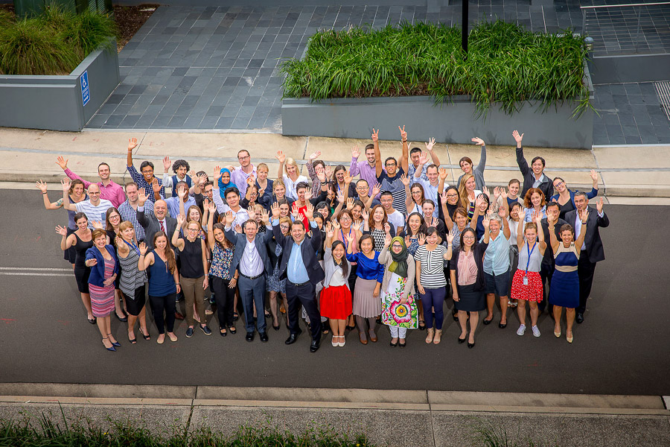
Australian Institute of Health Innovation

Slide 6
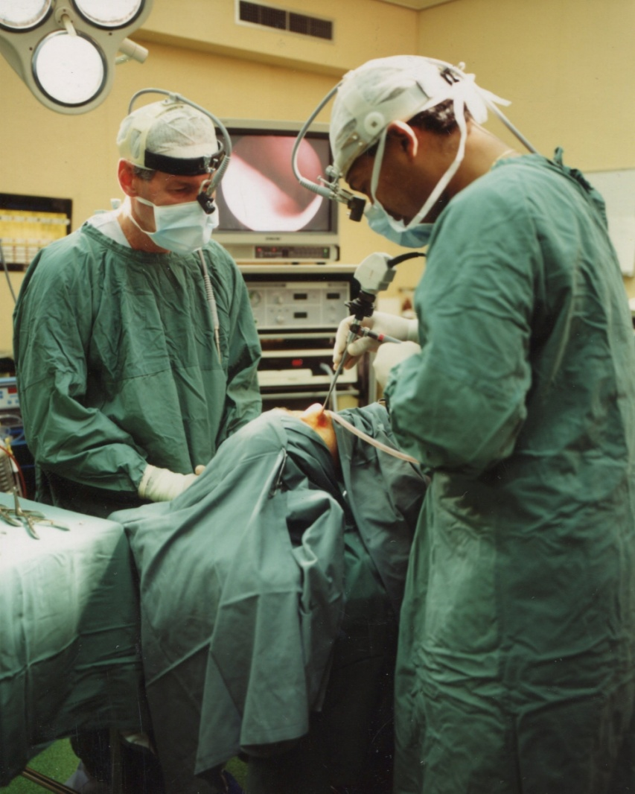
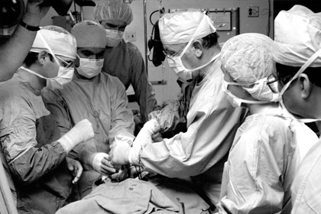
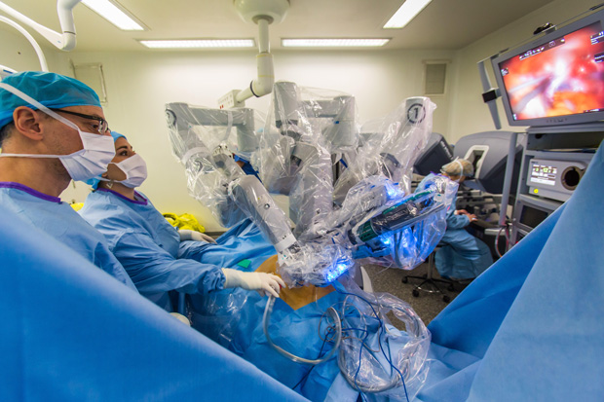
Changing world of health care
The 1970’s
Present day
The 1990’s

Slide 7
New issues in patient safety

Slide 9
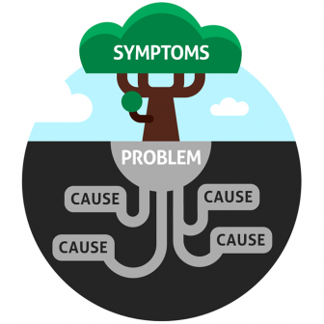

Patient safety initiatives
Root cause analysis
Hand hygiene
Medication safety
Accreditation
Etc etc …

Slide 10
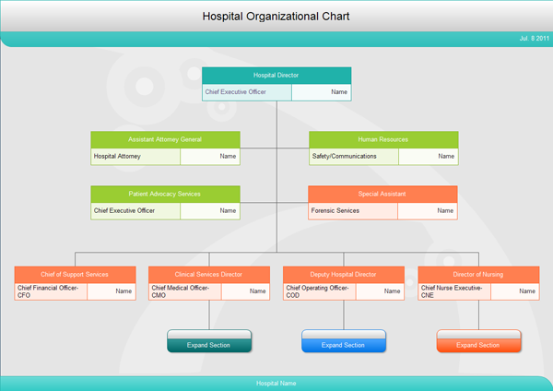
If your mental model is this …

Slide 11

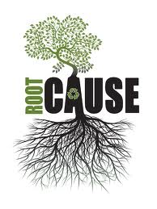
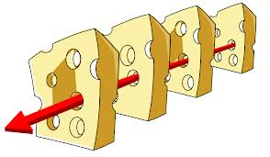
This is how you will deal with error …

Slide 12
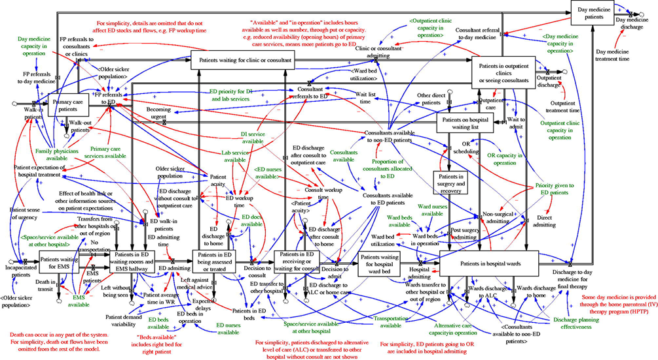
But healthcare really looks like this …

Slide 13
Not like this … but this

Slide 14
And … it’s very hard to
make large-scale change

Slide 15
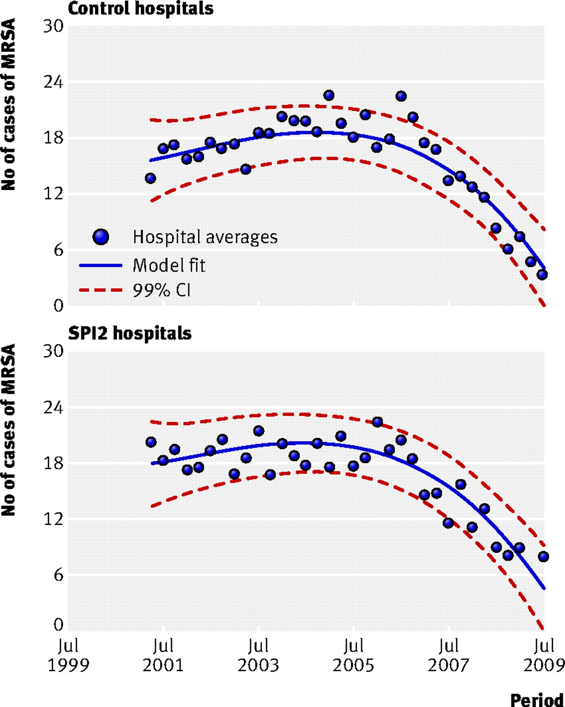

Example #1: UK Safer Patients Initiative
Rates of cases of MRSA per 100 000 bed days in control and SPI2 hospitals.
SPI phase 2 study, 20 hospitals
[Benning A et al. BMJ 2010]1
©2011 by British Medical Journal Publishing Group

Slide 16
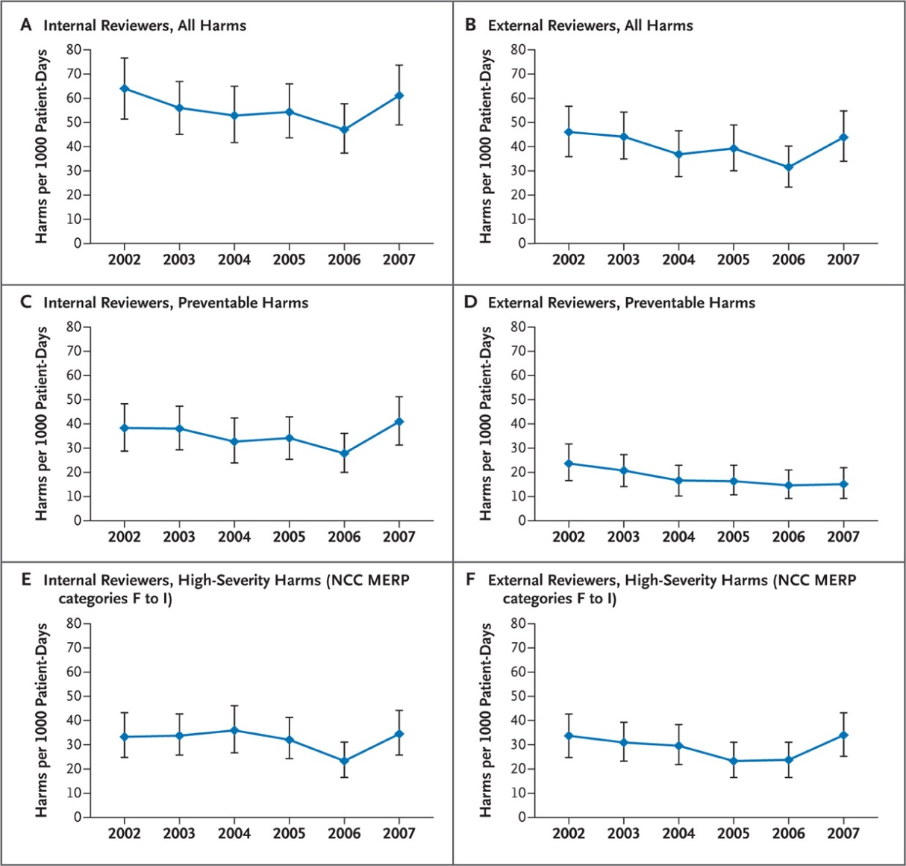
Example #2: harm per 1000 patients in ten N. Carolina Hospitals
Measures of adverse events using the global trigger tool
Little change in adverse event rates over six years
[Landrigan et al. NEJM 2010]

Slide 17
By the way, there is some reassurance:
We have been successful e.g. …

Slide 18
Heart bypasses on eighty year olds, key hole surgery, treatment for HIV/AIDS.

Slide 19

But the rates of harm haven't reduced far enough

Slide 20

It seems to have flatlined at 10%

Slide 21
So we need new ideas and innovations in thinking about patient safety

Slide 22
New ideas and innovations in
patient safety
Health care as a CAS
Safety-I and Safety-II
WAI and WAD

Slide 23
1. Exposing the CAS features

Slide 24
Health care as a complex adaptive system
Agents
Inter-relating
Rich relationships
Non-linearity
Self-organising
Hierarchical
Path-dependent
Emergent behaviours
Feedback occurs
Fractal, nested
Heterarchical
Individuals only know local elements
[Braithwaite et al. 2014]

Slide 25

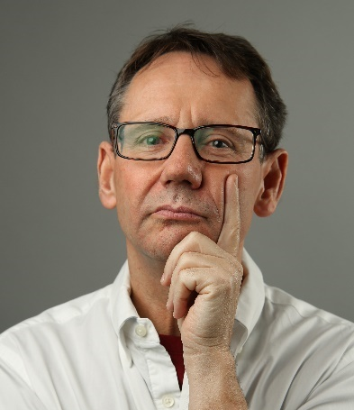


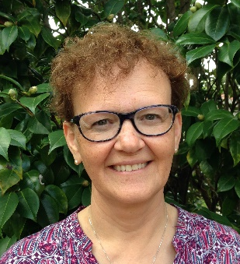
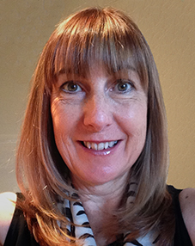
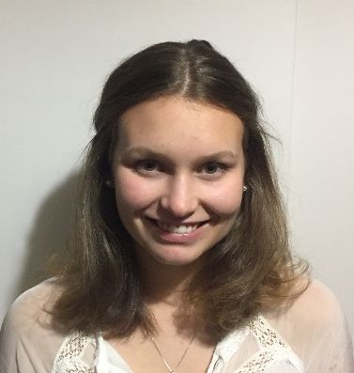


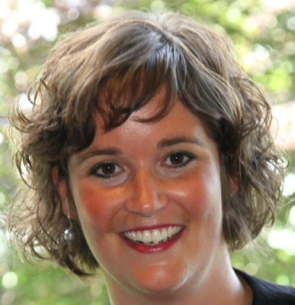
Complexity Science in Health Care: A White Paper

Slide 26
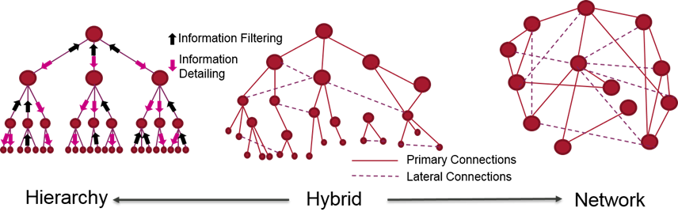
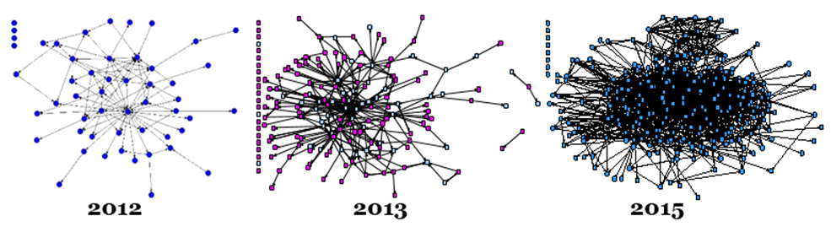
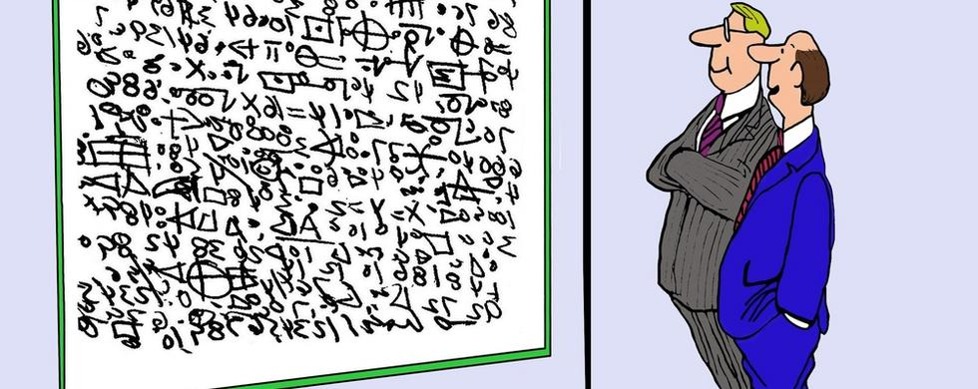
Complexity Science in Healthcare—
ASPIRATIONS, APPROACHES, APPLICATIONS AND ACCOMPLISHMENTS:
A WHITE PAPER
Jeffrey Braithwaite, Kate Churruca, Louise A Ellis, Janet Long, Robyn Clay-Williams, Nikki Damen, Jessica Herkes, Chiara Pomare, Kristiana Ludlow
Australian Institute of Health Innovation, Macquarie University, Australia

Slide 27
Complexity Science in Healthcare—
ASPIRATIONS, APPROACHES, APPLICATIONS AND ACCOMPLISHMENTS:
A WHITE PAPER
Jeffrey Braithwaite, Kate Churruca, Louise A Ellis, Janet Long, Robyn Clay-Williams, Nikki Damen, Jessica Herkes, Chiara Pomare, Kristiana Ludlow
Australian Institute of Health Innovation, Macquarie University, Australia
Uncertainty
Emergence
Capacity
Interacting agents
Adaptation
Resilience
Ambiguity
Flexing and adjusting
Improvisation
Capacity for maneuver

Slide 28
For example: obesity
That’s a linear problem, right?

Slide 29
For example: obesity
Fewer calories, more exercise =

Slide 30






Slide 31
For example: obesity
Unfortunately not =

Slide 32
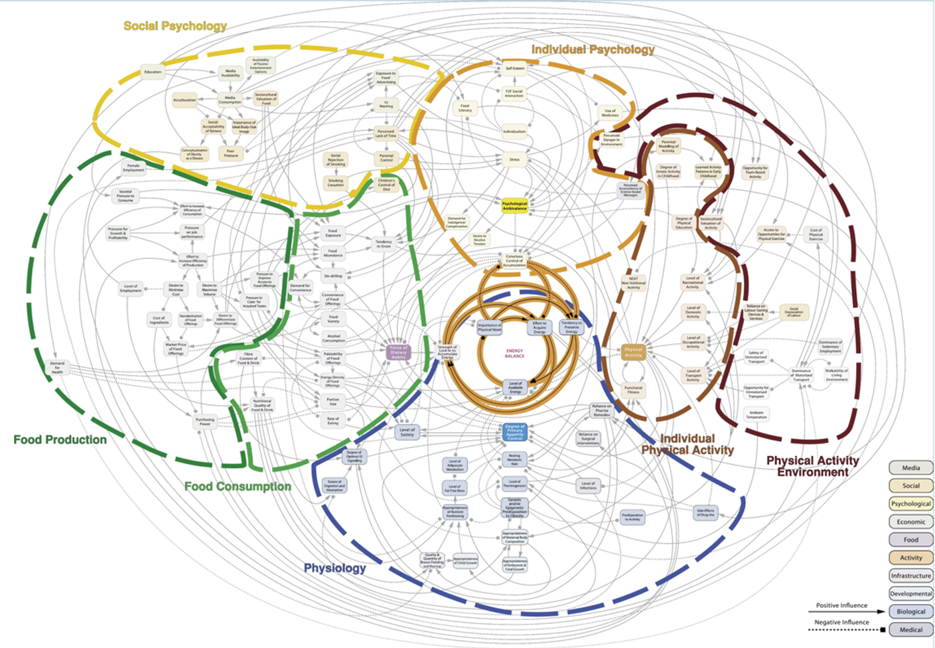

Slide 33
Translational Cancer Research Network – Eastern Sydney, Australia
2012
2014
2015
Long, Hibbert, Braithwaite (2016), Structuring successful collaboration: a longitudinal social network analysis of a translational research network, Implementation Science: 11 (19).

Slide 34
2. Safety-I and Safety-II

Slide 35

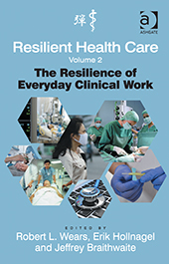

Slide 36
Safety Perspectives in RHC
Safety I
Safety II
The (relative) absence of adverse events
Reactive
Assumes safety can be achieved by finding, and eliminating the causes of adverse events
The ability to succeed under varying conditions
Proactive
Focuses on what goes right, so that the number of intended and acceptable outcomes is as high as possible every day
[Hollnagel, Braithwaite, Wears. Resilient Health Care, 2013]

Slide 37
Safety-I and Safety-II
The amazing thing about health care isn’t that it produces adverse events in 10% of all cases, but that it produces safe care in 90% of cases.

Slide 38
Resilient Health Care
“Resilience is the intrinsic ability of a system to adjust its functioning prior to, during or following changes/ disturbances in order to sustain required operations under expected or unexpected conditions”
Here are some ideas from RHC thinking...
[Hollnagel et al. Resilient Health Care, 2013]

Slide 39
Safety-I – where the number of adverse outcomes is as low as possible
Trying to make sure things don’t go wrong

Slide 40
Safety-II – where the number of acceptable outcomes is as high as possible
Trying to make sure things go right

Slide 41
Few people have ever looked at why things go right so often

Slide 42
3. Work-as-imagined and work-as-done

Slide 43
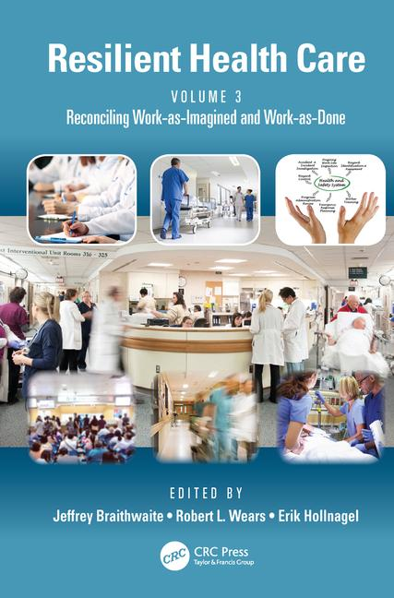

Slide 44
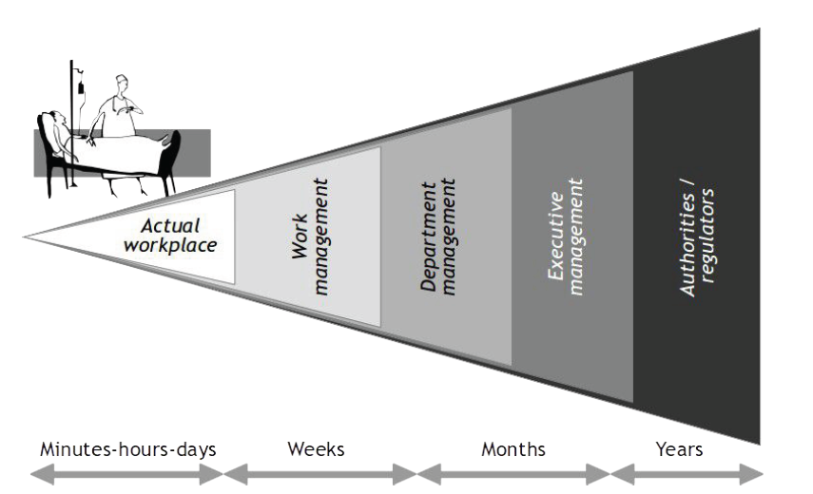
WAI and WAD
[Hollnagel, 2015]

Slide 45
Are you on this list?
Policy-makers, executives, managers, legislators, governments, boards of directors, software designers, safety regulation agencies, teachers, researchers.

Slide 46

The blunt end tries to …
shape, influence, nudge behaviour.

Slide 47

What they do seems perfectly logical, obvious and feasible.
47

Slide 48

In health care, those doing WAI have designed, mandated or encouraged a bewildering range of tools, techniques and methods, to reduce harm to patients.

Slide 49
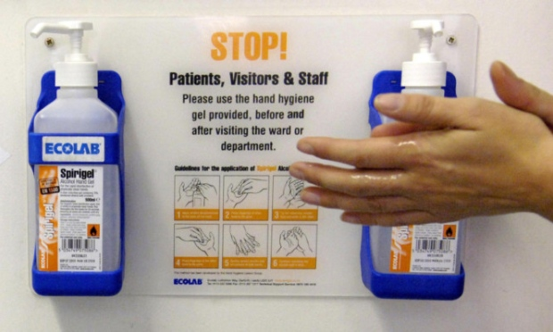
E.g., root cause analysis, hand hygiene campaigns, failure modes effects analysis ...
And there’s lots of others …

Slide 50

Meanwhile work is getting done, often despite all the policies, rules and mandates

Slide 51
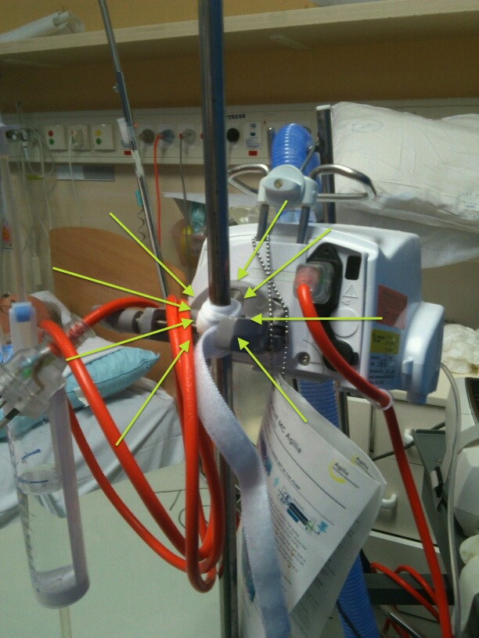
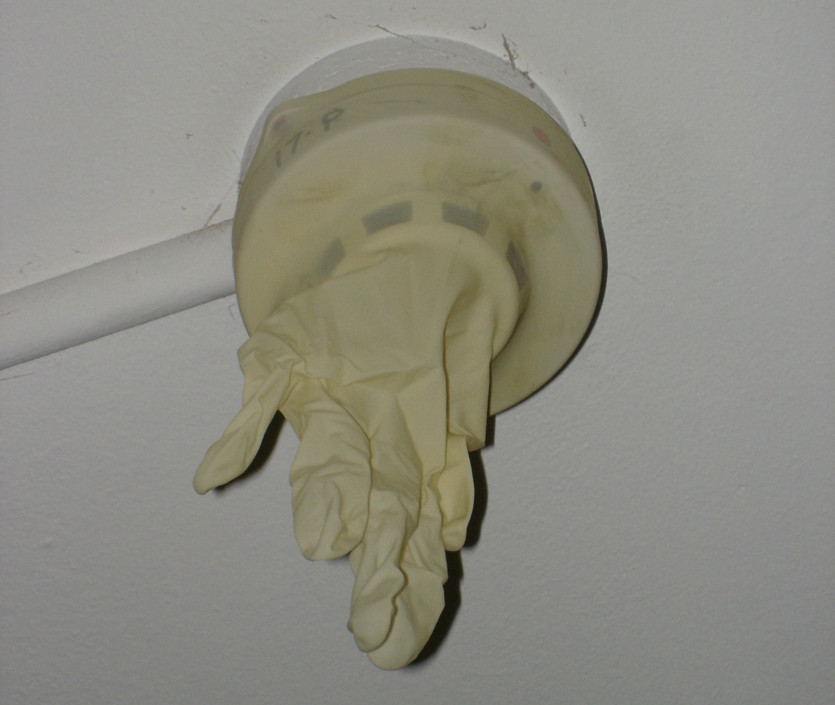
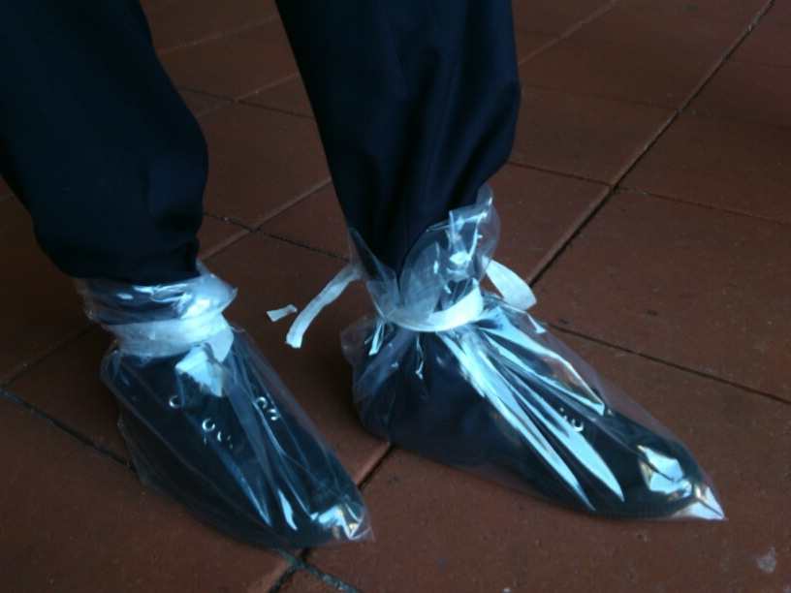
WAD—workarounds
Plastic bags placed over shoes to workaround the problem a of gumboot (welly) shortage.
Glove placed over a smoke alarm, as it kept going off due to nebulisers in patients’ rooms.
A leg strap holding an IV to a pole, as the holding clasp had broken.

Slide 52
WAD—fragmentation
Doctors in Emergency Departments in a study:
Were interrupted 6.6 times per hour.
Were interrupted in 11% of all tasks.
Multitasked for 12.8% of the time.
[Westbrook et al. (2010). Qual Saf Health Care]

Slide 53
Doctors in EDs in a study:
Spent on average 1:26 minutes on any one task.
When interrupted, spent more time on tasks.
And … failed to return to approximately 18.5% of interrupted tasks.
[Westbrook et al. (2010). Qual Saf Health Care]

Slide 54

So work-as-imagined folks often have some sort of linear, mechanistic view of the system.

Slide 55
Instead, health care is a complex adaptive system delivered by people on the front line who flex and adjust to the circumstances.

Slide 56
Not like this … like this

Slide 57

And clinicians don’t deliver care in the way blunt end prescriptivists want them to.

Slide 58

And therefore the only real solution is to try and reconcile work-as-imagined and work-as-done.

Slide 59
Let’s explore this …

Slide 60
Claim 1: Work-as-imagined
“After 25 years of evidence based medicine, care is evidence based.”

Slide 61
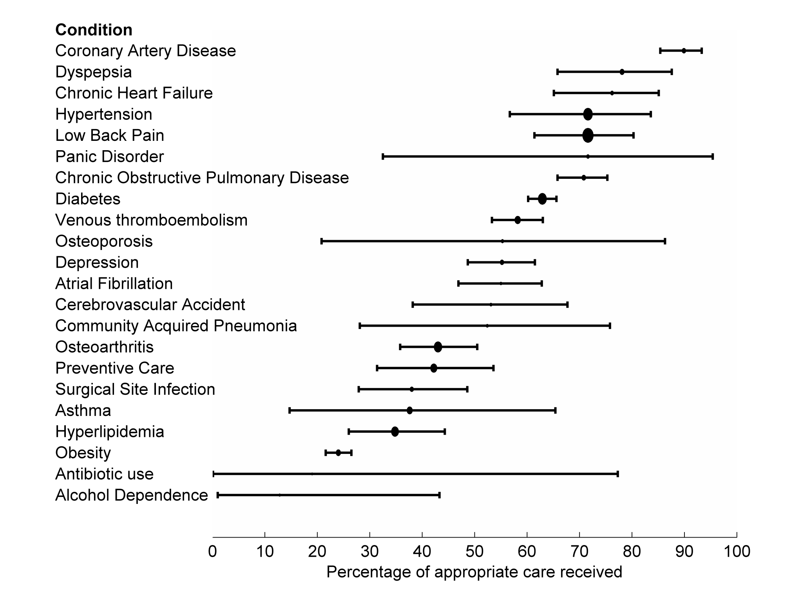
Study 1: Work-as-done
Runciman WB, Hunt TD, Hannaford NA, Hibbert PD, Westbrook JI, Coiera EW, Day RO, Hindmarsh DM, McGlynn EA, and Braithwaite J. (2012) CareTrack: assessing the appropriateness of health care delivery in Australia. Medical Journal of Australia, 197:2.

Slide 62
Claim 2: Work-as-imagined
“We deliver care in multidisciplinary teams.”

Slide 63
Study 2: Work-as-done
Problem solving networks in an ED
Nurses
Doctors
Allied health
Admin and support
[Creswick, Westbrook and Braithwaite, 2009]

Slide 64
Study 2: Work-as-done
Medication advice-seeking networks in an ED
Nurses
Doctors
Allied health
Admin and support
[Creswick, Westbrook and Braithwaite, 2009]

Slide 65
Study 2: Work-as-done
Socialising networks in an ED
Nurses
Doctors
Allied health
Admin and support
[Creswick, Westbrook and Braithwaite, 2009]

Slide 66
Claim 3: Work-as-imagined
“We know how our systems work.”

Slide 67
Study 3: Work-as-imagined
Work-as-imagined:
Lynch syndrome study
Screen
High risk
Refer
67

Slide 68
Study 3: Work-as-done
Key:

Slide 69
Claim 4: Work-as-imagined
“We are a high performing hospital.”

Slide 70
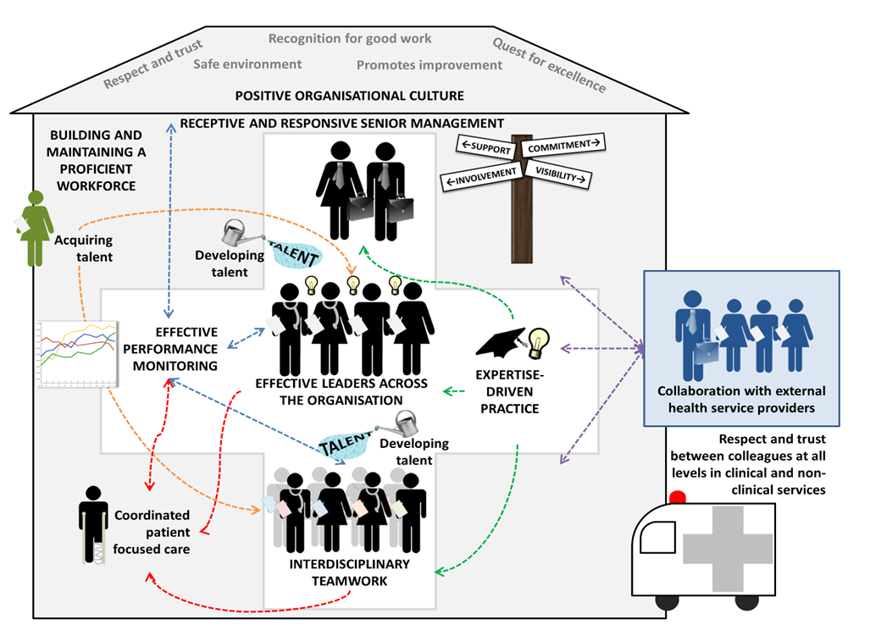
Study 4: Work-as-done
[Taylor, Clay-Williams, Hogden, Braithwaite, Groene, 2015.]

Slide 71
Claim 5: Work-as-imagined
“It’s a moribund system and doesn’t change.”

Slide 72
Study 5: Work-as-done
ISBN:
978-1-4724-8204-4
Website: https://www.crcpress.com

Slide 73
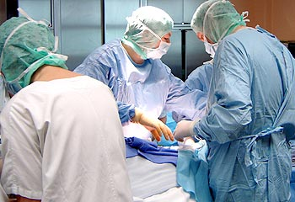

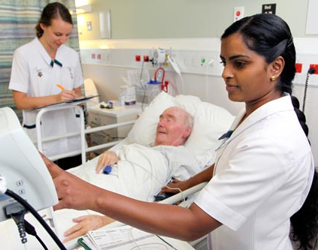
A message to blunt end people—learn how work actually works.

Slide 74



A message to sharp end people—work more closely with WAI people.

Slide 75
The bottom line?

Slide 76
In life, in marriage, in affairs of the heart, in friendships, in international relations, and in working environments:
It’s always better to engage with your partner.

Slide 77
Lessons
New rules for an old problem
Don’t ever think getting evidence into practice is easy
Progress will always be hard work
Linear will only get you so far—often, nowhere fast
Work with the natural characteristics of the CAS
Always look out for unintended consequences
Braithwaite, 2010; Braithwaite 2015 Gaps in systems

Slide 78
Lessons
New rules for an old problem
Don’t do it alone … it’s a system of systems
Harness others—mavens, cosmopolites, bridges, brokers, opinion leaders
You’ll need institutional support, too
Look at what goes right, and think why
Do more of things going right
Braithwaite, 2010; Braithwaite 2015 Gaps in systems

Slide 79
Questions or comments?

Slide 80
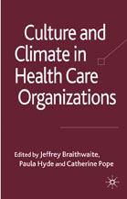


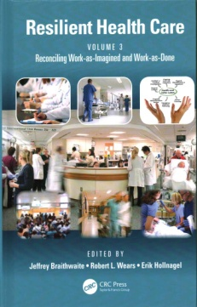
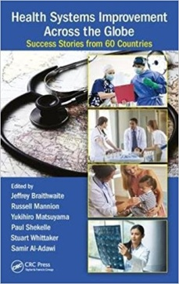
Recent Published Books
Published
2010
2013
2015
2015
2016
2017
2017
Culture and Climate in Health Care Organizations
Resilient Health Care
The Resilience of Everyday Clinical Work
Healthcare Reform, Quality and Safety: Perspectives, Participants, Partnerships and Prospects in 30 Countries
The Sociology of Healthcare Safety and Quality
Reconciling Work-as-imagined and Work-as-done
Health Systems Improvement Across the Globe: Success Stories from 60 Countries

Slide 81

Forthcoming Books
In Production
Health Care Systems: Future Predictions for Global Care
Gaps: the Surprising Truth Hiding in the In-between
Surviving the Anthropocene
Field Guide to Resilient Health Care
Counterintuitivity: How your brain defies logic

Slide 82
Contact details
Jeffrey Braithwaite, PhD
Foundation Director
Australian Institute of Health Innovation
Director
Centre for Healthcare Resilience and Implementation Science
Professor, Faculty of Medicine and Health Sciences
Macquarie University
NORTH RYDE NSW 2109
Email: jeffrey.braithwaite@mq.edu.au
Web: https://jeffrey-braithwaite.squarespace.com/
AIHI Website: http://aihi.mq.edu.au
Wikipedia: http://en.wikipedia.org/wiki/Jeffrey_Braithwaite

