Slide 1
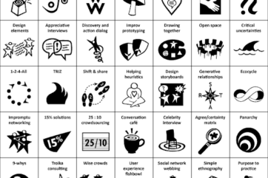
Agreement & Certainty Matrix
Liberating structures
Notes:
Afra

Slide 2
Take a moment just to pause
Notes:
Afra

Slide 3
Safe space
This exercise enables us to share perspectives about a challenge in a structured way. We have prepared a scenario for this practice session.
Please be aware that in your own situations this liberating structure may reveal uncomfortable issues, so it is important to consider how you would create a safe space for yourself and others.
Notes:
Afra

Slide 4
What we will cover this session
Introduction to Agreement- & Certainty-Matrix
The Purpose Agree/Certainty Matrix can serve
Min Specs
Time allocation
Chance to Practice
Notes:
Afra

Slide 5
Agreement- & Certainty-Matrix Attribution: Liberating Structure developed by Henri Lipmanowicz and Keith McCandless. Inspired by Seeds of Compassion practitioners and consultant Mark Jones.
Sort Challenges into Simple, Complicated, Complex, and Chaotic Domains (45 min.)
If I had an hour to solve a problem and my life depended on the solution, I would spend the first 55 minutes determining the proper question to ask…. – Albert Einstein
Notes:
Afra
What is made possible? You can help individuals or groups avoid the frequent mistake of trying to solve a problem with methods that are not adapted to the nature of their challenge. The combination of two questions makes it possible to easily sort challenges into four categories: simple, complicated, complex, and chaotic. A problem is simple when it can be solved reliably with practices that are easy to duplicate. It is complicated when experts are required to devise a sophisticated solution that will yield the desired results predictably. A problem is complex when there are several valid ways to proceed but outcomes are not predictable in detail. Chaotic is when the context is too turbulent to identify a path forward. A loose analogy may be used to describe these differences: simple is like following a recipe, complicated like sending a rocket to the moon, complex like raising a child, and chaotic is like the game “Pin the Tail on the Donkey.”

Slide 6
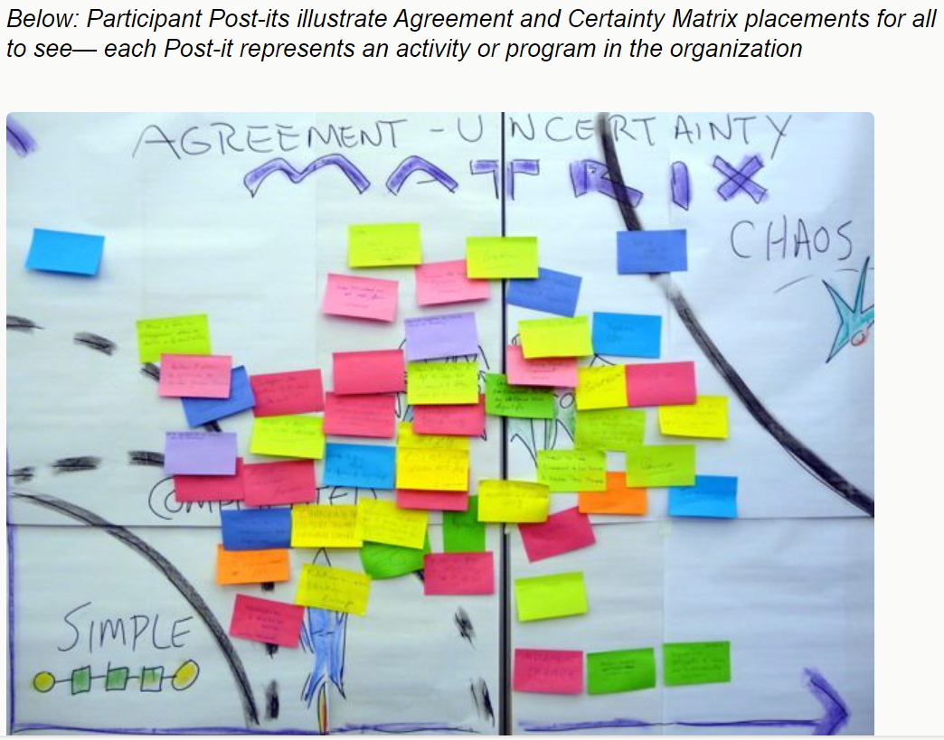
Notes:
Afra
This is how it may look in reality

Slide 7
Purpose of the Agreement & Certainty Matrix (AC Matrix)
Reduce wasted effort by matching challenges with methods
Identify where local experiments may help solve larger problems
Make visible to everyone the range and the nature of the challenges facing people in the organization
Reduce the frustration of people not making progress on key challenges by identifying mismatches
Share perspectives across functions and levels of the organization
Notes:
Afra
Read Through

Slide 8
Min Specs
1. Structuring Invitation
Invite participants to categorize their current challenges as simple, complicated, complex, or chaotic
Ask them to place every challenge in the matrix based on their answers to two questions:
What is the degree of agreement among the participants regarding the challenge and the best way to address it?
What is the degree of certainty and predictability about what results will be generated from the solutions proposed for addressing the challenge?
Ask them to think about the approaches they are using or considering to address each challenge, evaluate how well these fit and determine where there are mismatches.
Notes:
Afra
We shall give you a short while to familiarise yourself with the process of this LS but don’t worry about remembering as we shall guide you through it and this will just aid your practice/memory if you want to replicate in the future.

Slide 9
Min Specs
2. How Space Is Arranged and Materials Needed
Chairs or breakout rooms for people to sit in groups of 4–6, with or without small round tables
Long open wall with a large tapestry paper or virtual collaborative space with illustration of the matrix taped/pined to the wall or virtual space
One page with a blank matrix for every participant
Post-it notes and markers for everybody or edit access to the virtual space
3. How Participation Is Distributed
Everyone involved in the work, team or unit under discussion (not only leaders)
Everyone has an equal opportunity to contribute
4. How Groups Are Configured
Individually to make initial assessments
Small groups of 4 to 6
Whole group
Notes:
Afra
Ill give you some time here to just be aware of the steps.
Just to highlight that the text in red is where we have adapted the original spec to include virtual delivery that we are going to test out today.

Slide 10
Tips and Traps
Tips and Traps (for introducing AC Matrix)
Clarify what type of challenges and activities are being included
Work up from the individual, then into pair and table conversations
Avoid making judgments about where people put their challenges
Explore items that fall into more than one sector by asking, “Does this challenge have multiple dynamics at play? How is it simultaneously simple and complex?”
Pre-define, simple, complicated, complex and chaotic
Notes:
Petra
Read Through tips for introducing the Agreement/Certainty Matrix
A way you may assist people to define these categories could be to have a cheat sheet like the one on the next slide.

Slide 11
Notes:
Petra
This is to aid clarity and commonality on defining the challenges. (This will be in the chat for people to refer to)

Slide 12
Overview of proposed timeline
2 mins - Ask participants to individually generate list of challenges related to the scenario
2 mins – Place challenges in one of the four categories based on your answer to the 2 questions
5 mins – In pairs discuss the challenges and placements
5 mins – In groups of 4-6 find points of agreement, differences in challenges and mismatches of problem to solution
5 mins – All to post their challenges on the Large Group Matrix
15 mins - Whole group to share reflections, step back to reflect on, “What pattern do we see? Do any mismatches stand out that we should address?” then decide potential next steps.
Notes:
Petra
So these are the proposed timelines. We shall guide you through the steps and what to do but does anyone have any questions or concerns at this point?
(if few people (less than ??) you can say the following) Normally step 4 would be done in groups of 4 to 6 but because there are fewer people today we shall skip that step and move to the whole group section of this structure. (shall we ask the whole group to do this instead of skip)

Slide 13
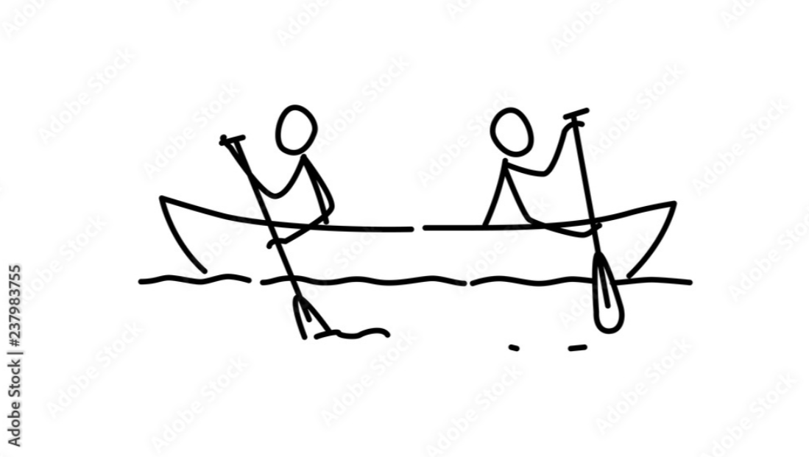
Scenario You have recently taken a new leadership role in a well established team and want to bring everyone together around a common vision.
What do you perceive the challenges to be?
Notes:
Petra
Read scenario
Problem statement – “You have recently taken a new leadership role in a well established team and want to bring everyone together around a common vision. What do you perceive the challenges to be?” (Posted into breakout rooms)
So we are going to give you a couple of minutes to consider this and jot down individually what those challenges may be. (2 mins for exercise).
okay so now can we move on, still individually, to categorising all of those challenges into simple, complicated, complex and chaotic based on your answers to two questions posted into the chat: The questions are…..
What is the degree of agreement among the participants regarding the challenge and the best way to address it?
What is the degree of certainty and predictability about what results will be generated from the solutions proposed for addressing the challenge?
Now it may be that you have an idea of the solution at this stage or that you just know it will be a solution to suit a simple, complicated, complex or chaotic situation and that going through this process helps to get to a future solution. Again we have a few minutes to do this individually (2 mins for exercise).
Wonderful, hope you have not grappled too much with the challenges and where they should go, however, now we are going to move into breakout room pairs for 5 minutes to discuss what challenges you have that may be different or similar and where you have placed them. (5 mins for exercise).
Fabulous, welcome back, hopefully that lent itself well and was not too chaotic for you. We are going to boost our collective thinking here now and break out into groups of 4-6 to find points of agreement, differences in perceived challenges and any potential mismatches of solutions to a challenge. We are going to take 5 minutes to do this and then come back to the main group and ask you all to post 1-2 of your challenges where you feel they fit into the whole groups matrix within a template on miro. (5 mins for exercise).
Hello again, I hope that was interesting and enjoyable. We are now going to populate the Agreement & Certainty Matrix on the Miro board with post its. So please pop in one or two challenges and their proposed solutions if you have them where you feel they sit and avoid duplicates if you can. If you are unable to post them in or have difficulties please pop them into the chat and where you would like them placed. (5 mins for exercise).
I think that is all of them up now, can we now as a group have a little reflection on what we are seeing and what we have just done to get to this point. What are the approaches we are considering to address each challenge, maybe evaluate how well these challenges fit into the matrix and are there mismatches between the challenge and how we have planned to address them. Please do pop a hand up to share your thoughts or type into the chat (15 mins then bring to a close)
I think that we will need to draw this section to a close now but we have certainly had a lot to think about and it has been good to share our thoughts around a familiar scenario and common challenges and how we may work towards addressing it.

Slide 14
Liberating Structure – Agree/Certainty Matrix
Notes:
Petra
Afra and I have really enjoyed collaborating on this session and hearing all of your conversation in testing out the Agreement & Certainty Matrix. At this point it would be great to hear your views on how you have found it to use this structure. Would you use it in practice and for what scenario? Alternatively, if not, why do you feel that. Please do type into chat or pop a hand up.
Presenters to summarise
Thank you for helping us learn and share together and I’m going to hand over to Maria now.

