Slide 1
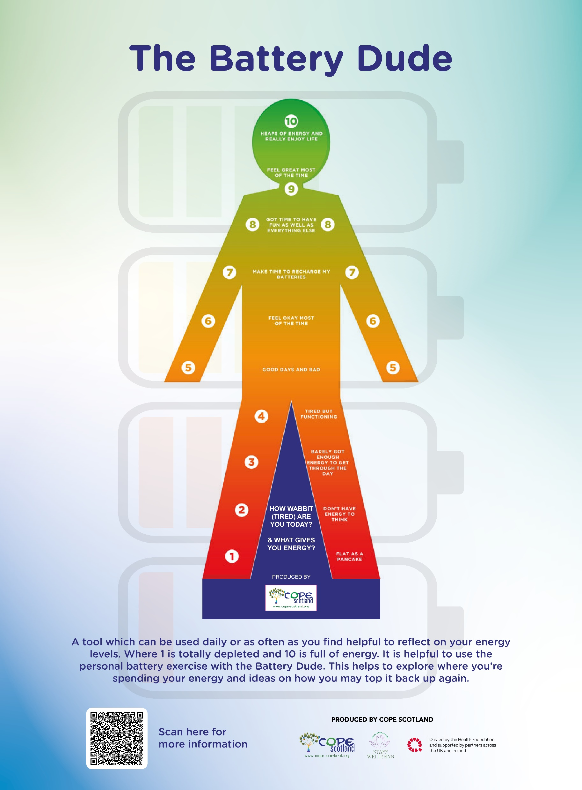
How are your energy levels?

Slide 2
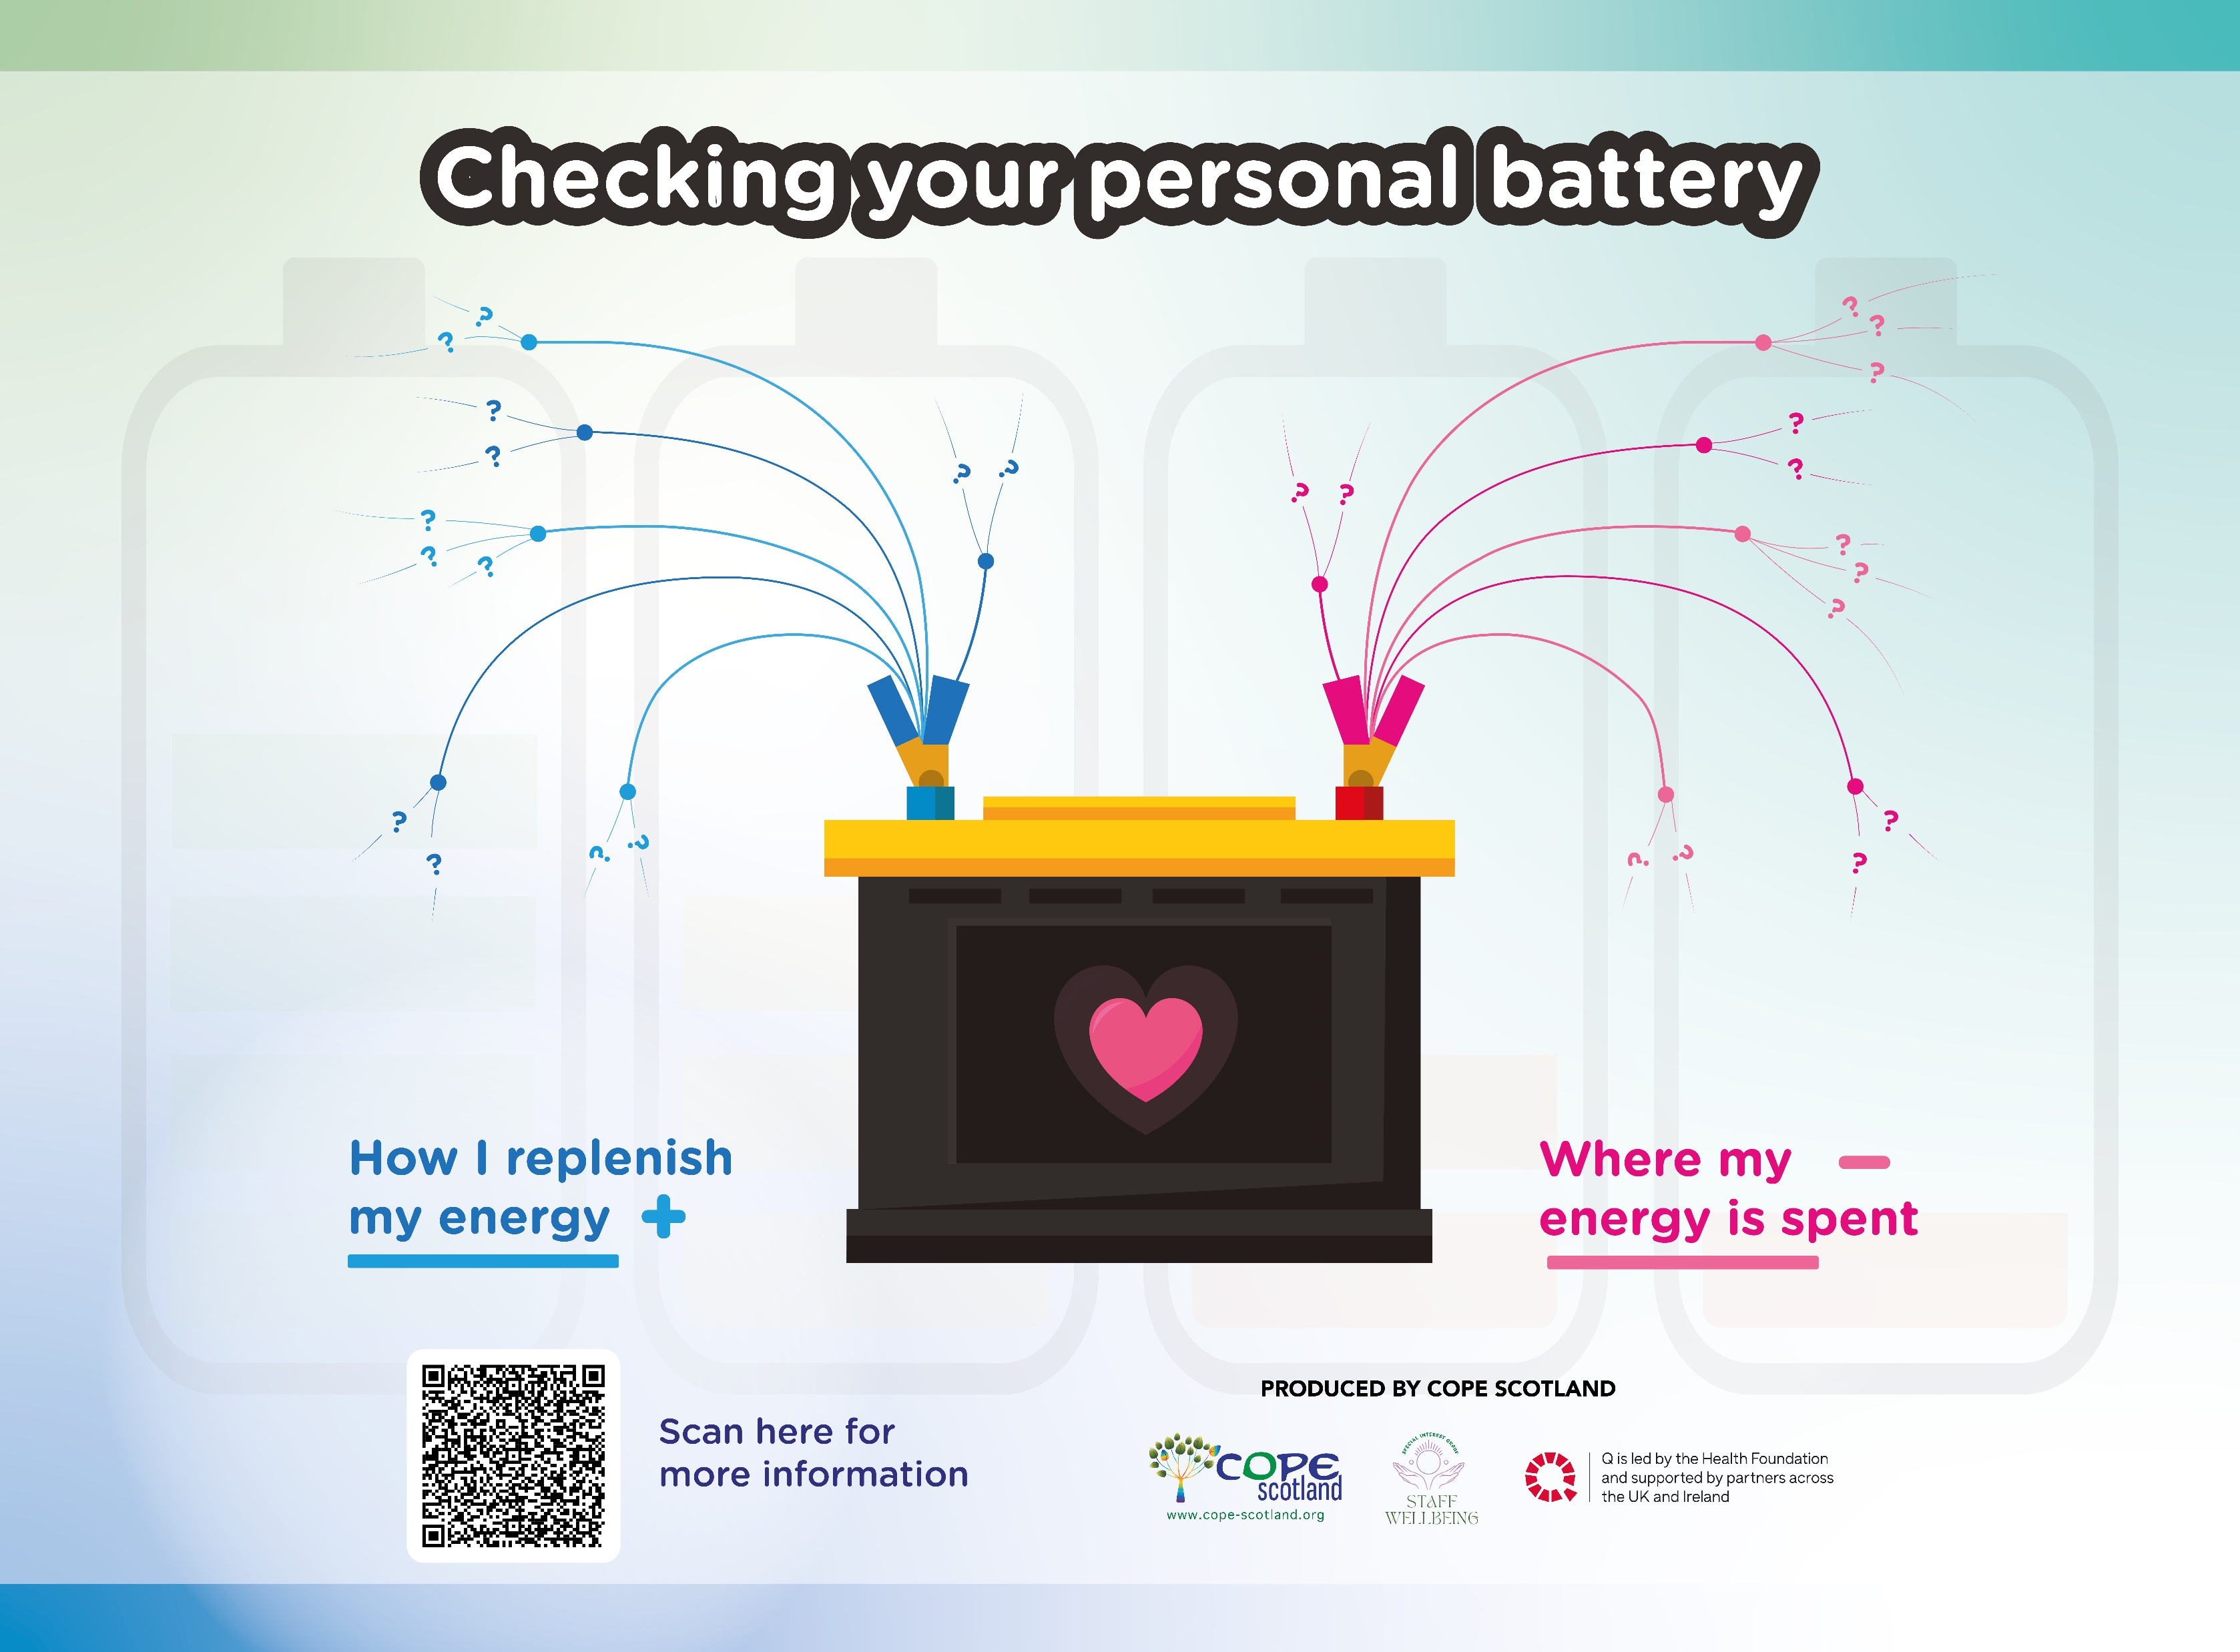
Becoming Mindful of where you spend your energy and how you replenish it

Slide 3

Liberating Structure 15% solutions
What is made possible? You can reveal the actions, however small, that everyone can do immediately. At a minimum, these will create momentum, and that may make a BIG difference. 15% Solutions show that there is no reason to wait around, feel powerless, or fearful. They help people pick it up a level. They get individuals and the group to focus on what is within their discretion instead of what they cannot change. With a very simple question, you can flip the conversation to what can be done and find solutions to big problems that are often distributed widely in places not known in advance. Shifting a few grains of sand may trigger a landslide and change the whole landscape
Attribution: Liberating Structure developed by Henri Lipmanowicz and Keith McCandless. Inspired by Professor Gareth Morgan.

Slide 4
Why 15% can be helpful
Move away from blockage, negativism, and powerlessness
Have people discover their individual and collective power
Reveal bottom-up solutions
Share actionable ideas and help one another
Build trust
Remember unused capacity and resources (15 percent is always there for the taking)
Reduce waste
Close the knowing-doing gap

Slide 5

15% solutions in action
Things we can do to help increase feelings of being valued:
Celebrate achievement.
Involve people in decisions.
Be honest even when the message is a challenging one.
Reach out to individuals who may be struggling.
Make the time to connect on a one to one, recognise someone as a person not only the label they carry at work.
Recognise if you work part time you cannot deliver the same output as someone who works full time. This applies also when you work full time but on multiple projects.
Be mindful of the time when you send emails.
How we do supervision matters and how we value the restorative side of supervision and making the time for supervision. Use outdoor spaces where possible, face to face time.

Slide 6
What is within your control when supporting meaningful engagement in online meetings?
First alone, each person generates their own list of 15% Solutions. And puts these on a post it note on Jamboards 5 min.
In groups of 3 to 4 take a moment to read what others have written, discuss and add more ideas which emerge 10min
Come back to the main group and share key insights from each group 5min

